Slide 1

Peering Pirates: Do what I say, not what a I do
A Pirate Story: The conflict between Subspace v AWS
1st Peering Forum in Puerto Rico (1703)

Slide 2
Timeline
12. 2017: Subspace is founded ($26MM)
6.21.2019: Agreement between Subspace and Epic Games
7.2019: Peering established between Subspace and AWS
1.2020: Subspace requested peering augument in different locations.
2.2020: AWS starts ‘stonewalling’ tactic
2.2022: Subspace forced to terminate agreement with Epic Games
5.13.2022: Subspace files bankruptcy and dissolution.
11.18.2023: Complaint filed Subspace vs AWS – US District court Washington.
Seeking damages between $416MM – $1.3B

Slide 3

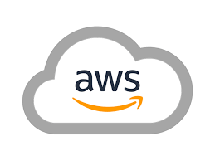

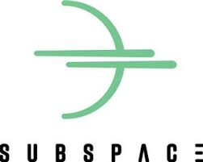
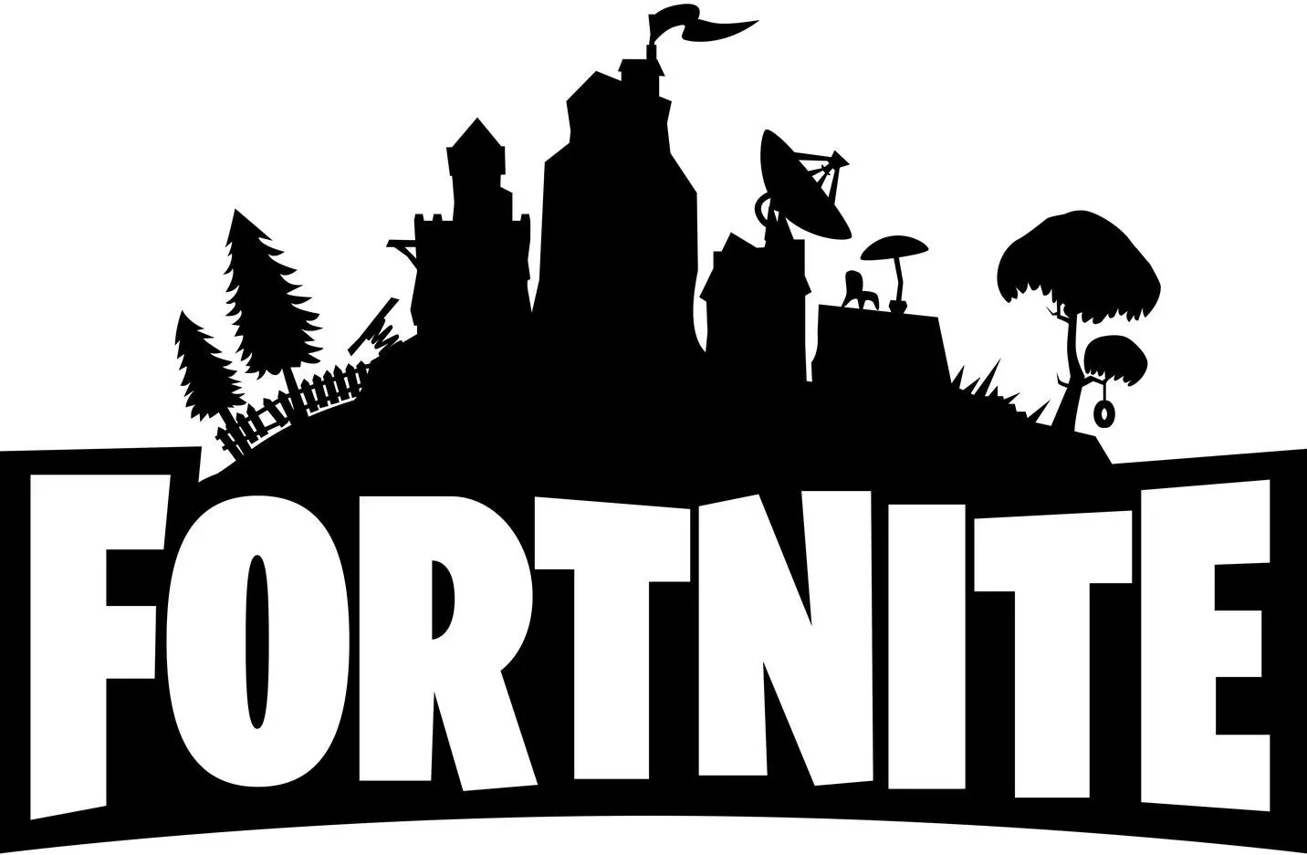








The Conflict
Notes:
Subspace was providing Online game acceleration services for Epic Games’ fortnite. Fortnite was hosted in AWS, so Subspace needed a peering (or economic feasible connection) to AWS. First peering was established, future auguments (in different locations) were not. Subspace terminated the agreement with Epic since it could not provide the service.

Slide 4
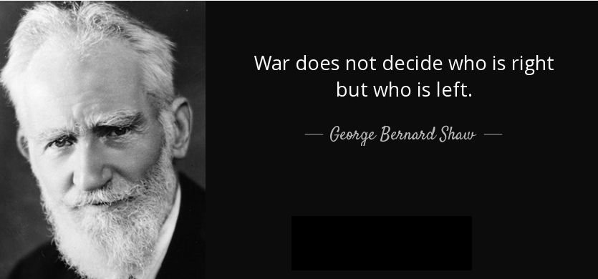
Notes:
It is not the point of this presentation to say who is right and who is wrong, that is a job for judge Tana Lin in Washington State who will decide.

Slide 5


“peering would allow both parties, to transmit higher quality data to their customers at lower costs for both parties”
Notes:
The point of this presentation is the elephant in the room that few would like to talk about; not always peering is a relationships with lower costs for both parties. We have to take into account all the economic costs, in the case of Subspace v AWS, clearly the peering was not the optimum solution to minimize the economic costs for AWS, there are another option (no peering) which has a lower economic cost.

Slide 6

About BRUNO or Peering exceptions
Notes:
It is like the Disney Song, we do not talk about Bruno. We do not talk about peering exceptions because it seems that we do not talk they do not exist. Which is not the case. And exceptions are everywhere and coming from all corners in the peering ecosystem (ISPs, Content providers, CDNs, etc). Since 2018 Internet is classified as an informative service (not Title II type of service like voice) and not subject to regulation by the FCC, so there is not Net Neutrality currently in effect. It is an open game since then.

Slide 7
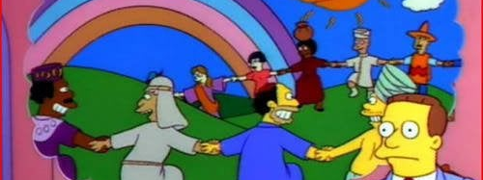
Can you imagine a world with free peering?
Notes:
Our meetings are great, and probably ever since the very first one that I attended back in 2005, where we went on a cruise and somebody (whom I know but promised not to reveal his name ever) hacked the WiFi on the cruise and opened it to the whole forum, it has been my favorite meeting and show. Probably, that is the image that our C-level executives and commercial managers have of our meetings in their heads (and probably it is not too far from reality). However, those same managers are the ones who, in the end, dictate the exceptions, as has clearly happened in the case of AWS against Subspace. In the end, we have to accept that peering does not have to be free and is not mandatory, and we should not sweep it under the rug."

Slide 8

The End

Slide 9
Bibliography
Case: Case 2:23-cv-01772 , Subspace Omega LLC (Plaintiff) v Amazon Web Services, Inc (Defendant) (2023) UNITED STATES DISTRICT COURT FOR THE WESTERN DISTRICT OF WASHINGTON
Battle over Net Neutrality Back at FCC. (2023). Stephen Goodman

