Slide 1
High cost transit and IX’s
For fun, not profit
Jeff Brandt - President
Puerto Rico Internet Exchange, Inc.
AS18804

Slide 2

Operates as a Puerto Rico non-profit, established in late 2019
Maintains 5 different pops across the San Juan Metro area
Entirely supported by volunteers, donations and sponsorships
Substantial growth, the largest IX in the Caribbean
36 Gbps peak traffic, expected to exceed 60 Gbps by in 2025

Slide 3
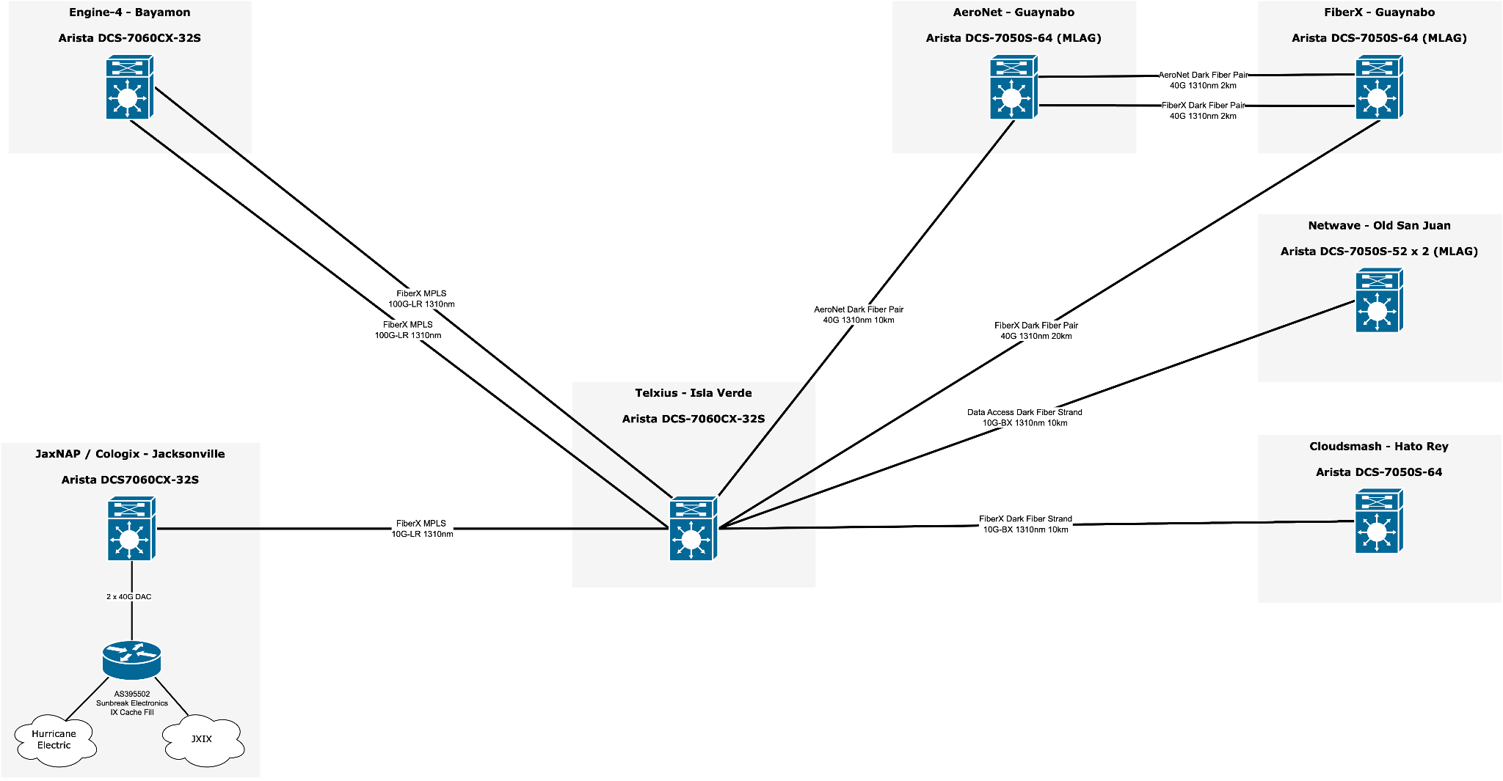
Puerto Rico Internet Exchange Topology

Slide 4
Challenges For All IX’s
Exchanges cannot run sustainability from local peers alone
Content providers bring a value proposition to local peers
The bulk of IX revenue comes from 100G ports (content providers)
More than 10 paying 100G peers allows for budgeting hardware and support
Dependencies still exist for sponsored or donated colo, transport and power
Growing beyond 30 paying 100G peers enables a paying an employee for outreach, administration and herding cats (coordinating NOC volunteers).

Slide 5
Attracting Peers and Interim Solutions
Working with local peers to piece together transit for content caching providers
Let content providers dip their toes into a peering ecosystem with minimal risk
Reducing $ / Mbps for locally delivered content, IX value proposition!
Dealing with high cost submarine transport - begging for mercy
Creative frugality is a must!
The constant search for transport partners never ends! Educational institutions?

Slide 6
The path to the POP
Content providers expand peering and build justification for larger presence.
There are several quality carrier neutral data centers in Puerto Rico.
Transit costs dropping from ~$2-3/Mbps in 2019 to <$0.70/Mbps in 2024.
Burstable L2 transport providers finally exist!
Puerto Rico is an emerging gateway to LATAM markets.
Someday inter-island peering in the Antilles may become possible.

Slide 7
Contacts & Information
Current Board of Directors
Jeff Brandt, President <jeff@puertoricoix.net> - Cloudsmash AS27024
Ivan Rivera, Vice President <ivan@puertoricoix.net> - Osnet AS21559
Gino Villarini, Executive Director <gino@puertoricoix.net> - AeroNet AS14979
Peering Contact - <peering@puertoricoix.net>
PeeringDB - https://www.peeringdb.com/ix/2353

Slide 8
Special Recognitions
The following individuals were absolutely instrumental for their advice, support and encouragement for launching the exchange in 2019;
Mehmet Akcin, Ivan Rivera, “Juanma” Rodríguez del Rey, Juan Thomas Penagaricano, Hector Miranda, Edwin Candelario and Gino Villarini
Full List of Puerto Rico Internet Exchange Sponsors
https://docs.google.com/document/d/1aotCRpZaTuuguVwZjUswy-oq2mKl8axRWTGgSqGTUGU

