Slide 1
Network Hygiene:
Combating Malicious Actors with BGP
John Brown, CISSP, CFI, CP-AMEL, Team Cymru

Slide 2
Trademark Disclaimer
All trademarks, logos and brand names are the property of their respective owners. All company, product and service names used in this website are for identification purposes only. Use of these names, trademarks and brands does not imply endorsement.

Slide 3





Introductions
Introductions
Who is Team Cymru?
What is Hygiene / Network Hygiene
Why do we care ?
AGENDA
How are networks abused
What can we do / Example Configs
Closing Comments
Questions ?

Slide 4
INTRODUCTIONS

Slide 5
John Brown
John Brown, CISSP, CFI, AGI, IGI, CP-AMEL
Senior Security Evangelist at Team Cymru
35+ years as software and network engineer
Principal Technical Engineer for ICANN’s L-Root DNS
Have built Internet networks on 3 continents
Recovering owner of a regional ISP business, ran it for 17 years
Passionate about helping ISP’s improve their networks
Past Mikrotik Authorized Instructor (MT-CNA, MT-CRE, MT-CINE)
Past ISC2 CISSP Instructor
Commercial Multi-Engine Pilot and Flight Instructor
I can be reached at: jbrown@cymru.com

Slide 6
Who is Team Cymru ?

Slide 7

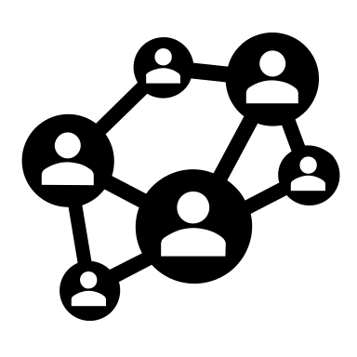


Team Cymru
Who we Are
We uncover the who, what, when, where and why of malicious behavior.
15+ years of service to network defenders, internet operators and cybercrime investigators worldwide.
Free services for ISPs, hosting providers and CSIRTs
Unmatched eco-system of data sharing and collaboration partnerships worldwide
Work with 130+ CSIRT teams in 86+ countries
Relied on by many security vendors, Fortune 100 companies, and public sector teams.
CSIRT
Events
Team Cymru is comprised of former…
Members of national and industry CSIRT teams
Law enforcement
Analysts from research, education, private and public sectors
ISP backbone engineers
Fortune 500 enterprise network engineers
Penetration testers
Military – US and allied nations
Frontend, backend, gaming, web app, kernel, high-performance computing and big data developers and system engineers
Free Tools
DNB

Slide 8
What is Hygiene

Slide 9

What is Hygiene
Hygiene is a series of practices performed to preserve health.
According to the World Health Organization (WHO), "Hygiene refers to conditions and practices that help to maintain health and prevent the spread of diseases.”
Basically the practice of keeping yourself clean and to help promote a health environment.
Each of us generally assumes that the person next to them is also interested in keeping healthy and not spreading diseases..

Slide 10
What is Network Hygiene

Slide 11
What is Network Hygiene ??
”Just as good personal hygiene is a prime contributor to personal (and community) health, good network hygiene is a major contributor to overall network health.” – Terry Slattery
Generally, if you keep YOUR network clean, then you AND your neighbors will have fewer problems. When a problem pops up it will also be easier to spot and resolve.
Back in 2006 Daniel Karrenberg (RIPE NCC) talked about a paper that Joao Damas wrote called “Network Hygiene Pays Off”….. Link in the references section of this talk

Slide 12
Why do we care ?

Slide 13
Why do we care ?
Each of us network operators should care that our neighbor is also being responsible and practicing good network hygiene! Just as they wish that you do the same.
Brushing your teeth everyday helps with the dentist visit (no or few cavities), keeping your network clean means fewer issues to solve when there is a really big problem.
It is also about TRUST. Other network operators will trust your network more.
      But its more than just other network operators….
It is about CUSTOMERS (those people that pay you!)
Knowing that your network runs with “Cleaner Pipes” is actually a REVENUE PLUS!!
WE EACH HAVE A DUTY TO HELP KEEP THE INTERNET AS CLEAN AS POSSIBLE!!

Slide 14
How do Malicious Actors Abuse Networks?

Slide 15
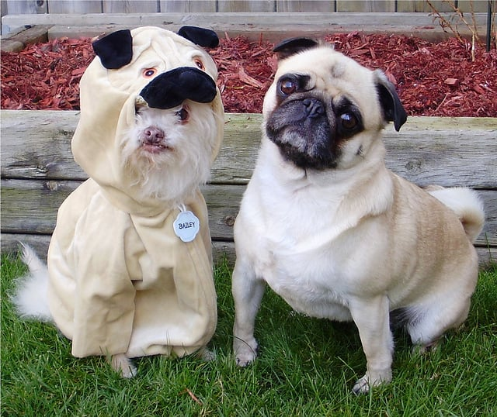
IP Spoofing!
Spoofing the Source IP of a packet
The victim is the Source IP
And the victim is all the networks in between
BCP 38. (Best Current Practice # 38)
Published in May 2000 (24!!! YEARS AGO)
A simple means to PREVENT Source Spoofed packets from entering the network.
WHY AREN’T WE DOING IT ??
By preventing SRC Spoofed packets from leaving your network you are helping your neighbors' network be safer.
The technology can easily do it today!!

Slide 16
Source spoofing enables….
Open NTP Servers – Can be used in Amplification attacks!
Open Recursive DNS Resolvers – Can be used in amplification attacks!
  Do you really need to provide recursive DNS services to the entire world ?????
  To name a few……

Slide 17
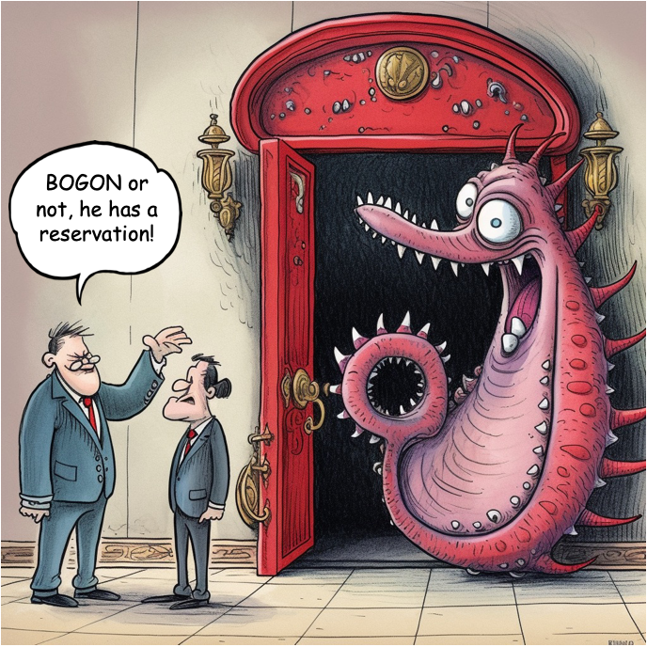
Bogon’s – What are they ?

Slide 18
What are BOGON IP Prefixes
Traditional bogons are Martians (private and reserved addresses defined by RFCs) and prefixes that have not been allocated to a regional internet registry (RIR) by the Internet Assigned Numbers Authority (IANA)
Fullbogons contain the traditional bogon prefixes, but also include the IP space allocated to the RIRs, but not yet assigned by them to Local Internet Registry's (LIRs), for both IPv4 and IPv6. These also contain prefixes that have been reclaimed or returned to a RIR.
The Bogon Reference: https://www.team-cymru.com/bogon-networks

Slide 19
IP Martian Prefixes
IPv4 Martians
IPv6 Martians
0.0.0.0/8 # RFC 1918 private space
10.0.0.0/8 # RFC 1122 'this' network
100.64.0.0/10 # RFC 6598 CG NAT space
127.0.0.0/8 # RFC 1122 localhost
169.254.0.0/16 # RFC 3927 link local
172.16.0.0/12 # RFC 1918 private space
192.0.2.0/24 # RFC 5737 TEST-NET-1
192.88.99.0/24 # RFC 7526 6to4 anycast relay
192.168.0.0/16 # RFC 1918 private space
198.18.0.0/15 # RFC 2544 benchmarking
198.51.100.0/24 # RFC 5737 TEST-NET-2
203.0.113.0/24 # RFC 5737 TEST-NET-3
224.0.0.0/4 # multicast
240.0.0.0/4 # reserved
::/8 # RFC 4291 IPv4-compatible, loopback
0100::/64 # RFC 6666 Discard-Only
2001:2::/48 # RFC 5180 BMWG
2001:10::/28 # RFC 4843 ORCHID
2001:db8::/32 # RFC 3849 documentation
2002::/16 # RFC 7526 6to4 anycast relay
ffe::/16 # RFC 3701 old 6bone
fc00::/7 # RFC 4193 unique local unicast
fe80::/10 # RFC 4291 link local unicast
fec0::/10 # RFC 3879 old site local unicast
ff00::/8 # RFC 4291 multicast

Slide 20
What are Bogon ASN’s (Autonomous System Numbers)
Similarly, to prefixes, an ASN should be termed as Bogon if any of the following conditions is true.
  It is reserved for special use by an RFC
  It is not part of the block assigned to a RIR by IANA
  It is not assigned to a LIR by any RIR
https://www.manrs.org/2021/01/routing-security-terms-bogons-vogons-and-martians/

Slide 21
Reserved ASN’s
0 # RFC 7607
23456 # RFC 6793 AS_TRANS
64496 – 64511 # RFC 5398 and documentation/example ASNs
64512 – 65534 # RFC 6996 Private ASNs
65535 # RFC 7300 Last 16 bit ASN
65536 – 65551 # RFC 5398 and documentation/example ASNs
65552 – 131071 # IANA reserved ASNs
151866 – 196607 # Unallocated
213404 – 262143 # Unallocated
273821 – 327679 # Unallocated
329728 – 393215 # Unallocated
401309 – 4199999999 # Unallocated
4200000000 – 4294967294 # RFC 6996 Private ASNs
4294967295 # RFC 7300 Last 32 bit ASN

Slide 22
Why do we care about Bogon’s in the global BGP ?
Generally, they are the results of a misconfiguration on a network router.
However, these prefixes can be and are used for malicious activity.
Bogon’s can be used for DDOS.
Bad Actors know that these prefixes aren’t “traceable” since they are not registered to a proper ORG.
But because they are in the global routing tables, they can be used (short term) for TCP based attacks. Those attacks may be limited in “scope” or network reach…
Bogon AS’s can be used for Route Hijacks, Route Leaks.

Slide 23
Looking into BGP data
Using various global BGP Monitoring tools we see:
  Hundreds to Thousands of announcements of BOGON IP’s and ASN’s
  Actual BOGON IP’s (reserved, unallocated by RIR, special use addresses)
  AS Numbers that are being used to provide TRANSIT to other networks, and those AS Numbers are not assigned in any RIR database. (These are not reserved ASN’s)
  Reserved AS Numbers that are providing TRANSIT, they are in the middle of an AS PATH
  Data at RIR’s that is not up to date, or is missing..
Criminals love this because it makes it harder to track and catch them!

Slide 24
How to reduce the risk of BOGON’s
Reducing the impact of BOGON’s can be handled several ways:
  Filter your INBOUND BGP routes to not accept BOGON prefixes from your neighbors
  Filter your OUTBOUND BGP routes to not send BOGON prefixes.
  Route Servers at IXP’s can filter their inbound AND outbound advertisements to drop BOGON’s
  Make use of TC’s free BOGON feed via BGP to have the router drop packets to those BOGON addresses.

Slide 25
Prefix Filtering / RPKI

Slide 26
Make use of RPKI
Make sure YOUR prefixes are properly signed with the appropriate RIR(s).
  This will help tell your neighbors that these are really YOUR prefixes!!
  APNIC, RIPE, LACNIC, ARIN, AfriNIC all have well documented and easy processes here!!! They are happy to help.
Start using RPKI to validate routes YOU RECEIVE from others.
  Maybe start with peering / IX’s first, then move towards transit providers
In the time it took to listen to this presentation, you could have signed your routes with a RIR Hosted RPKI model!! But, thank you for sticking around to hear my presentation ☺

Slide 27
DDOS and Network Hygiene

Slide 28
DDOS and Network Hygiene
By preventing Source Spoofed packets from leaving your network….
  You help yourself AND the person sitting to your left and/or right!!!!
If we didn’t have Source Spoofed Packets a HUGE amount of DDOS would evaporate from the planet.
Stop Source Spoofed IP packets and become an Internet Hero!!
Actively check and remove public facing services that can be abused for DDOS
  (Recusive DNS, NTP, CharGen, etc)

Slide 29
Leverage Malicious Actor IP Feeds

Slide 30
Use BGP to have your router drop traffic
Several malicious IP address feeds are available from folks like
  Spamhaus, Team Cymru, and others
  You can create your own internal data set as well. Exa-BGP / JSON your friend.
You can ingest these IP’s into your internal BGP routes and set Next-Hop to /dev/null
  This would prevent traffic from leaving your network towards the malicious IP’s
Leveraging uRPF (UniCast Reverse Path Forwarding) you can also drop packets that have a Malicious Source IP address.

Slide 31
Remote Triggered Blackhole Routing

Slide 32
Remote Triggered Blackhole
Leverages BGP to signal your peer (transit or IX peer)
  Please DROP traffic to this specific prefix
  Prefix is advertised with a Blackhole community string. 65505:666
  This causes your neighbor to set next-hop for that prefix to /dev/null
  The BGP sessions does not have to be with your router. You could do Exa-BGP on a VM at an off-site location, incase your link is to congested.
There is a global Remote Trigger Blackhole service that is FREE
  Team Cymru’s UTRS service.

Slide 33
What can you do / Example Configs

Slide 34
What steps can we take ?
ISP’s should
  Validate their external facing route filters. Make use of RPKI
  Make sure your IRR and PeeringDB database entries are UP TO DATE AND CORRECT!
  Make sure you are ONLY announcing prefixes that are valid.
  You MUST filter what your BGP downstream peers send you!!! (Yes, it can be a pain)
  Set up a TEST router to see what you are actually sending. You could use a Mikrotik or Exa-BGP or similar…
  Configure Remote Triggered Blackhole with your peer(s)
  Prevent Source Spoofed packets from LEAVING your network!!!
  Filter prefixes you receive and drop any BOGON prefixes.

Slide 35
What steps can we take ?
IX’s should
  Validate the routes received from peers/members at the route-server(s)
  Reject BOGON’s with a specific set of filters.
  Confirm that members are only announcing prefixes they are permitted to.
  Possibly have TC’s BOGON’s available via a specific community
  Possibly take Spamhaus or TC or others Malicious IP / C2 feeds and make them available via a specific community (Value Add Service ??? )
  Make sure that members have current PeeringDB and IRR records.

Slide 36
Some additional recommendations on things to do
Implement BCP 38
Make use of FREE Open Community tools like Team Cymru’s:
  BOGON’s,
  UTRS (DDOS Mitigation)
  Nimbus (Near real-time Threat Intelligence Information)
Work in your community to help other ISP’s improve their network hygiene.
Make Network Hygiene / Security a key and critical part of your day to day operations.

Slide 37
Mikrotik ROS v7.x Sample Bogon Config
/routing bgp template
set default address-families=ip as=<YOUR_ASN> disabled=yes multihop=yes router-id=<YOUR_IP> routing-table=main
add address-families=ip as=<YOUR_ASN> disabled=no input.filter=TC-BOGONS-IN
multihop=yes name=TC-BOGON-TEMPLATE nexthop-choice=force-self router-id=<YOUR_IP> routing-table=main

Slide 38
Mikrotik ROS v7.x Sample Bogon Config
/routing bgp connection
add address-families=ip as=<YOUR_ASN> disabled=no input.filter=TC-BOGONS-IN
local.address=<YOUR_IP> .role=ebgp multihop=yes name=bogonrs02
nexthop-choice=force-self remote.address=<BOGON_SERVER_IP> .as=65332
router-id=<YOUR_IP> routing-table=main templates=TC-BOGON-TEMPLATE
/routing filter rule
add chain=TC-BOGONS-IN disabled=no rule="if (dst==192.168.0.0/16) {reject;}"
add chain=TC-BOGONS-IN disabled=no rule="if (bgp-communities includes 65332:888)
{set distance 1; set gw 192.0.3.1; append bgp-communities no-export,no-advertise;
set blackhole yes; accept;}"

Slide 39
Closing Comments

Slide 40
Closing Comments
As Network Engineers and Operators we are responsible for our network hygiene
Take the time to validate routes received from neighbors, including the origin ASN
Take the time to validate what you are sending to your BGP peers / neighbors
This is not a one time process. It must constantly be reviewed and audited!
  Please don’t run smelly networks ☺
If you need help with possible configuration examples, reach out. outreach@cymru.com

Slide 41
Questions ??

Slide 42
References
https://www.ripe.net/ripe/mail/archives/spoofing-tf/2006/msg00022.html
https://netcraftsmen.com/the-importance-of-good-network-hygiene/
https://www.flickr.com/photos/dapuglet/8426525097
https://creativecommons.org/licenses/by-sa/2.0/
https://www.ietf.org/rfc/bcp/bcp38.html
https://datatracker.ietf.org/doc/rfc5635/
https://www.rfc-editor.org/rfc/rfc3704

Slide 43
THANK YOU

