Slide 1


Peering LAN Security at IXPs Revisited
Greg Hankins, Nokia
Daniel Kopp, DE-CIX
Matthias Wichtlhuber, DE-CIX
GPF 2024
April 15, 2024

Slide 2
Background and Motivation
IXPs want to make peering LANs as secure as possible to only forward wanted traffic
A lot of work has been done to define BCPs, RFCs and other standards several years ago, but they have not evolved with peering traffic changes
  Especially with IPv6 adoption and traffic growth
Router hardware technology and protocols have also evolved
  Layer 3 filtering capabilities
  EVPN
We looked at what types of Layer 2 and Layer 3 traffic is seen on a large IXP peering LAN
Can we make peering LANs more secure now?

Slide 3
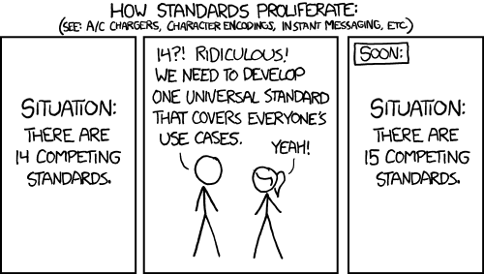
BCPs and Standards
Several BCPs and standards have been written on IXP port hygiene and peering LAN security
  MANRS, Open-IX, Euro-IX, etc.
  IXP service definitions and configuration guides
  RFC 5963, RFC 7113
Some are more detailed than others, but none cover everything in one place
A lot of specific filtering details are missing and must be figured out by each IXP and customer
Where should these documents and examples be maintained?
Who should maintain them?
Standards: https://xkcd.com/927/

Slide 4
What are the risks to IXP customers?
Noise
  Unwanted traffic that the customer router processes and drops in hardware or software
Routing security risk that are accidental or malicious
  Injecting routes to customers will cause bad things to happen
  For example, form an OSPF adjacency
Many good examples were presented by Mike Jagar at APRICOT 2010 in Monkeying around on the APE (https://conference.apnic.net/29/pdf/IXPs_02_Monkeying-around-on-the-APE_Mike-Jager.pdf)
There is little risk to the IXP switch or router because customer traffic is forwarded transparently at Layer 2
What do you think IXPs should filter?
Is this a problem from an IXP customer perspective?

Slide 5
Data Sources
We looked at two sources of data on the DE-CIX peering LANs
  Layer 2 filters – as seen by the IXP and a customer
  Layer 3 filters – as seen by a customer
Analyzed data plane and control plane traffic looking for
  Frame types that should be filtered, like LACP, Layer 2 discovery protocols and MPLS
  Protocols and link-local packets that should be filtered, like Layer 3 discovery and routing protocols

Slide 6


Layer 2 Security and Analysis
Layer 2 peering LAN security is needed for two important functions
Forward wanted EtherTypes and drop all others
  Forward ARP
  Forward IPv4
  Forward IPv6
  Drop everything else
Prevent Layer 2 loops that are accidentally introduced by customers
  Allow one MAC address, one IP address per port
  Drop router source MAC on egress
  Drop router destination MAC on ingress
IXP

Slide 7
Layer 2 Security and Analysis –
IXP Filter Drop Counters
A small percentage of unwanted traffic is dropped by IXP filters
Ingress
  Filter counter total: 0.00001410616238%
  Total bytes: 0.00000154405386%
Egress
  Filter counter total : 0.05181140812%
  Total bytes: 0.01734255394%

Slide 8
Layer 2 Security and Analysis –
Conclusion
Defined well in BCPs and standards
Clear on what frames should be forwarded or dropped
Also provides IPv4 Layer 3 control plane protocol filtering based on EtherTypes
Working as implemented on the DE-CIX peering LANs to forward wanted frames
We expect this is also working well at other IXPs
[/]
A:user@customer-router# show system security cpm-filter ip-filter
===============================================================================
CPM IPv6 Filter (applied)
===============================================================================
Id Dropped Forwarded Description
-------------------------------------------------------------------------------
1088 0 0 EIGRP
1089 0 0 OSPF
1103 0 0 PIM
1112 0 0 VRRP
1124 0 0 IS-IS

Slide 9
Layer 3 Security and Analysis
Layer 3 peering LAN security is needed to drop unwanted discovery and routing protocols
Link-layer protocols should be filtered, but the BCPs and standards are either vague or don’t mention them at all
  Easy for IPv4 because EtherTypes filtering works for Layer 2 and Layer 3 protocols
  Harder for IPv6 because you need to filter on multicast addresses and/or the IPv6 Next Header for each protocol
What about Layer 3 protocols like DHCP that can be routed (relayed)?
  Restrict filtering to traffic sent to the peering LAN IP prefix

Slide 10
Layer 3 Security and Analysis –
Filter Counters
[/]
A:user@customer-router# show system security cpm-filter ipv6-filter
===============================================================================
CPM IPv6 Filter (applied)
===============================================================================
Id Dropped Forwarded Description
-------------------------------------------------------------------------------
5 0 21230 ICMPv6 Router Solicitation
10 0 11606028 ICMPv6 Router Advertisement
15 0 31372486341 ICMPv6 Neighbor Solicitation
20 0 54029357 ICMPv6 Neighbor Advertisement
25 0 0 ICMPv6 Redirect
30 0 30570679 ICMPv6 Echo Request
35 173897 0 ICMPv6 MLDv1 Query
40 776050 0 ICMPv6 MLDv1 Report
45 111814489 0 ICMPv6 MLDv2 Report
50 10 0 ICMPv6 MLDv1 Done
55 0 1054 ICMPv6 Time Exceeded
60 0 36273 ICMPv6 Destination Unreachable

Slide 11
Layer 3 Security and Analysis –
Unwanted IPv6 Protocols
Top unwanted protocols matched by Layer 3 filters
Omitted
  No IPv6 Next Header
  ICMPv6 Redirect
  Other ICMPv6, needs more detailed packet analysis
Noise (small risk): MLD, other ICMPv6
Routing security risk: RA/RS, OSPFv3, PIMv6

Slide 12
Layer 3 Security and Analysis –
Filtering
Filtering configurations must drop specific packet types and/or multicast addresses and permit everything else
These filters must be updated as technology evolves
  Modern routers have more advanced filtering capabilities in hardware
  Some IPv6 link-local protocols must be filtered on the Next Header
Should IXPs permit specific Layer 3 packet types and drop everything else instead?

Slide 13
Layer 3 Security and Analysis –
Conclusion
Not defined well in BCPs and standards
Unclear on what packets should be forwarded or dropped
Getting it right is difficult and requires a lot more filter entries
  Risk of accidentally dropping legitimate traffic
This may be an issue on peering LANs depending on how Layer 3 IPv6 filters are implemented

Slide 14
Technology evolutions make Peering LANs More Secure – EVPN
Neighbor discovery (IPv4 ARP, IPv6 ND) starts to become a problem as peering LANs get bigger
Generates lots of control plane traffic of up to several thousand packets per second that must be processed by all routers on the peering LAN
  Even though the routers may not be exchanging traffic
New technology like EVPN reduces neighbor discovery traffic significantly
  Replies are proxied from the IXP’s router based on a static database of MAC addresses
  Broadcasts are limited by the IXP’s router

Slide 15
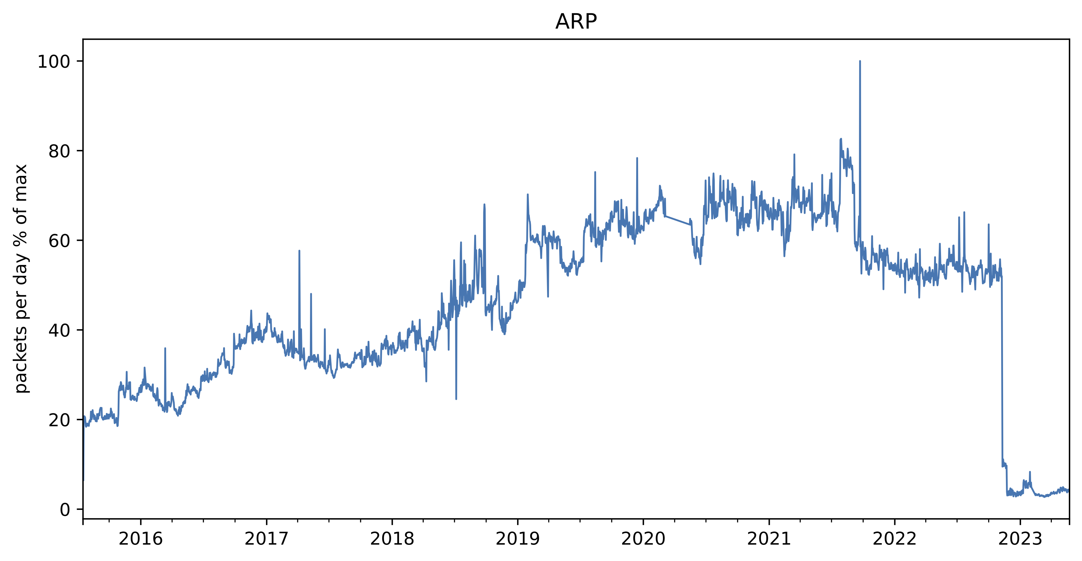
Technology evolutions make Peering LANs More Secure – EVPN
/22 to /21
EVPN!
ARP traffic on the DE-CIX Frankfurt peering LAN 2015 to 2023

Slide 16
Conclusions and Next Steps
Router hardware Layer 3 filtering and software technology like EVPN has evolved
  Gives IXP operators many new tools to make the peering LAN more secure
A lot more needs to be done to make IXP peering LANs more secure
  Layer 2 peering LAN security is working, Layer 3 needs to be revisited
  We suspect this may be an issue in the IXP community as well
  We need more investigation and action in the IXP community

Slide 17
Conclusions and Actions
BCPs, standards and configuration examples need to be updated
  IPv6 protocols and Next Header filtering (ND, MLD, OSPF, PIM, etc.)
  New technology like EVPN to reduce BUM traffic
IXPs should examine their quarantine procedures and filtering
  Router configurations change after quarantine, so implement good filters
IXP participants should look at their router filtering
  You decide what traffic you accept, don’t only rely on the IXP to filter
  Also consider filtering on private peering links

Slide 18
Questions?
Comments?
Thoughts?

