Slide 1
Update
Chris Malayter
GPF 2024
San Juan, Puerto Rico
15th April 2024
Notes:
What is PeeringDB? Its a directory of information related to peering including sites, networks, internet exchanges and other useful information (unique voltage offerings, contact information and other data)

Slide 2
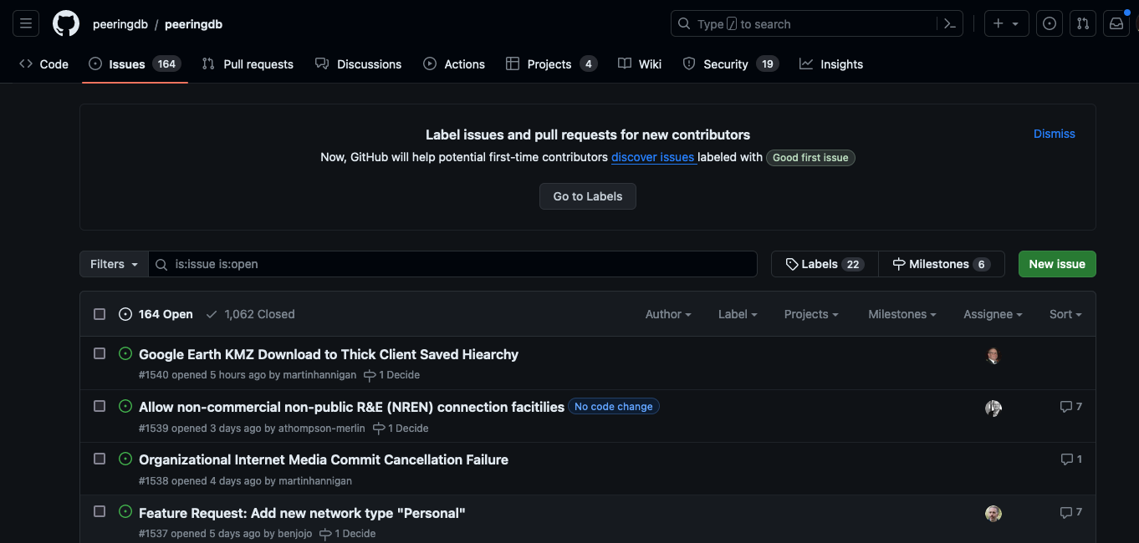
Updates
News from the Frontlines
Web UI design changes
New KMZ export feature
Improved search
Beta testing
Call for Volunteers
Notes:
Web UI summary changes
Facility data to KMZ!
Search functionality - why that’s important
Beta testers
CFV

Slide 3
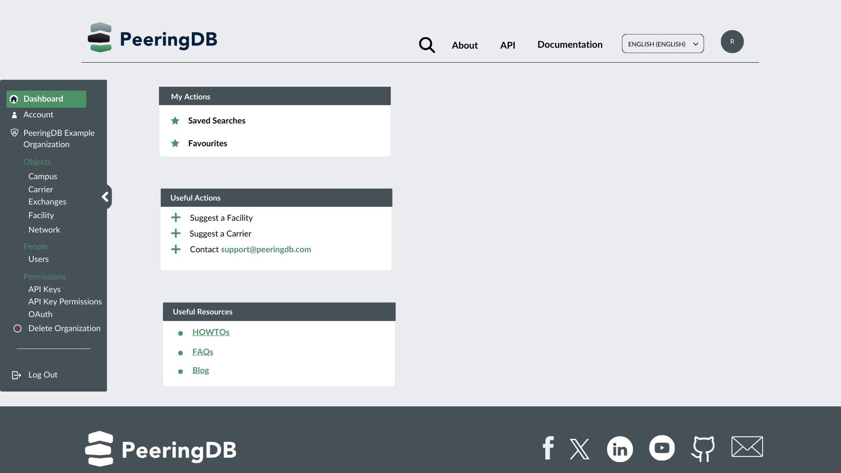
Web UI
Planned Improvements
Better device presentation
Dashboard options
Lazy loading
Notes:
Screens will be more consistent across devices
Dashboards and other personalization
Lazy loading for faster choice recognition
Improved overall presentation attributes

Slide 4
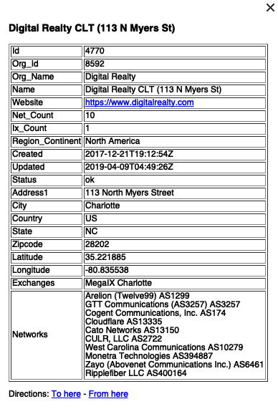
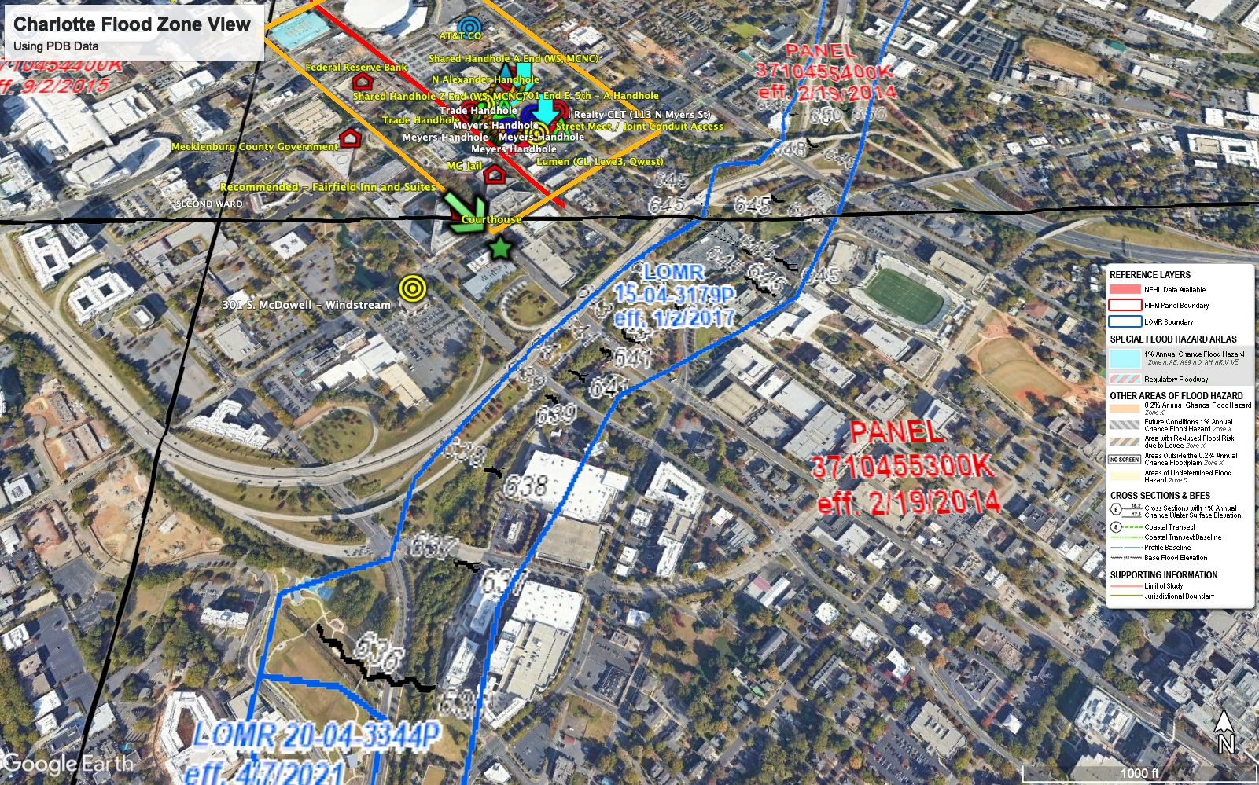
New KMZ Features
Facility Data
  Locations and metadata
  Exported daily
  Importable to Google Maps
Later this year
  Export searches to KMZ
  Improved visual attributes
Notes:
KMZ being auto generated once a day.
Contains useful record metadata (Thank you to our Sponsor Digital Realty)
Powerful uses, FEMA, quake, near facilities (Thanks Digital – and they’re safe)
Other very cool uses aligned with personal data

Slide 5
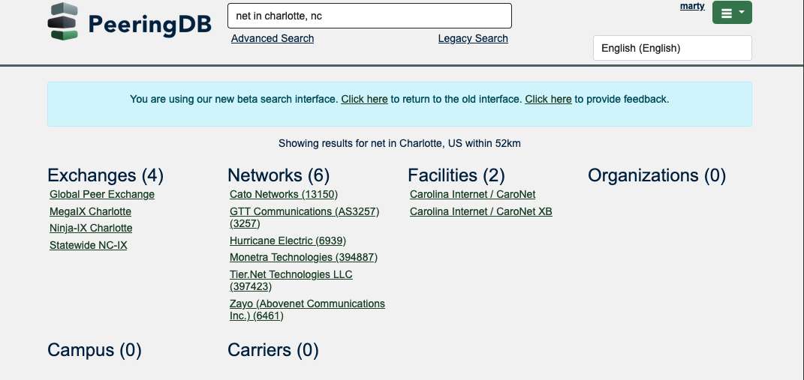
Search (pending release)
Search is getting better
Location support
Object type searching
Boolean operators
Refined results
Notes:
Location support includes ….
Simple search knows about objects to move at user speed
We have more work to do, but we’ll be retiring legacy simple search in the near future

Slide 6
We Need Beta Testers
Consider using the Beta environment as default
Just over half a percent of users visit beta.peeringdb.com each month
  We recognize that there are good and bad reasons for this!
As of release 2.57.0, beta.peeringdb.com refreshes once an hour
Early access to improvements
Easy feedback mechanism
Try it at https://beta.peeringdb.com
Contact us at pc@peeringdb.com with any questions
Notes:
On the good side, people are pretty happy with www.peeringdb.com. But on the bad side, we only used to refresh the data in beta.peeringdb.com once a month.

Slide 7
Call for Volunteers
Admin Committee
  Answer user support questions
  Suggest improvements based on experience
Email us at admincom@lists.peeringdb.com for more info.
Notes:
PeeringDB runs on volunteers
- need AC volunteers
- good global exposure
-get to know people (ticket submitters! Hah!)
- great experience learning about PDB
-about a 1 HR commit per week

Slide 8
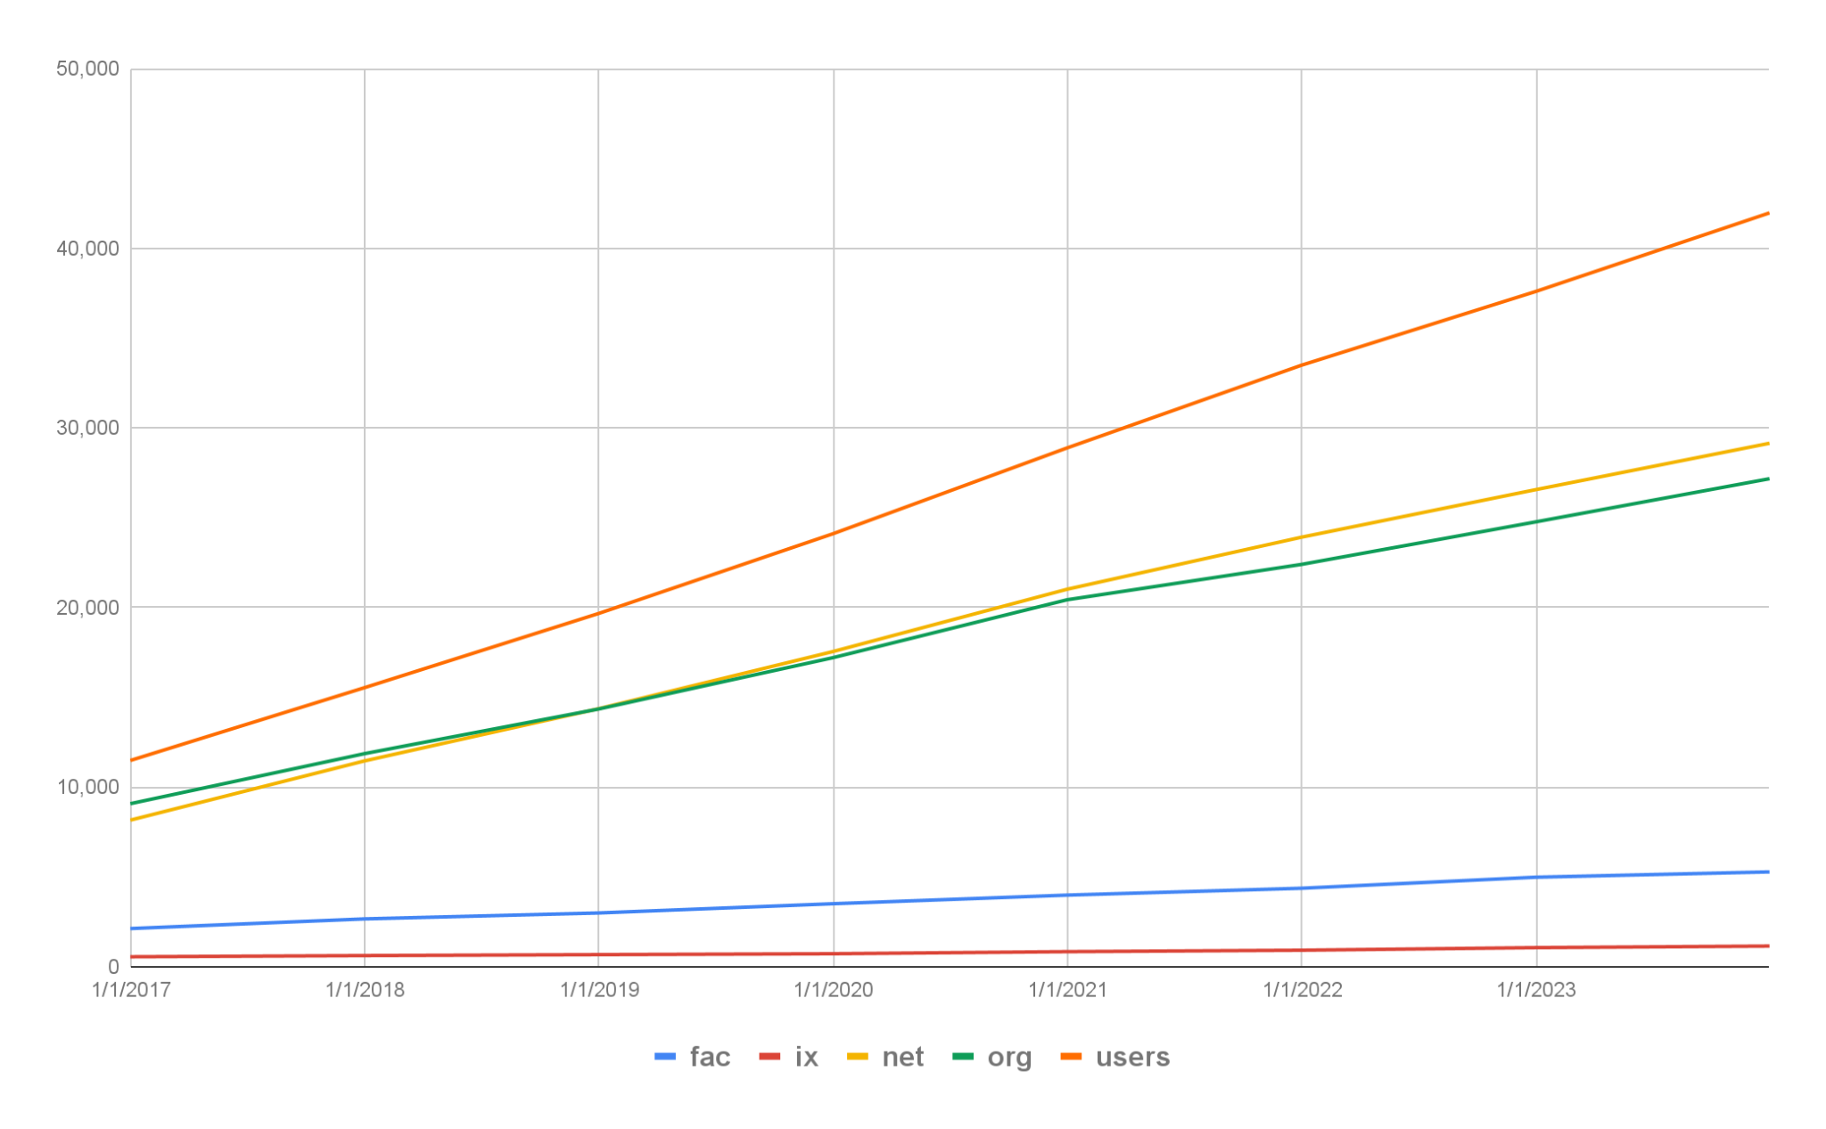
Tracking Growth
End of 2023, and growth on 2022
Facilities: 5,282
  6% increase
IXs: 1,152
  8% increase
Networks: 29,148
  10% increase
Orgs: 27,174
  10% increase
Users: 41,975
  10% increase
Notes:
PeeringDB runs on volunteers
- need AC volunteers
- good global exposure
-get to know people (ticket submitters! Hah!)
- great experience learning about PDB
-about a 1 HR commit per week

Slide 9
















































Thank you to our sponsors!
Diamond Sponsor
Platinum Sponsors
Gold Sponsors
Silver Sponsors
Notes:
Logo height proportions: 100%, 85%, 65%, 40%

