Slide 1

What Open
Caching Means
for a Peering Manager
GPF 2024
Jeff Budney
April 15, 2024

Slide 2
Agenda
Introductions
Streaming Media Trends
Verizon Interconnect Trends
Streaming Video Technology Alliance
What is Open Caching?
Why Use Open Caching?
Open Caching at Verizon
Performance Comparison

Slide 3
Legal Disclaimer/Safe Harbor
NOTE: In this presentation we have made forward-looking statements. These statements are based on our estimates and assumptions and are subject to risks and uncertainties. Forward-looking statements include the information concerning our possible or assumed future results of operations. Forward looking statements also include those preceded or followed by the words “anticipates,” “believes,” “estimates,” “expects,” “forecasts,” “hopes,” “plans” or similar expressions. For those statements, we claim the protection of the safe harbor for forward-looking statements contained in the Private Securities Litigation Reform Act of 1995. We undertake no obligation to revise or publicly release the results of any revision to these forward-looking statements, except as required by law. Given these risks and uncertainties, readers are cautioned not to place undue reliance on such forward-looking statements. Furthermore, the this presentation shall not represent any guarantee or commitment of level of service for any Verizon product or service.

Slide 4
Introductions
Jeff Budney
Associate Director, Network Planning
Global Peering Manager
Board Member: Streaming Video Technology Alliance
Verizon
9.1M broadband connections (wireline and wireless)
145M Wireless retail connections
FiOS, DSL, Enterprise: AS 701
Verizon Wireless: AS 6167, 22394

Slide 5
Streaming Media Trends
The Consumer - “Cutting the Cord”
Nielsen Insights “The Gauge”
  Streaming surpassed Cable for preferred format in 2022
  Streaming 37.7%, Cable 27.6%, Broadcast 23.3%, Other 11.6%
Omdia’s Media & Technology Digest
  OTT subscriptions grew 67m in 2022 to 437 million (7x pay TV)
  615M streaming subscriptions by end of 2028 (10x pay TV)
Trend is towards “Streaming first” content sources
https://www.nielsen.com/insights/2024/super-sunday-delivers-a-record-day-of-tv-viewing//
https://omdia.tech.informa.com/OM032855/Media--Technology-Digest--September-2023

Slide 6
Streaming Media Trends
The Content Providers –Tech and Business Innovation
Since 2018 over half of Internet encrypted (Sandvine)
IETF QUIC (May 2021) adopted beyond Google (Sandvine)
“Multi-CDN” strategies (StreamTV)
  Price / Performance
Sports league exclusive broadcast rights to streamers
Streamers join forces (StreamTV)
Streaming traffic is a moving target
https://www.sandvine.com/hubfs/Sandvine_Redesign_2019/Downloads/2018-phenomena-report.pdf
https://www.sandvine.com/hubfs/Sandvine_Redesign_2019/Downloads/2023/reports/Sandvine%20GIPR%202023.pdf
https://www.streamtvinsider.com/tech/industry-voices-rayburn-pros-and-cons-deploying-a-diy-or-outsourced-multi-cdn-solution
https://www.streamtvinsider.com/video/espn-fox-wbd-sports-streaming-jv-poses-another-strike-pay-tv

Slide 7
Verizon Interconnect Trends
Video dominates Internet traffic
Three of Sandvine’s content categories surpass 81% downstream volume
  Largely repeated content
Constantly reacting to content shifts
  Kentik reported TNF on five different CDNs plus embedded caches
  Sports leagues rotate media partners annually for big games
POV: You play
whac-a-mole
at work
Application (Rank)
On-Demand Streaming (1) | 54%
Live Streaming (2) | 14%
File Delivery (3) | 13%
https://www.sandvine.com/hubfs/Sandvine_Redesign_2019/Downloads/2024/GIPR/GIPR%202024.pdf
https://www.kentik.com/blog/anatomy-ott-traffic-surge-thursday-night-football-amazon-prime-video/#-are-you-ready-for-some-caching-

Slide 8
Verizon Interconnect Trends
Direct Interconnect to ~15 “Major content networks”
  Vast majority of capacity
  14+ U.S. Metro areas
Network Management Challenges
  Shifting content partnerships = moving target
  Inefficiency of idle capacity
  Recurring cost of carrier hotels to meet content

Slide 9
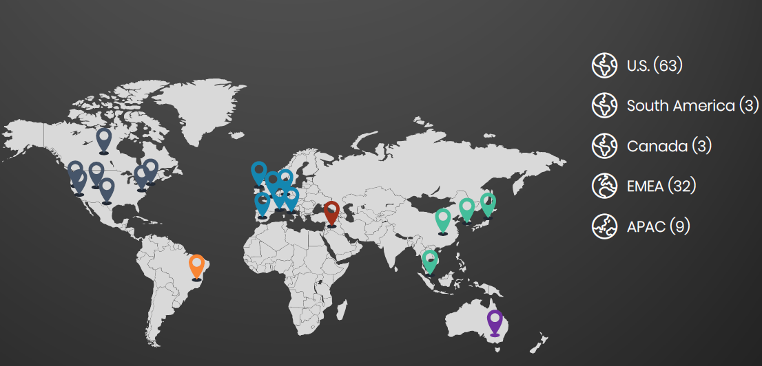
Streaming Video Tech. Alliance
A global technical association focused on solving key challenges in delivering high-quality video at scale
Neutral forum
Education
Collaboration
Technical documents
Software code
Visit svta.org for more

Slide 10
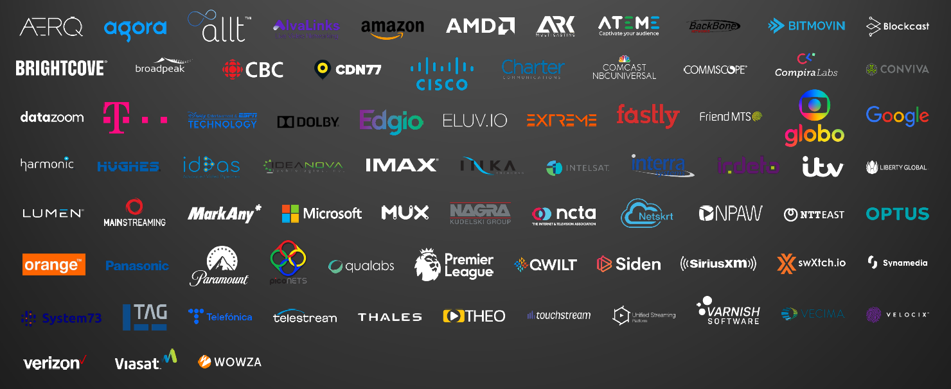
Streaming Video Tech. Alliance

Slide 11
What is Open Caching?
SVTA Working Group formed to address the efficiency of large scale video streaming
Cache content inside the ISP on a shared server
Cooperation of Content Provider (CP), Content Delivery Network (CDN) and Service Provider (SP)
Twelve functional requirements and specifications published at opencaching.svta.org

Slide 12
Why Use Open Caching?
Large Service Provider (SP)
  Efficiency/Reduce backbone traffic
  Avoid space/power constraints of multiple proprietary caches
  New revenue source
Small/Medium Service Provider
  Efficiency/Reduce Internet transit costs
  New revenue source
Content Provider (CP)/Content Delivery Network (CDN)
  Extended delivery reach and management
  Improved QOE

Slide 13

Why Use Open Caching?
I’m a peering manager. How
does this help me?
Peering Manager
  Simplify the content paths into your network
    You know your network best
  Less management than deploying multiple cache solutions
  Less overhead than ongoing support for multiple cache solutions
    Avoid multiple on-site support models
  More control over capacity needed for your end users

Slide 14
Open Caching at Verizon
Nodes located within Wireless and Wired Networks
  Broadband Network Gateway locations
  Wireless aggregation points
  Virtualized compute platforms
  Edge locations
Usage
  Video on demand
  Live events
  Large downloads

Slide 15
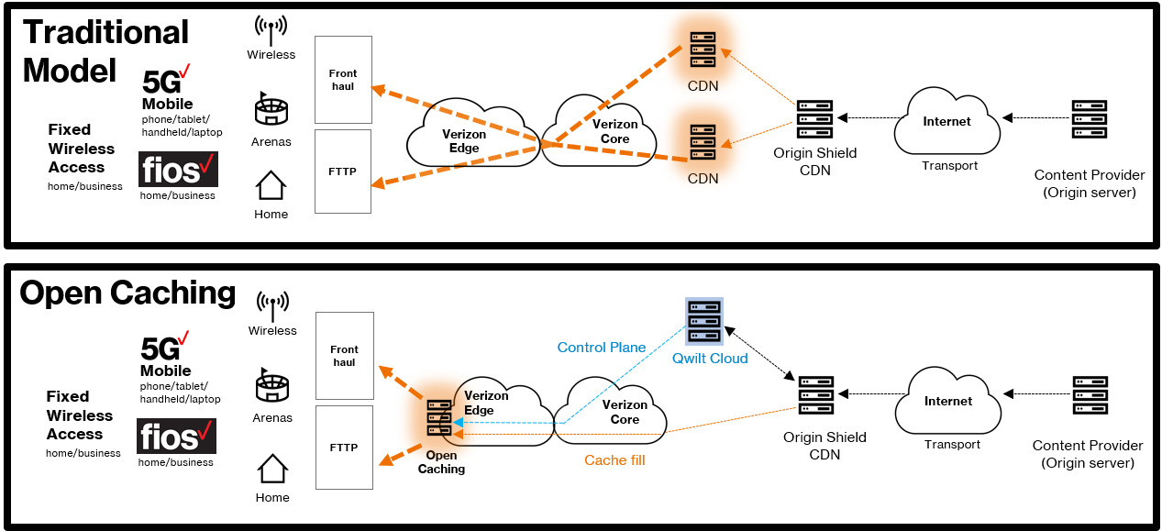
Open Caching at Verizon

Slide 16
Performance Comparison
Internal Use Case for Open Caching
In-house video service with live and on-demand
Real customers
Live network
Allows end-to-end visibility for performance
Content Provider has
the best perf visibility

Slide 17
Performance Comparison
Buffering Ratio – Percentage of time a viewer must wait for the video to resume playing (Seconds spent with spinning wheel / total play time)
Video Start Failures – Percentage of client requests that are unsuccessful versus total playback requests
Play Failures After Video Start – Measurement of video plays terminated due to a playback error after starting other than client hitting the stop button or an "end of stream" which comes at the end of a video on demand
Exit Before Video start – Measures the requests for content terminated by the user before the video started by requesting for a second content before the first one played
HD Performance – Percentage of playback using either of the two highest video resolutions

Slide 18
Performance Comparison
Performance Metric | CDN (%) | Open Caching (%) | Improvement (%)
Buffering | 0.21 | 0.10 | 54%
Video start failures | 0.70 | 0.26 | 63%
Play failures after video start | 0.27 | 0.14 | 48%
Exit before video start | 0.68 | 0.04 | 94%
HD performance (average) | 93.13 | 99.32 | 7%
Verizon video application client-side metrics with and without Open Caching

Slide 19
Conclusion
Open Caching benefits ISP, CP, CDN and user
Eases the burden of OTT on the Peering Manager
Real world, demonstrated performance
How to learn more
  Read specifications and RFCs
  Participate in SVTA
opencaching.svta.org

