Slide 1
Global Interconnection Hub Update
A survey of mature & developing interconnection hubs plus underserved markets with potential
Patrick Christian
GPF San Juan
April 2024

Slide 2
What we’ll cover
Ranking interconnection hubs
  Data sets and scoring examples
  Top ranked global interconnection hubs
Hub rankings by region
  Top regional hubs plus biggest gainers & underserved markets
    Europe, Africa, the Middle East and Asia
  Submarine cable, regional network, data center trends
Global view & what’s to come
  Planned sub cables, cloud regions and data centers
  Underserved markets with the most potential

Slide 3
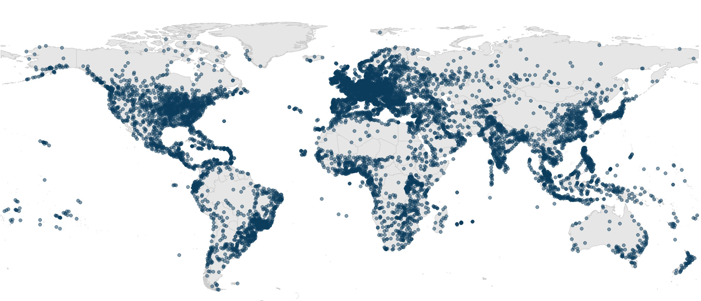
The interconnection index: what we’re doing
Questions we’re often asked
  What is the next emerging hub in region x?
  How do various hubs compare to each other?
  Where should I expand in country X besides the largest city?
We will solve with data and maps 🤓
Notes:
This is a map of all metro areas in the world that TeleGeography tracks. 8,200 blue dots on the map, each one a different metro area. We track even more city entities; cities are aggregated into these metro areas.
I’m going to preview an “alpha” version of a new project.

Slide 4
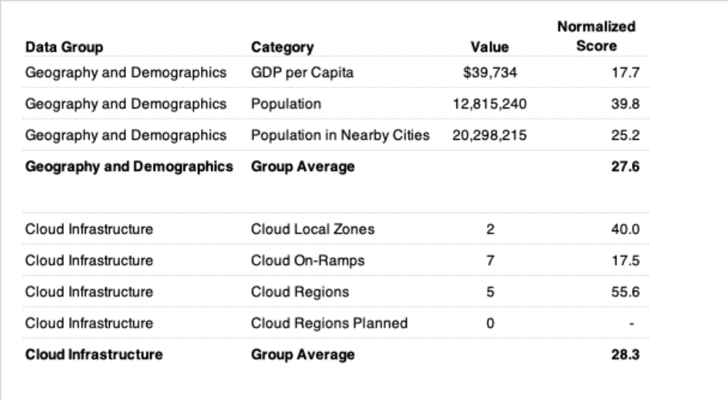
Example city: Osaka
Smallest city = 500 pop.
Largest city = 32,224,328 pop.
Osaka is 39.8% between the
MIN and MAX cities
Notes:
Largest metro = Shanghai. Shanghai gets a score of 100 for this category. Tiny hamlet gets a 0.

Slide 5
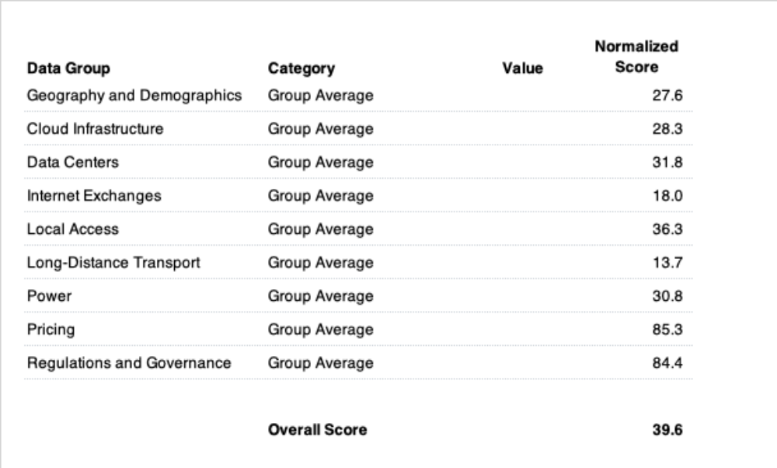
Example city: Osaka
Notes:
Largest metro = Shanghai. Shanghai gets a score of 100 for this category. Tiny hamlet gets a 0.
High pricing score = low prices

Slide 6
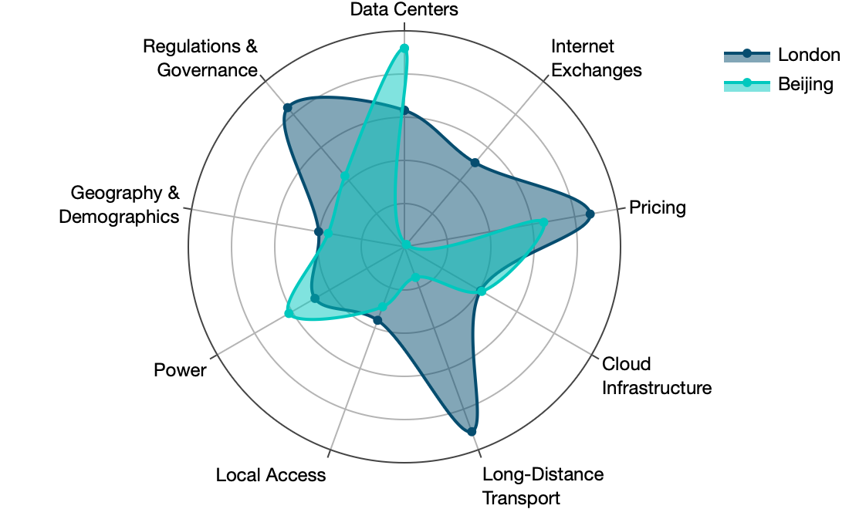
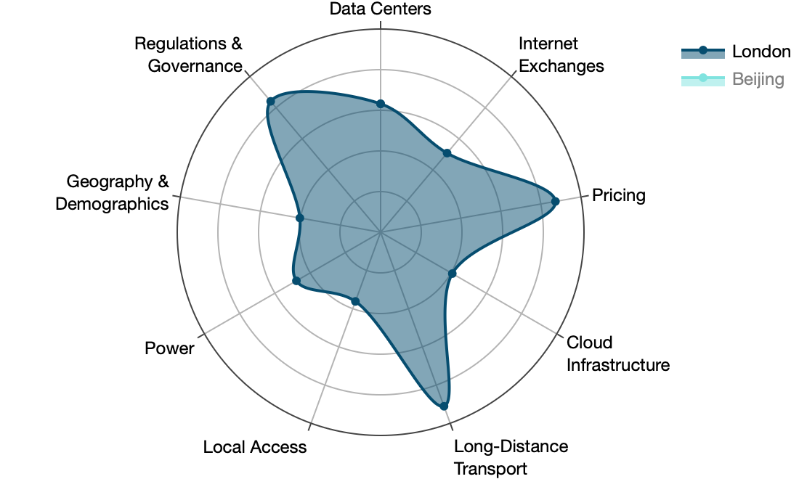
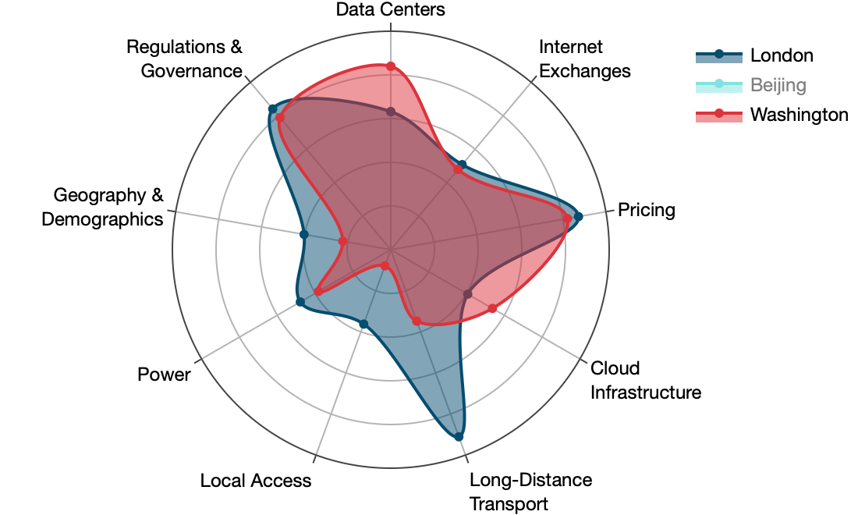
Overall quantity isn’t all that matters
The “shape” of a city’s interconnection assets matters too!
Notes:
Walk through each point in London first so that audience gets a sense of what we are showing.
High pricing score = low prices
London - Strong choices in data centers, low prices, many choices in long-distance transport, stable govt.
Beijing better:
FAR more data centers! 149 vs 118.
Power: More installed capacity in B. Double the gigawatts planned for B than L. Thanks to wind power, currently > share of clean power in L than B in proximity (56% vs 38%)
B and L comparable:
Comparable cloud infrastructure (though the cloud companies tend to be different)
Demographics: 20m population in B vs. 18m in London. But per-capita income about 3.5x in L vs. B
Local access: almost identical numbers of fixed and mobile subscribers. But far more are on 4G and 5G in L.
Pricing. London cheaper but prices have really fallen in B.
London better:
Network connectivity options. 7 internet exchanges in L; 1 in B. 130 transport carriers in L vs. 23 in B. Just a different mindset.
Governance. No comparison there. B falls behind on control of corruption, laws to protect private enterprise, and individual freedoms
Washington:
Comparable regulations and pricing.
2nd only to Beijing in data centers. Most DC space deployed in world. Lots of cloud infrastructure.
Far fewer people in DC metro area (5m) and therefore fixed/mobile subscribers.
Less overall installed power base than L, and smaller proximity to clean power generation
Also far fewer options for long-distance transport. London is an international internet hub. Washington is not. It ranks behind LA, NYC, and San Fran

Slide 7
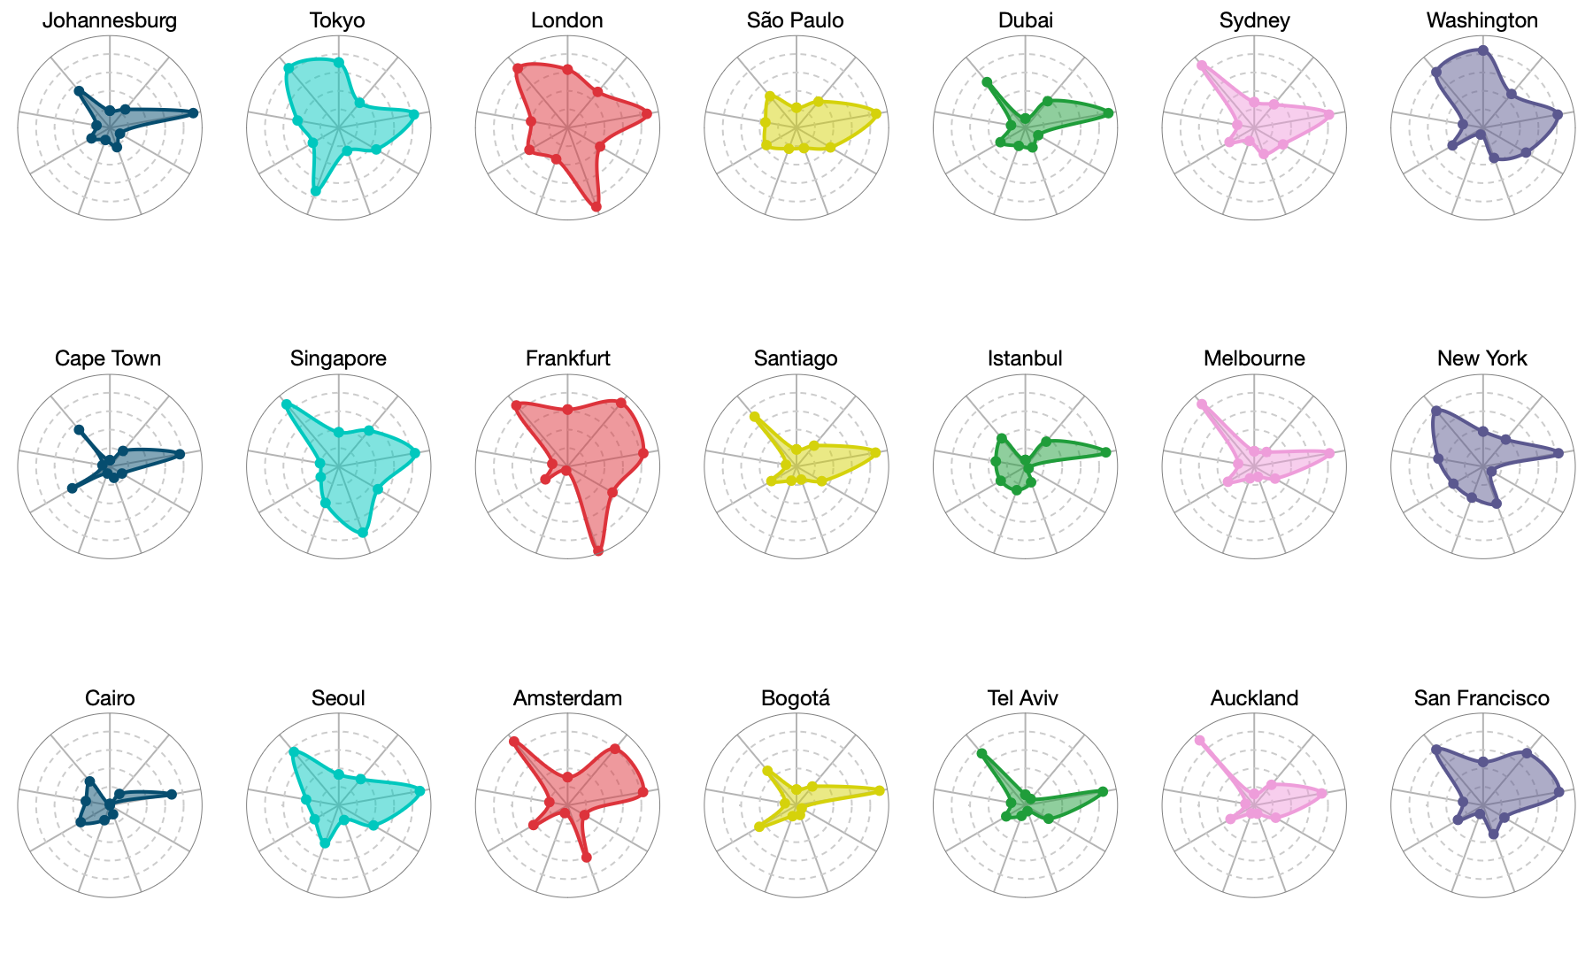
Top 3 hubs in each region
Legend
Notes:
Roughly arranged: W = market potential. E = data centers and network connectivity. NE = data centers. SE = network connectivity.
Smaller hubs tend to perform well in just a few categories. They have a jaggy, star-like shape. Tel Aviv is strong on governance and low prices, but poor on data center and cloud infrastructure and overall market size.
* Well-round cities are just that: well-rounded! Tokyo, Singapore, Seoul pretty strong in all categories.
Almost all these top hubs have low prices. That’s a change over the past 10-15 years that have proliferated through.
Some huge cities here with a strong installed power base but really lagging behind on data center and cloud infrastructure. Cairo good example.

Slide 8
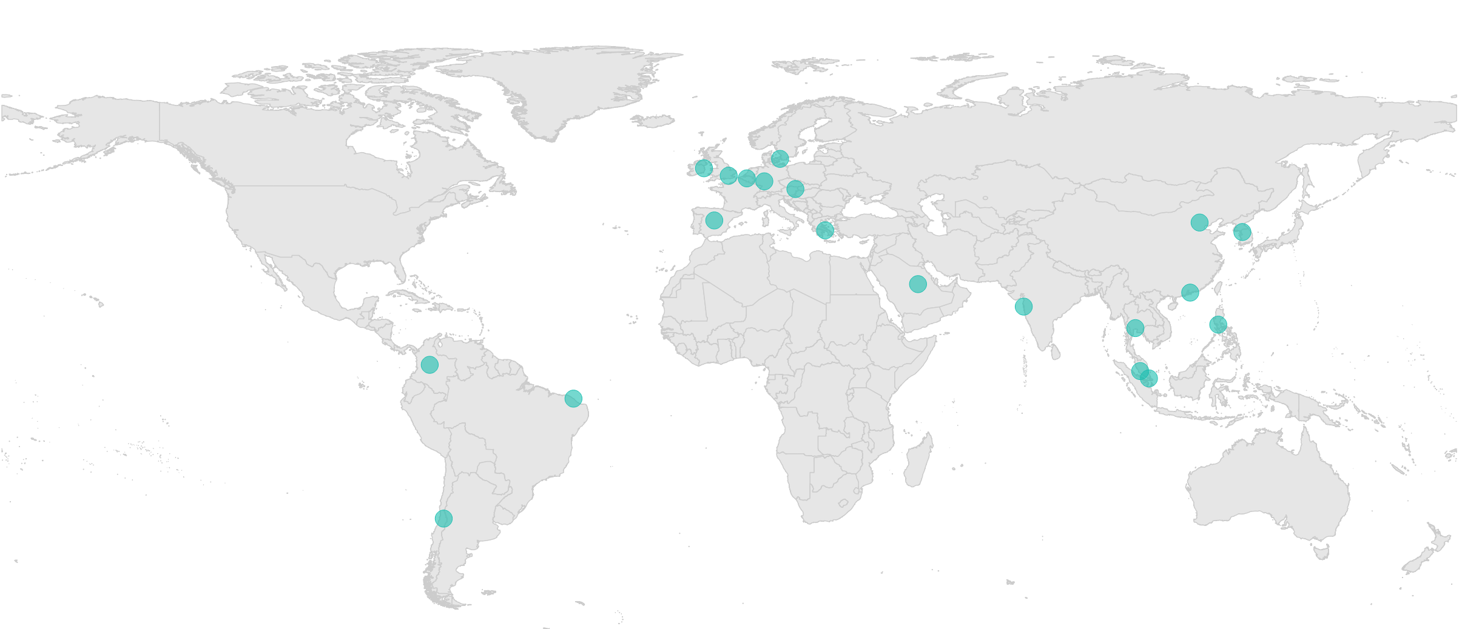
Biggest gainers in near term
Top 20 Cities with Fastest Expected Gains in Next Two Years
Madrid
Beijing
Riyadh
Kuala Lumpur
Fortaleza
Santiago
Notes:
Datasets: cloud regions planned, data centers planned, sub cables planned, clean power generation planned, pricing change
Some of the top 20 near-term gainers are just rich getting richer (London, Frankfurt, Singapore getting more data centers and cloud regions)
Beijing – huge number of data centers planned, power infrastructure builds, and fast-falling prices
Madrid – reasonable number of cloud regions planned, some data center build, lots of clean power plants being considered
Frankfurt
Kuala Lumpur
Athens
Singapore
Copenhagen
London
Manila
Bangkok
Shenzhen
Dublin
Vienna
Seoul
Riyadh – 2 cloud regions planned.
Fortaleza - 1 new data center planned. 51 GW clean power (wind)
Santiago – 1 cloud region, 5 data centers planned.
Mumbai
Brussels
Bogotá

Slide 9
Regional Rankings – Interconnection Hubs

Slide 10
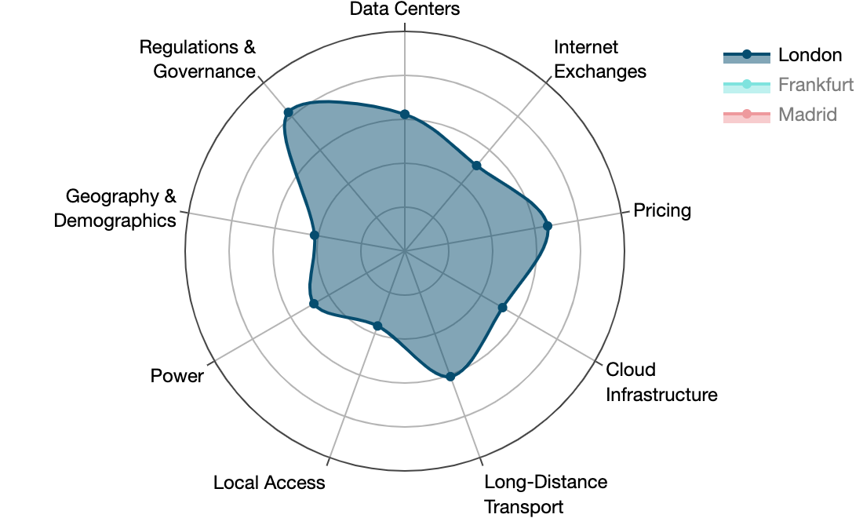
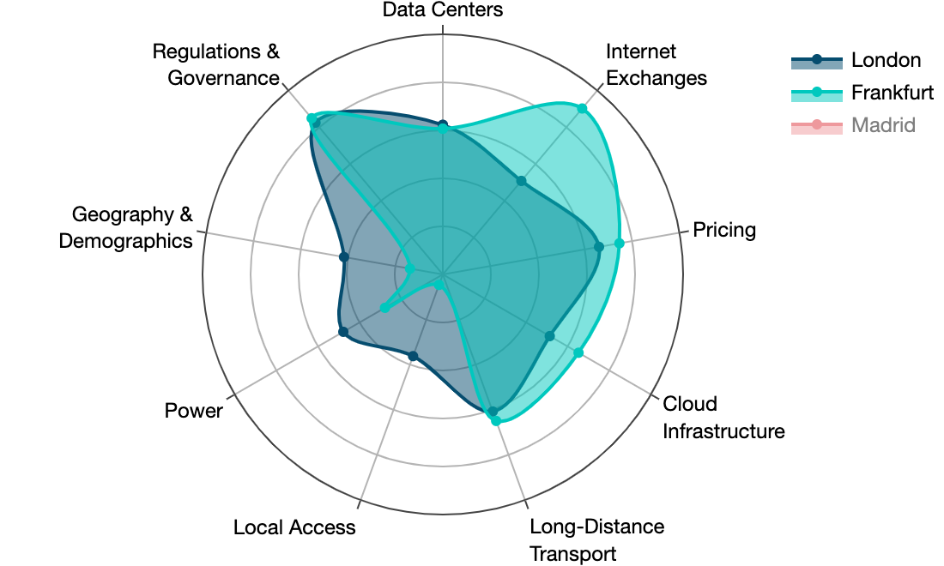
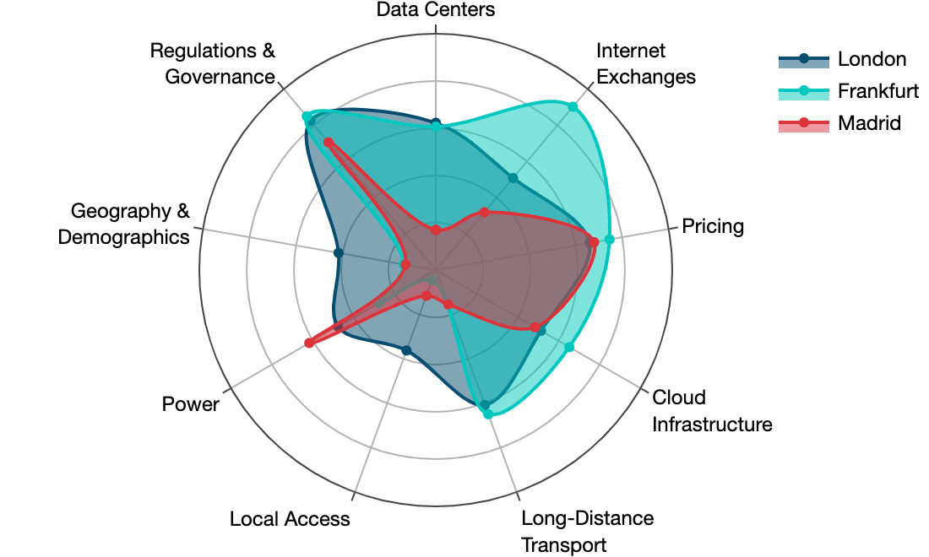
European interconnection hubs
Top ranking
  London*
  Frankfurt*
  Amsterdam
  Paris
  Stockholm
Biggest gainers
  Madrid
  Copenhagen
  Dublin
  Athens
  Vienna

Slide 11
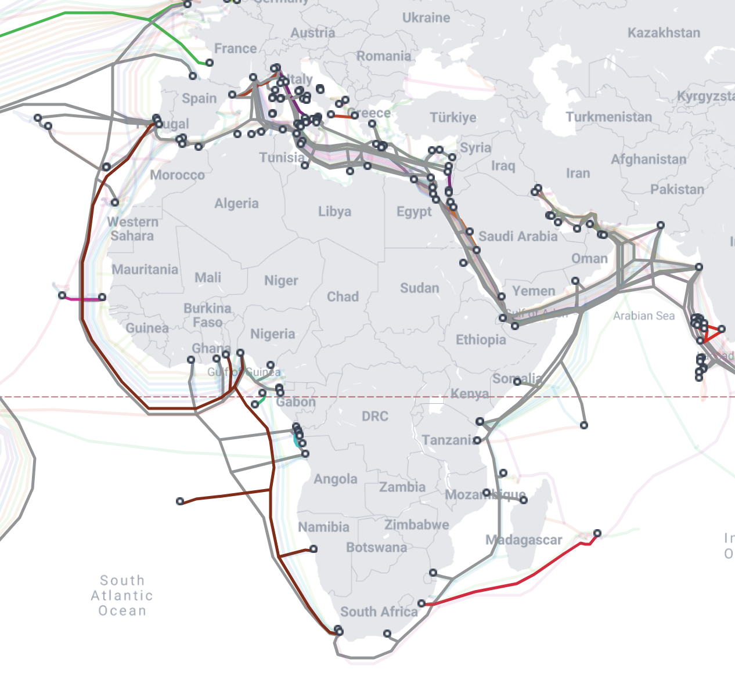
Major recent & planned cables in Africa & ME
Equiano (2023) – NG, NA, TG, ZA
2Africa (2023) – 33 African, ME, Europe & South Asia
Africa-1 (2024) – Egypt, Saudi Arabia, UAE, Djibouti, Kenya, PK
Raman (2025) Saudi Arabia, Jordan, Oman, Djibouti, India
Blue (2024) – Jordan, Israel, Cyprus, Greece, IT, FR
IEX (2024) – Saudi Arabia, Djibouti, Egypt, Oman, India, Italy
Medusa (2024) – N Africa + S Europe
SeaMeWe-6 (2025) – EG, DJ, SA, PK, LK, IN, BD, MY, SG, FR

Slide 12
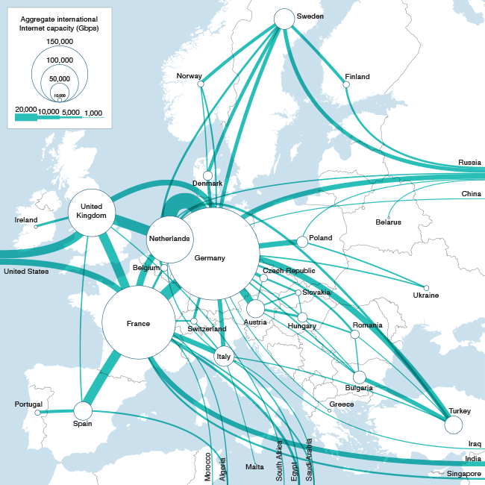
Europe’s top int’l routes
Europe’s hub countries – Germany, UK, Netherlands and France
Largest routes still within Europe
Intra-regional routes growing very slowly, most countries still connect primarily to Europe

Slide 13
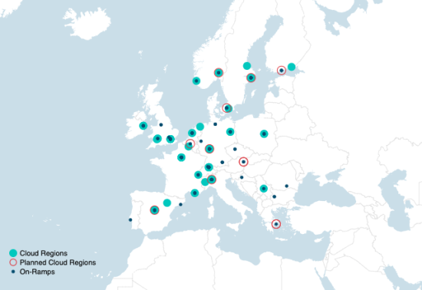
Cloud data center landscape
57 live and 12 planned cloud regions
8 launched in 2023 (7 in 2022)
UK & Germany most with 10
Italy, Spain, Poland, Germany, Ireland and Serbia newest regions
Planned regions: 2 each in Austria & Greece. Germany, Greece, Italy, & Spain. Singles in Belgium, Germany, Italy, Spain and the Nordics (Finland, Denmark, Norway, Sweden).

Slide 14
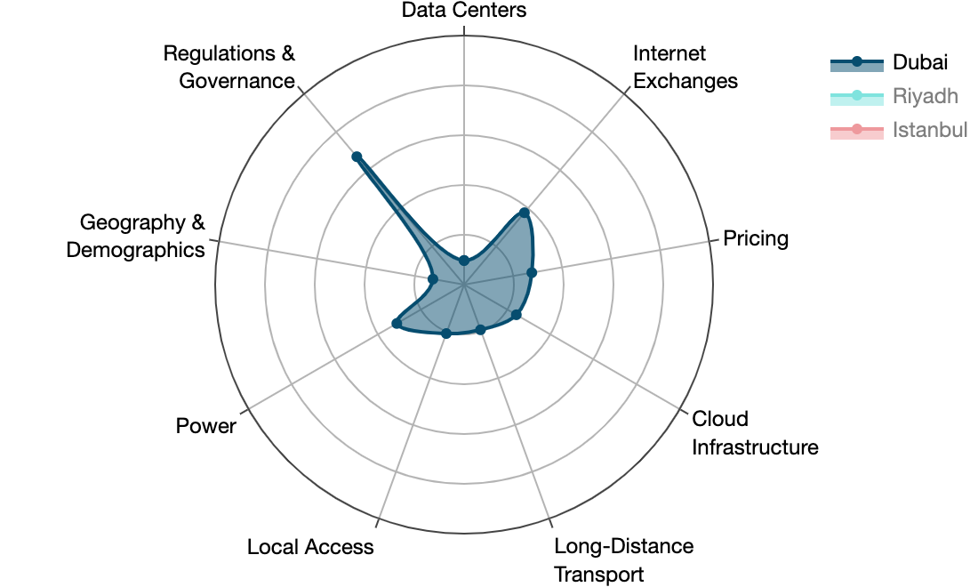
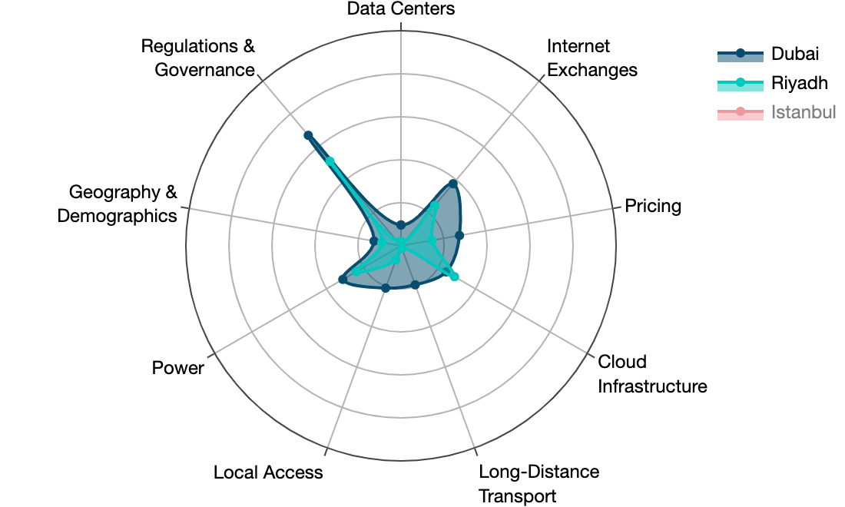
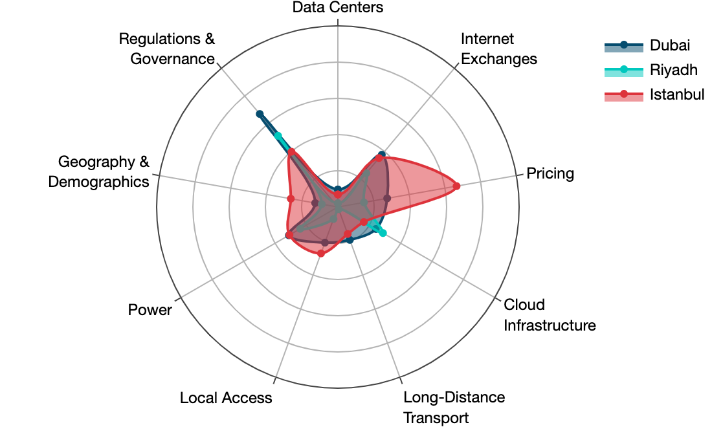
Middle Eastern hubs
Top ranking
  Dubai*
  Istanbul
  Tel Aviv*
  Fujairah
  Jeddah
Biggest gainers
  Riyadh
  Doha
  Istanbul
  Jerusalem
  Manama

Slide 15
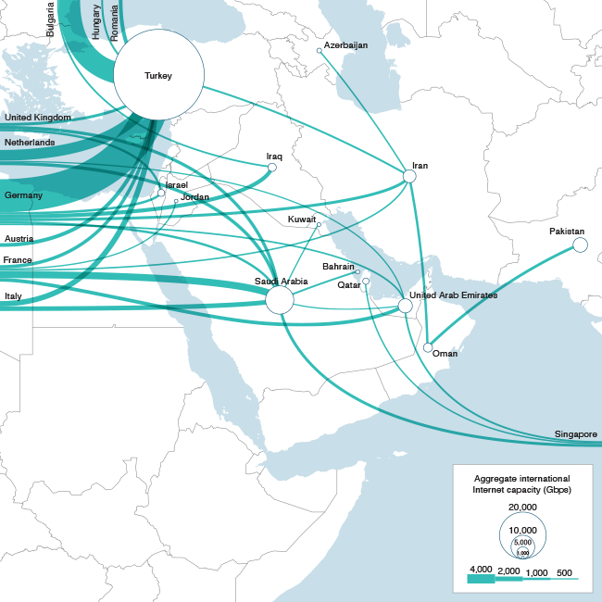
Middle East’s top int’l routes
Largest hub countries – Turkey most int’l capacity, distant second Saudi Arabia
Largest routes still to Europe
Intra-regional routes growing very slowly, most countries still connect primarily to Europe

Slide 16
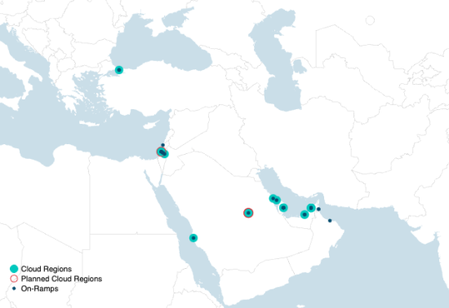
Cloud data center landscape
18 live and 4 planned cloud regions
6 launched since 2023
UAE most regions with 6
Israel, Saudi Arabia, Qatar & Turkey newest regions
Planned regions Saudi Arabia (3), Israel (1)

Slide 17
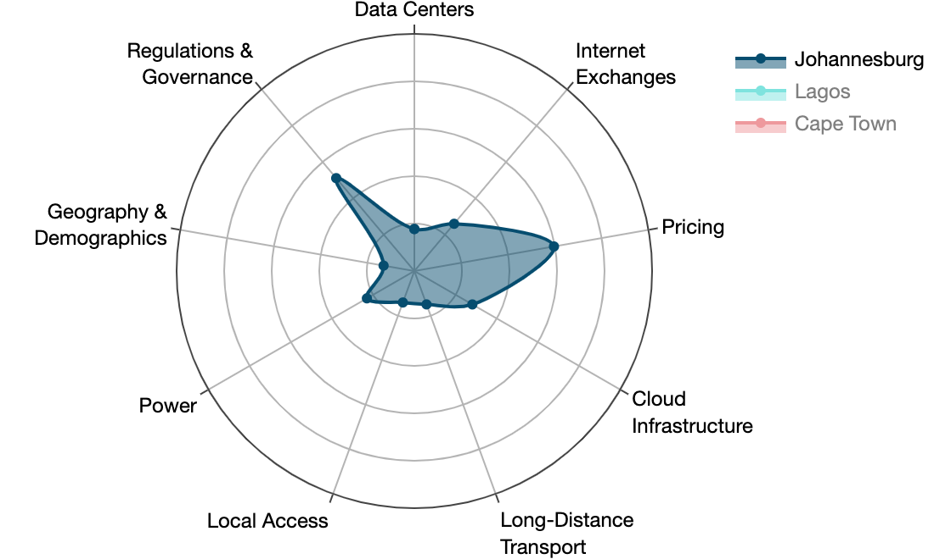
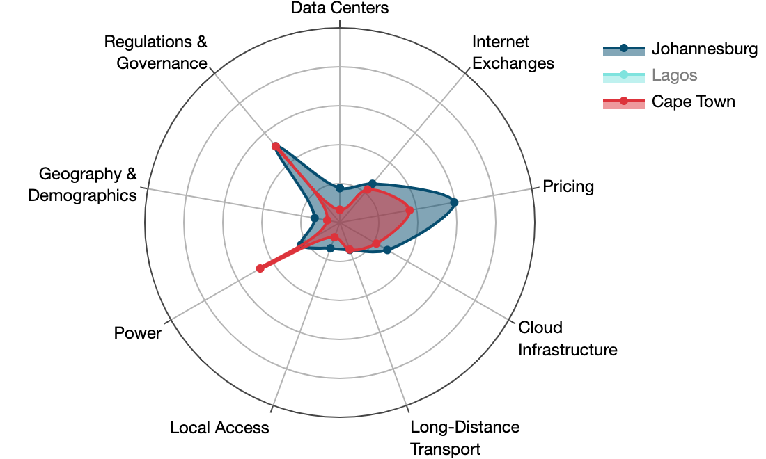
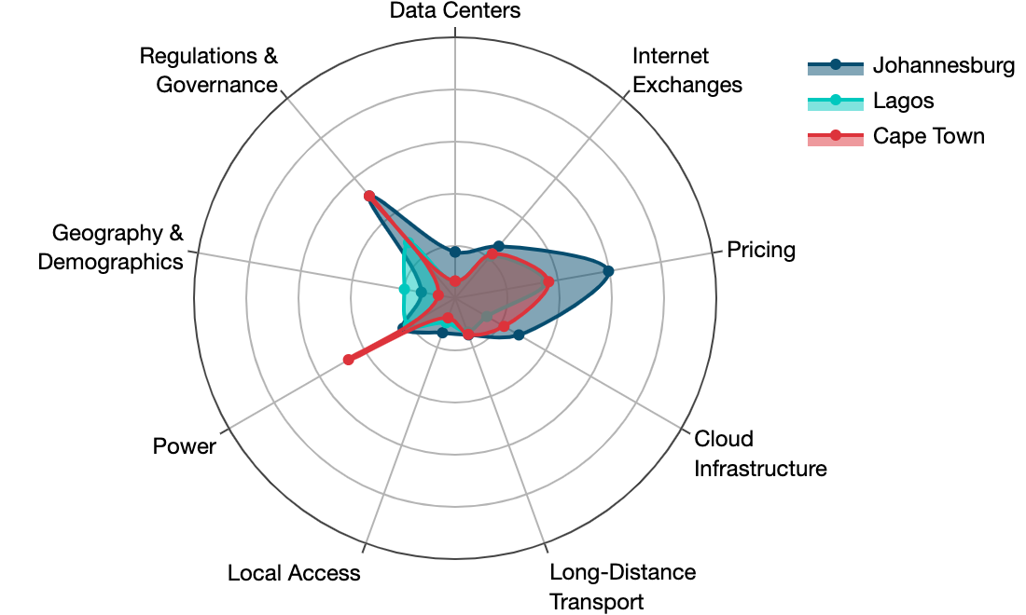
African interconnection hubs
Top ranking
  Johannesburg*
  Cape Town*
  Nairobi*
  Cairo
  Lagos*
  Accra*
Biggest gainers
  Djibouti City
  Luanda
  Mombasa
  Abidjan

Slide 18
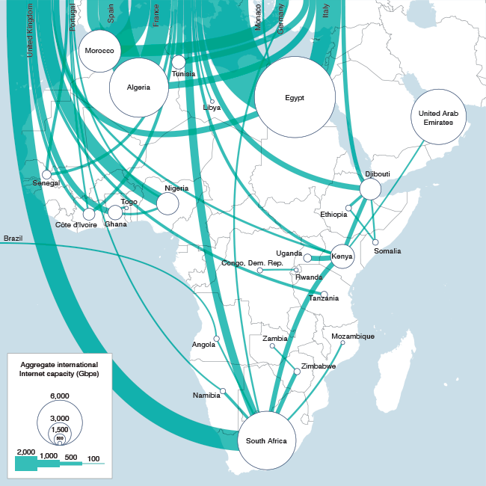
Africa’s top int’l routes
Largest hub countries – Egypt & South Africa then Kenya & Nigeria
Largest routes still mostly to Europe
Growing intra-region routes – South Africa to Nigeria and Kenya

Slide 19
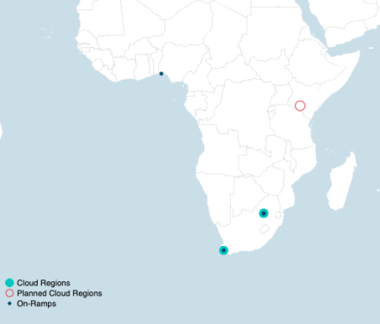
Africa’s top int’l routes
6 live and 1 planned cloud regions
0 launched in 2023
South Africa most regions with 5
Most recent in Jo’burg (4 in Jo’burg, 2 in Cape Town)
Planned region in Kenya

Slide 20
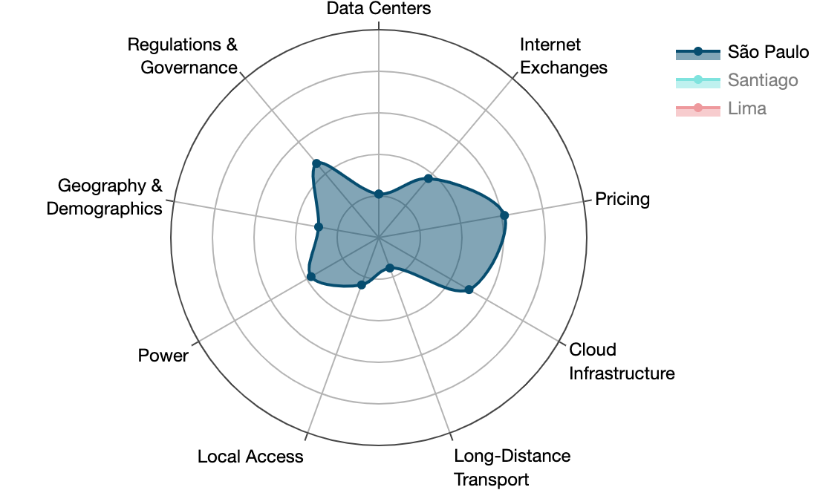
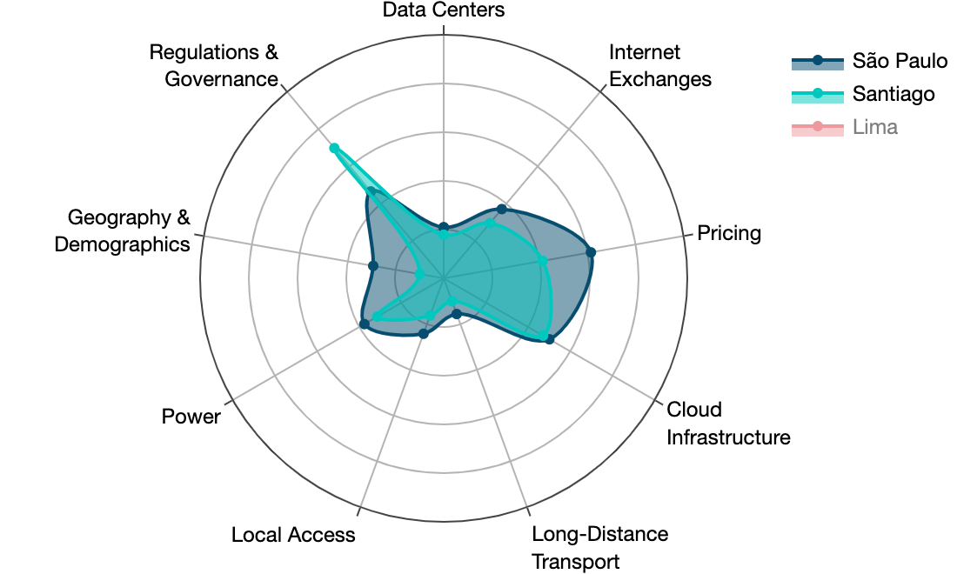
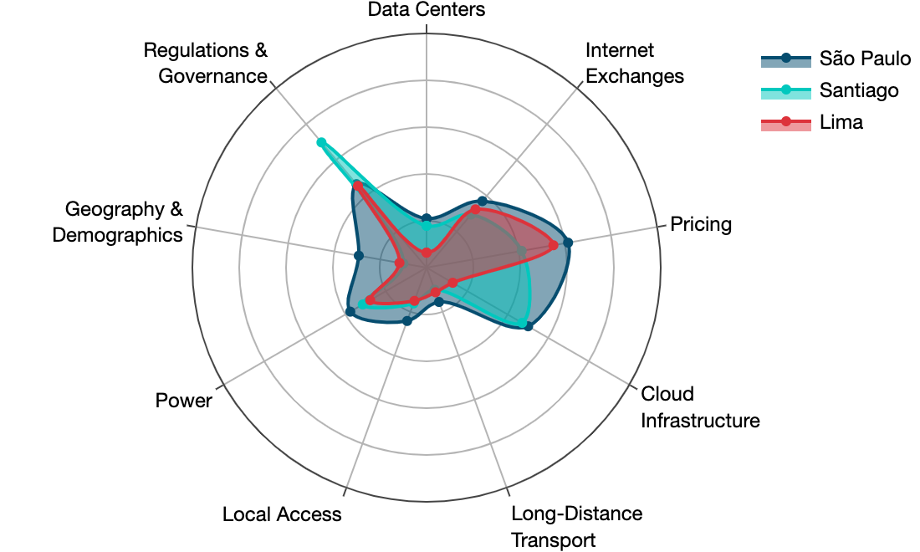
Latin american interconnection hubs
Top ranking
  Sao Paulo*
  Santiago*
  Bogota*
  Mexico City
  Rio de Janeiro*
Biggest gainers
  Fortaleza
  Lima
  Monterrey

Slide 21
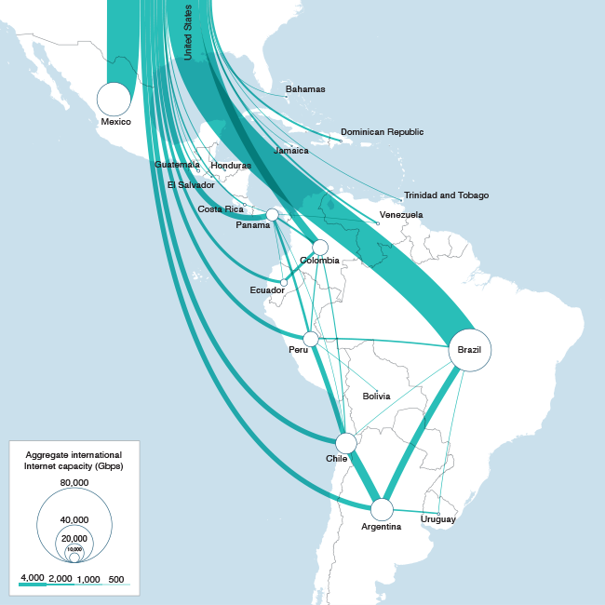
Latam’s top int’l routes
Largest hub countries – Brazil & Mexico
Largest routes still to U.S.
Growing intra-region routes – Brazil-Argentina, Argentina-Chile

Slide 22
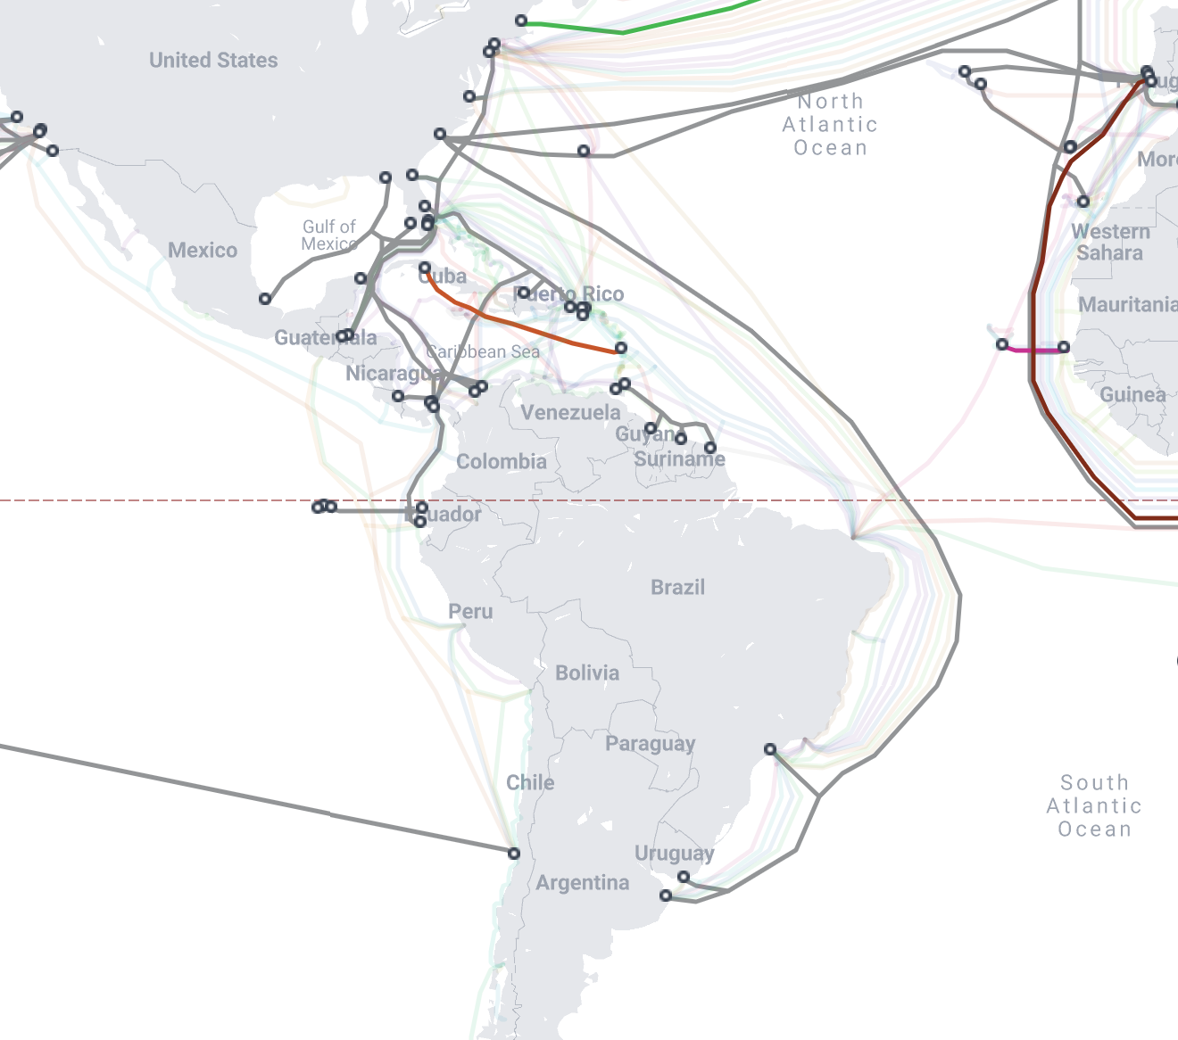
Major recent & planned cables in Latam
Firmina (2024) – BR, AR, UY, US
Deep Blue One (2024) – GF, TT, SR
Carnival Sub Network (CSN-1) (2025) – EC, CO, PA, US
AMX-3/Tikal (2026) – GT, MX, US
Caribbean Express (CX) (2026) – CO, PA, HN, MX, US
Gold Data-1/Liberty Networks-1 (2026) – CO, PN, MX, US

Slide 23
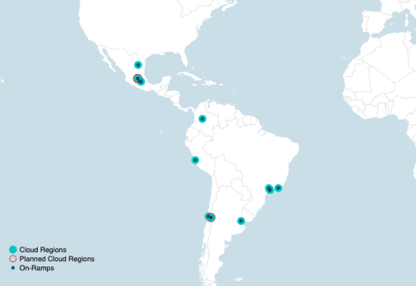
Cloud data center landscape
20 live and 5 planned cloud regions
4 launched in 2023
Brazil has most regions with 9
Mexico (2), Colombia (1) and Chile (1)
Planned Mexico (3), Chile (2)

Slide 24
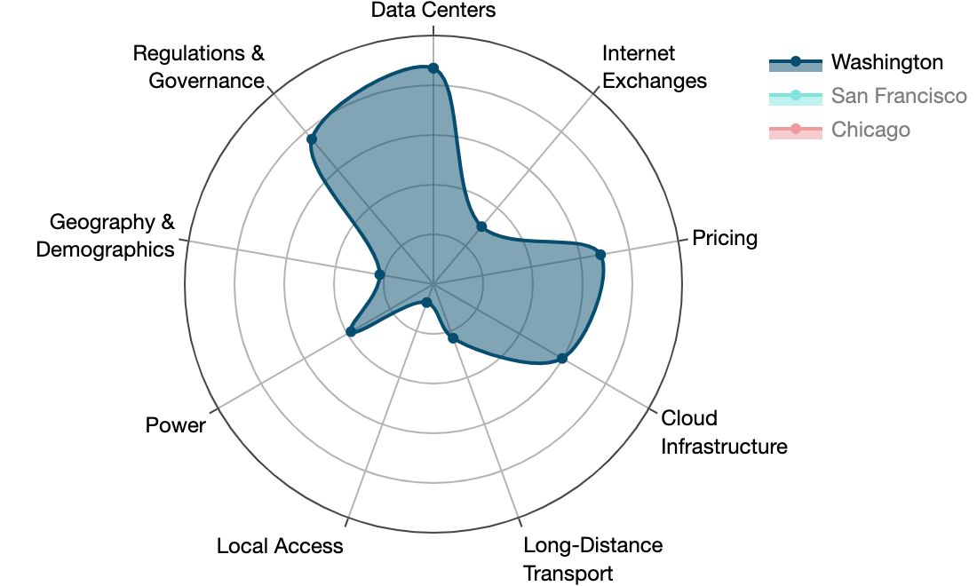
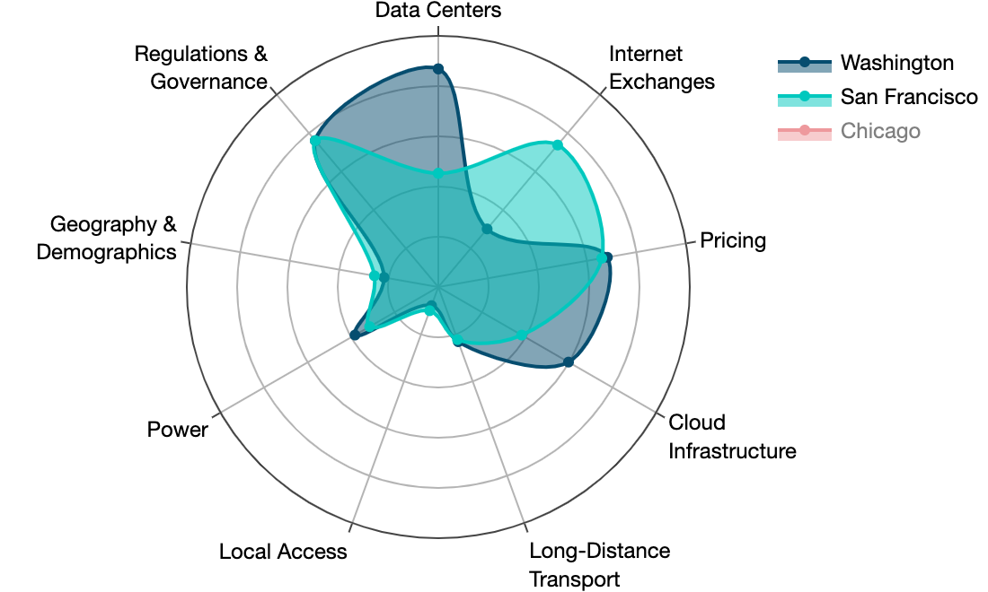
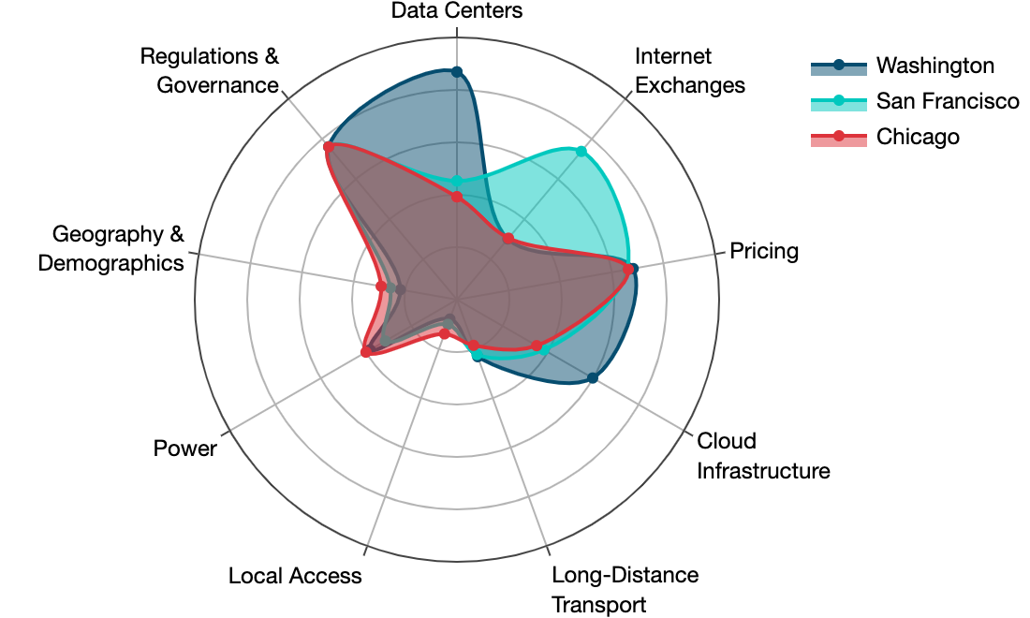
US & Canada interconnection hubs
Top ranking
  Washington*
  New York
  San Francisco*
  Los Angeles
  Toronto
Biggest gainers
  Atlanta
  Calgary
  Chicago
  Dallas
  Phoenix

Slide 25
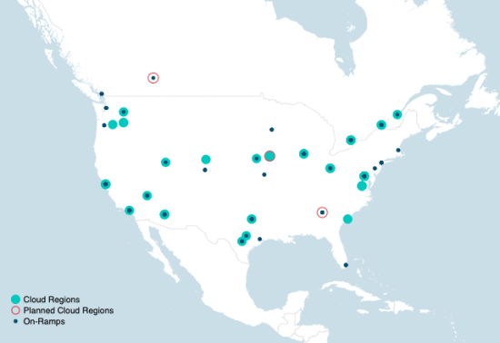
U.S. & Canada data center landscape
55 live and 3 planned cloud regions
0 launched in 2023
U.S. 46 live regions and 2 planned (Atlanta)
Canada 9 live and 1 planned (Calgary)
U.S. – Washington metro most regions (10) then San Francisco with 6
Canada – Toronto has 5 regions and Montreal 4

Slide 26
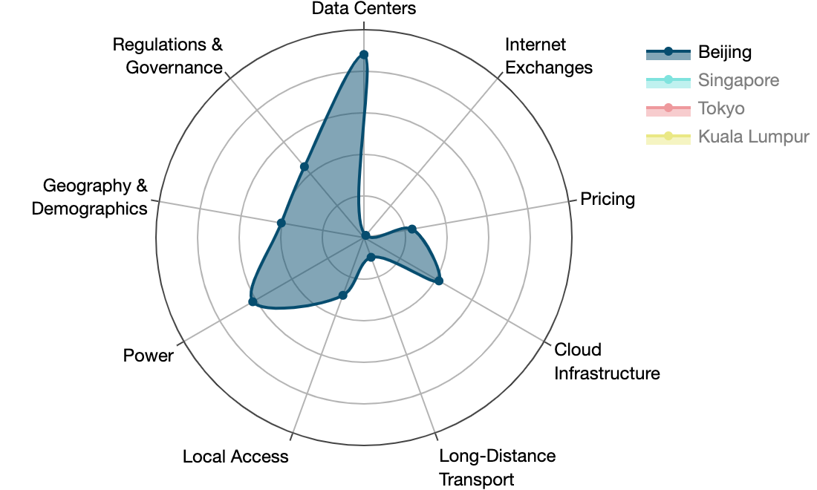
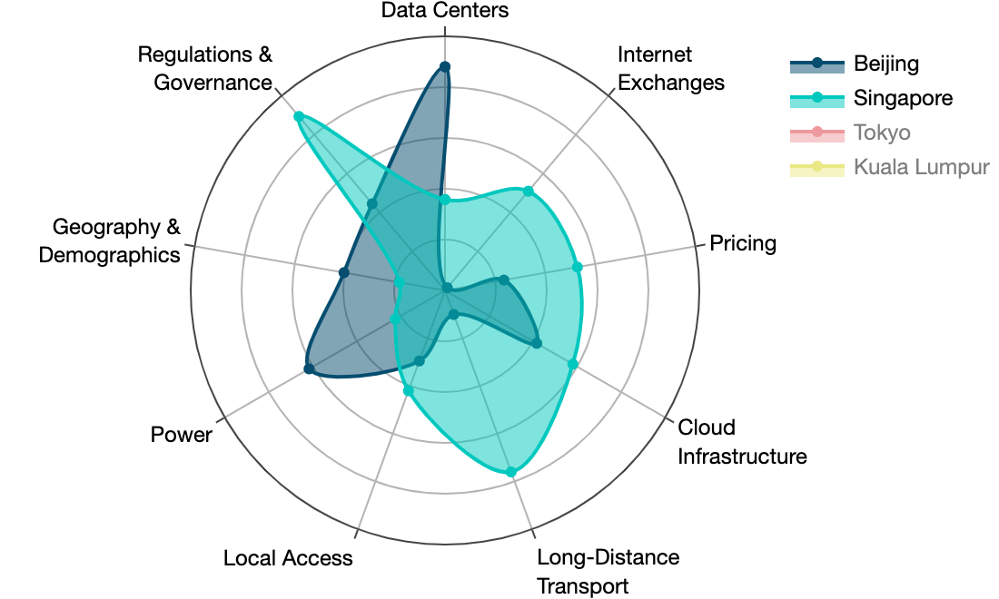
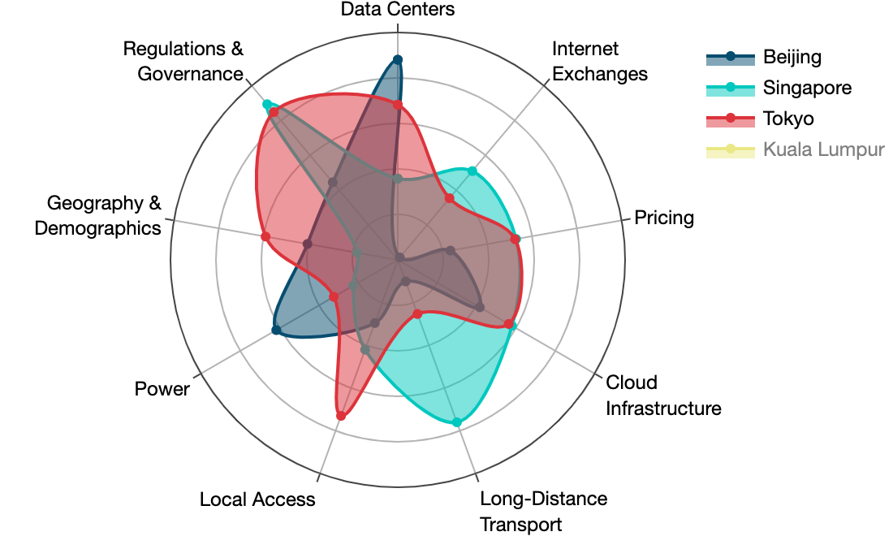
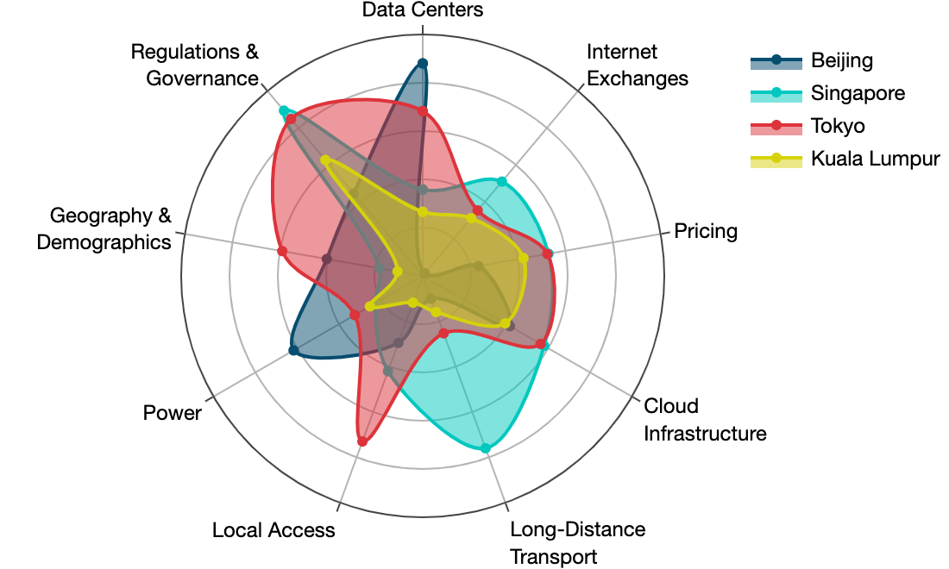
Asian interconnection hubs
Top ranking
  Tokyo
  Singapore*
  Seoul
  Taipei
  Mumbai
Biggest gainers
  Beijing
  Kuala Lumpur
  Bangkok
  Manila
  Jakarta

Slide 27
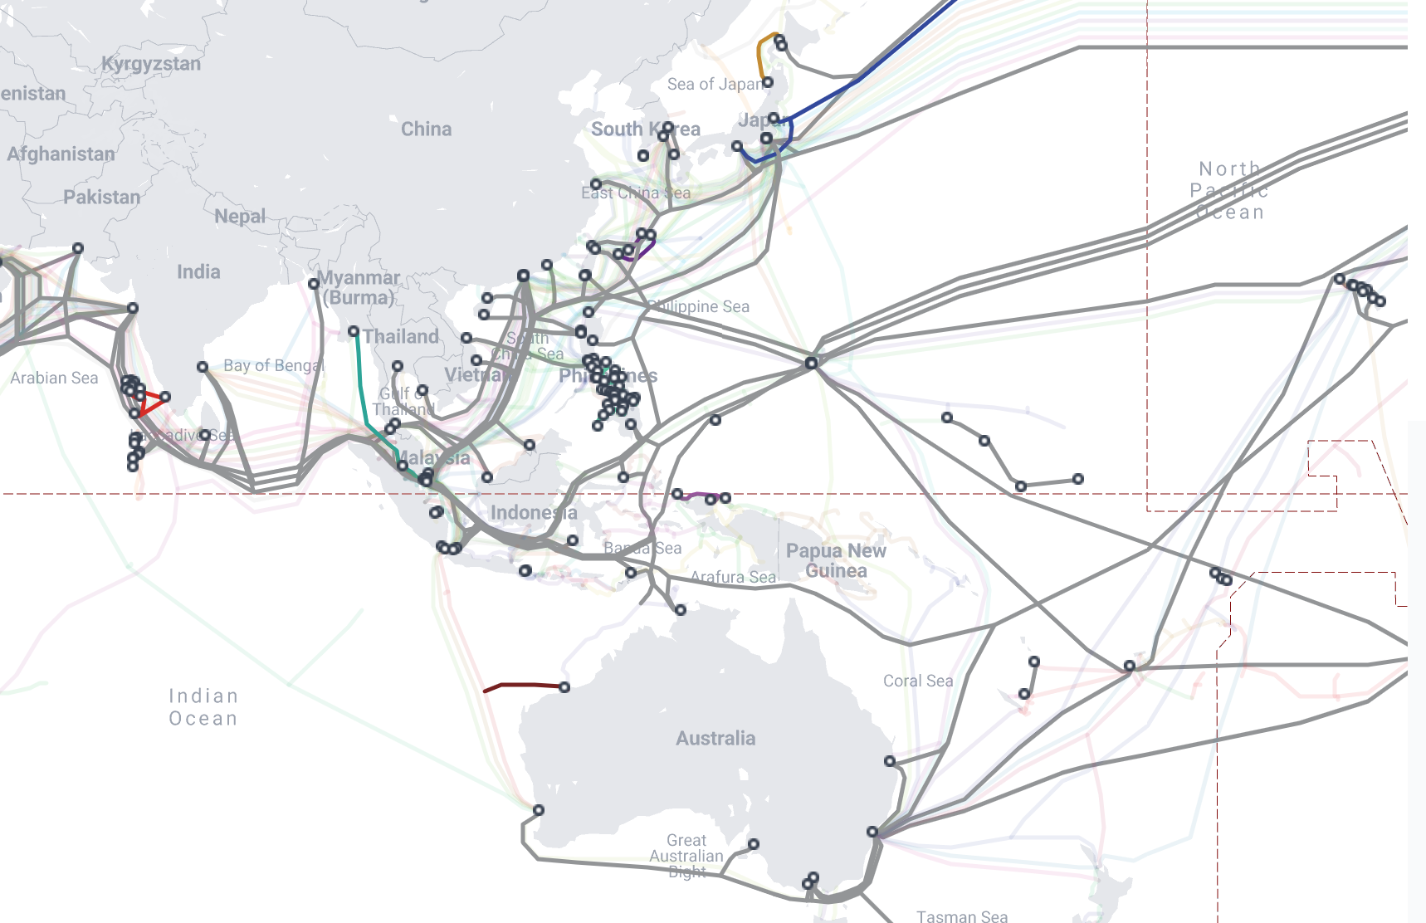
Recent and planned sub cables in Asia
Asia Direct Cable (2024) – PH, Vietnam, TH, CN, JP, SG
India Asia Xpress (IAX) (2024) - IN, TH, MY, SG, MV, LK
MIST (2024) – IN, MM, MY, SG
SJC2 (2024) – SG, JP, TH, KH, HK, TW, CN
SEA-H2X (2024) – PH, TH, MY, HK, SG
Asia Link Cable (ALC) (2025) – CN, SG, PH
Bifrost (2025) – SG, ID, PH, US, MX
ECHO (2025) – SG, ID, US
TPU (2025) – TW, PH, US
Apricot (2026) – PH, ID, JP, TW, SG
Asia Connect Cable (ACC-1) (2027) – IN, PH, SG, AU, US

Slide 28
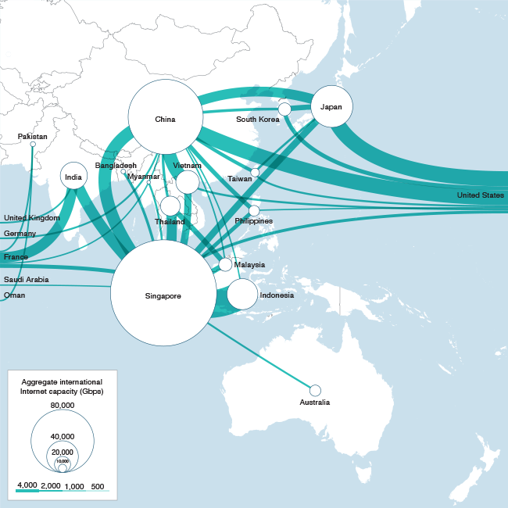
Asia’s top int’l routes
Largest hub countries – Singapore, China, Japan
Largest routes mostly still to U.S.
Growing routes to India and Europe
Intra-Asia int’l bw has been increasing rapidly past 5+ years

Slide 29
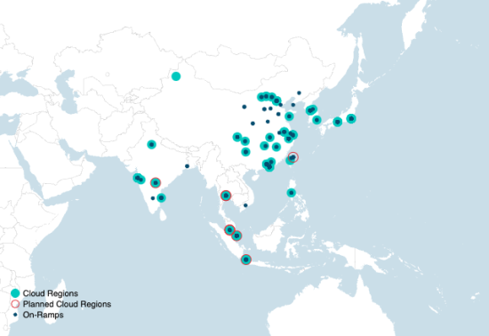
Cloud data center landscape
92 live and 9 planned cloud regions
3 launched in 2023
43 in China
12 each in Japan and India
Newer regions all in China
Planned new regions in Malaysia (3), Thailand (2), Indonesia (1), India (1), Taiwan (1) and Singapore (1)

Slide 30
Global trends & What’s to come

Slide 31
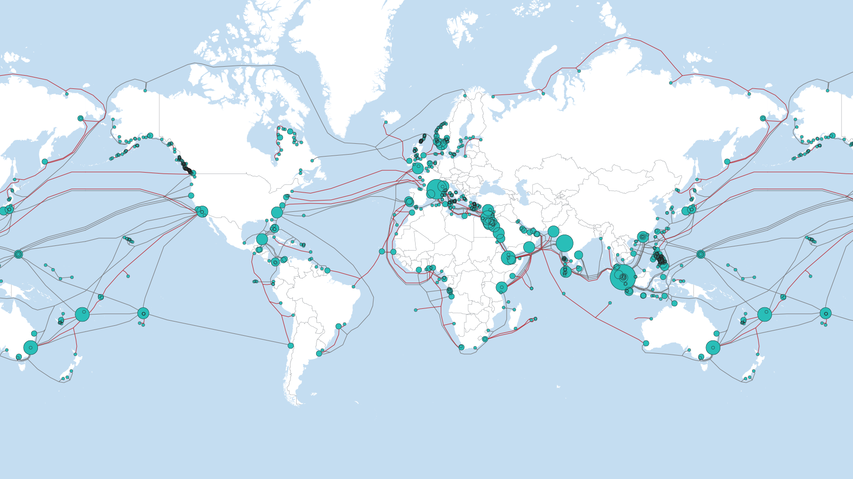

Planned & recent cable systems
www.telegeography.com

Slide 32
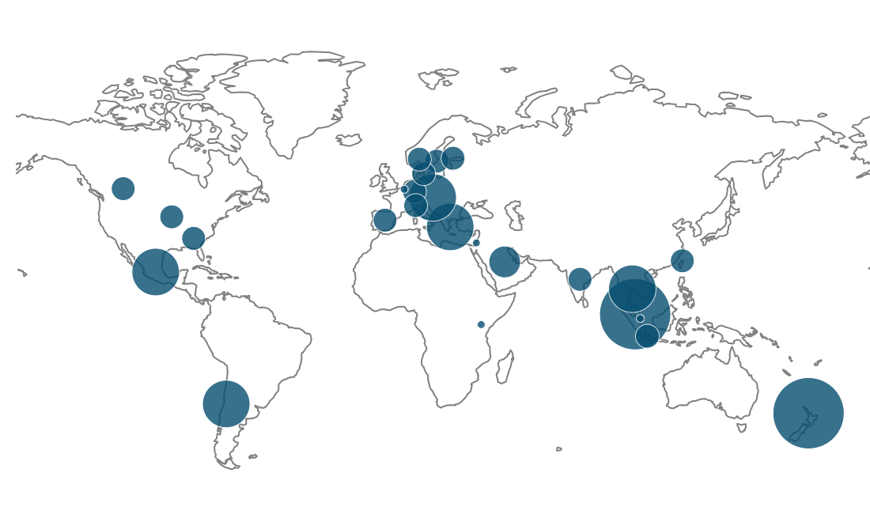
Planned cloud data centers
www.telegeography.com

Slide 33
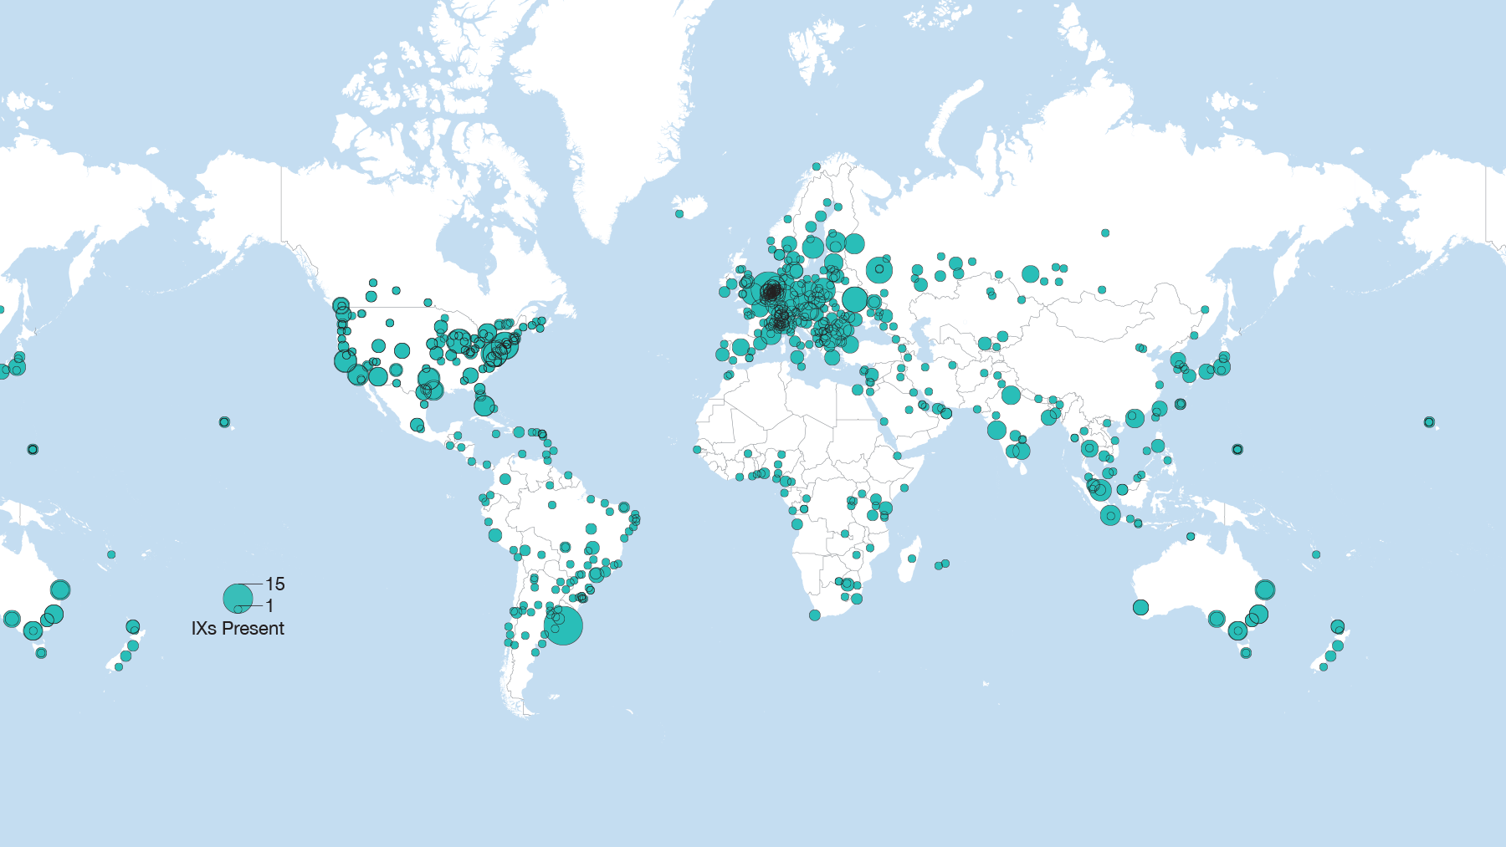

IX presence
Carlsbad, CA | Washington, DC | Exeter, UK | Singapore | www.telegeography.com | info@telegeography.com

Slide 34
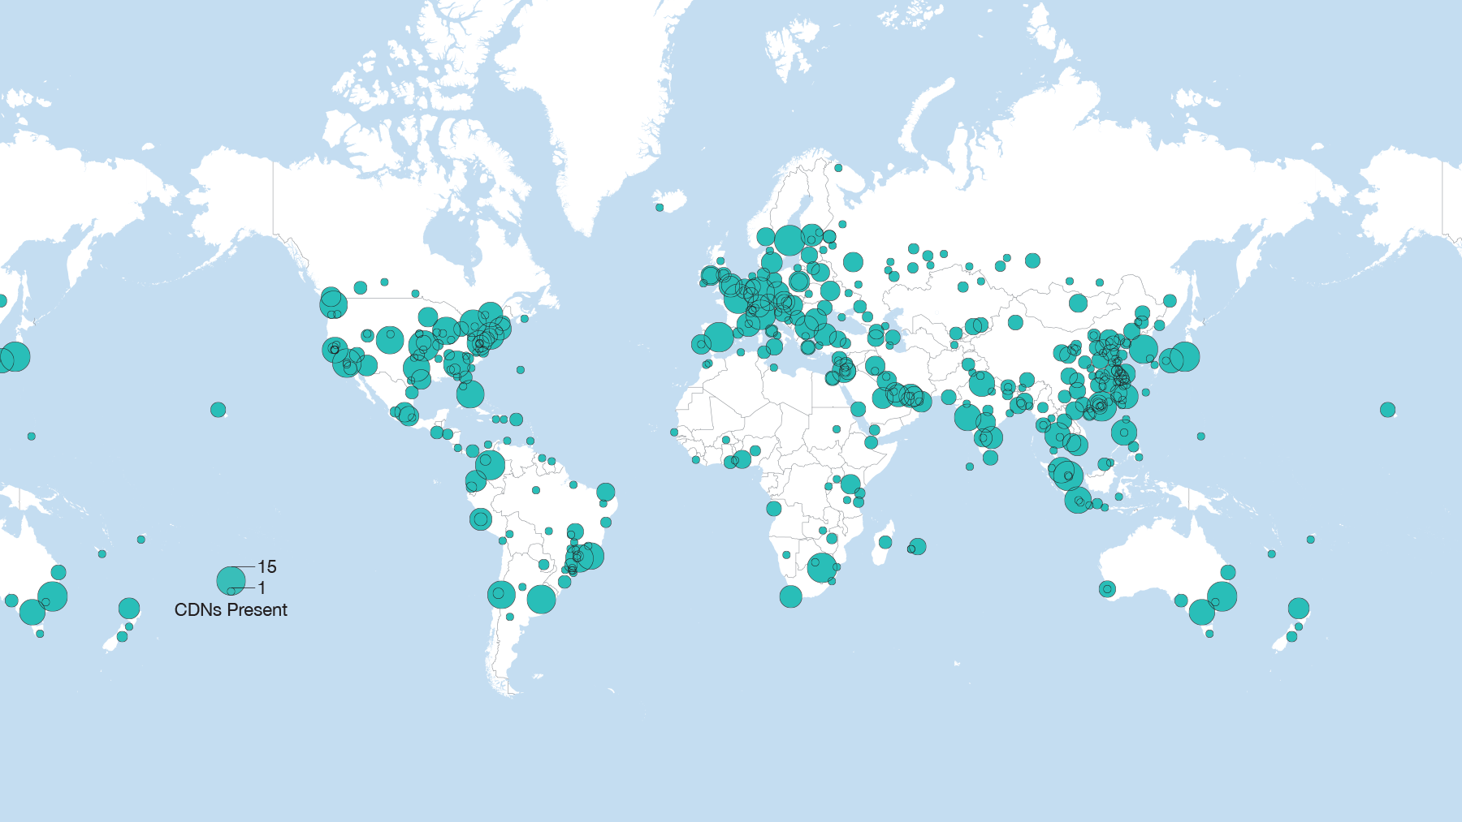
CDN global distribution
Carlsbad, CA | Washington, DC | Exeter, UK | Singapore | www.telegeography.com | info@telegeography.com

Slide 35
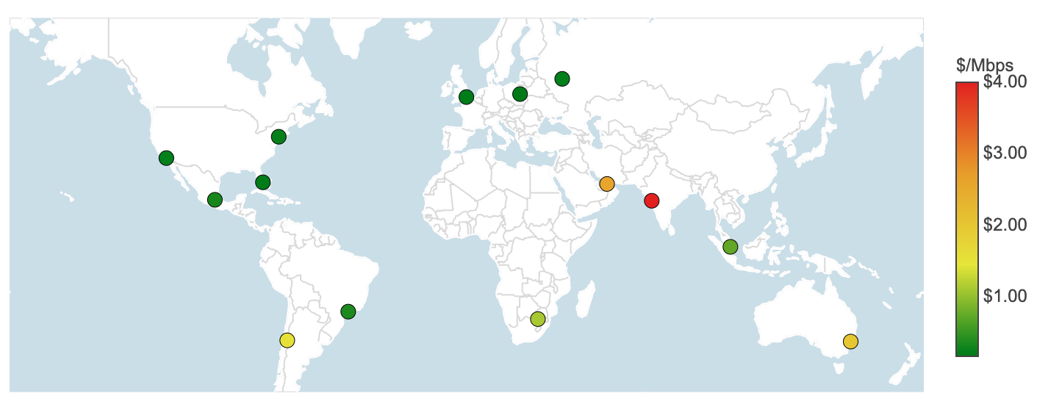
Global IP transit pricing
www.telegeography.com

Slide 36
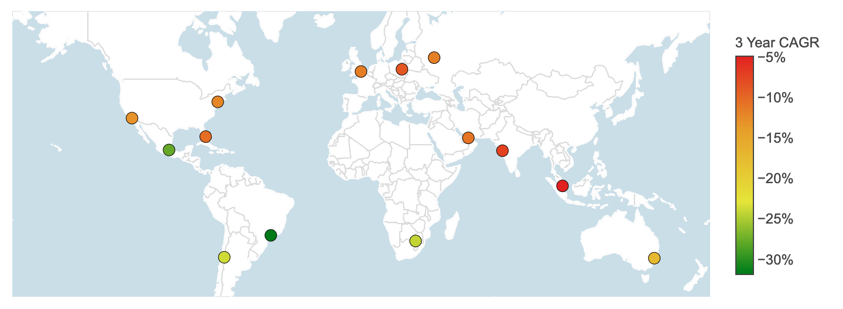
Global IP transit price decline
www.telegeography.com

Slide 37
Regional summaries
Asia
  Tokyo & Singapore are established hubs different factors – Tokyo higher population/local access & infrastructure (DCs, Cloud) while Singapore better long-haul connectivity + IXs
  Beijing & Kuala Lumpur – Beijing biggest gainer DC score & cloud infra + access to power but fewer IXs, ease of doing business (EoDB) lower
  KL (like Bangkok, Jakarta, Manila) in between Beijing & Tokyo for IXs & EoDB, but less cloud infrastructure, local access and smaller population
Africa
  South Africa remains the major hub, best EoDB in Africa, existing infrastructure, local access
  Lagos & Nairobi as well as Luanda, Kinshasa, Abidjan & Accra climbing fast (local access) but at present low infrastructure and EoDB

Slide 38
Regional summaries
Middle East
  As a whole low scores in terms of DCs, IXs, local access but cloud infrastructure growing & some demographics good – GDP per capita (Dubai, Tel Aviv…)
    Added 10 cloud regions in 2 years, 4 more in the pipe
  Istanbul stands out as biggest (recent) gainer – Demographics, local access, pricing higher scores but little cloud infrastructure and low GDP per capita
Latam
  Sao Paulo v Santiago – In SP DCs scores are high for Latam, as well as cloud and IXs and local access. Santiago EoDB scores higher but scores slightly lower in local access and power. But Santiago leads the second tier after SP
  Bogota & Lima – Similar to Santiago but lower in cloud infrastructure. Bogota is closer to Santiago’s scores while Lima slightly lower in DC scores

Slide 39
Regional summaries
Europe
  London & Frankfurt – FFT has high cloud infra + IX scores while LDN has high demographics + local access, high power scores
  Madrid – high scores for power, cloud infra but lower demographics + local access
  Nordics – high cloud infra, EoDB but lower demographics + local access
US & Canada
  Washington v San Francisco metros – high scores for infrastructure (DCs, cloud) in DC higher than SF but SF higher for IXs
  NY & LA – lower infra scores but high demographics + local access (NY pop 20m vs SF 5m)
  Chicago, Dallas, Atlanta, Phoenix – lower infra scores but slightly higher demographics + local access scores than DC & SF

Slide 40
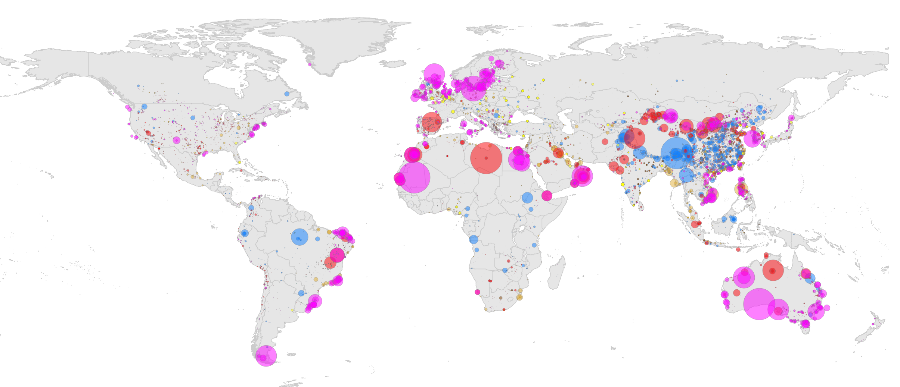
Let’s talk electricity before we go
Planned Electricity Generation Sites – All Sources
Underlying data source: Global Energy Monitor (https://globalenergymonitor.org/)
Notes:
These are individual electricity generation sites. For the Interconnection Index, we have aggregated total generation in GW by metro. Based on distance radius from the city center.

Slide 41
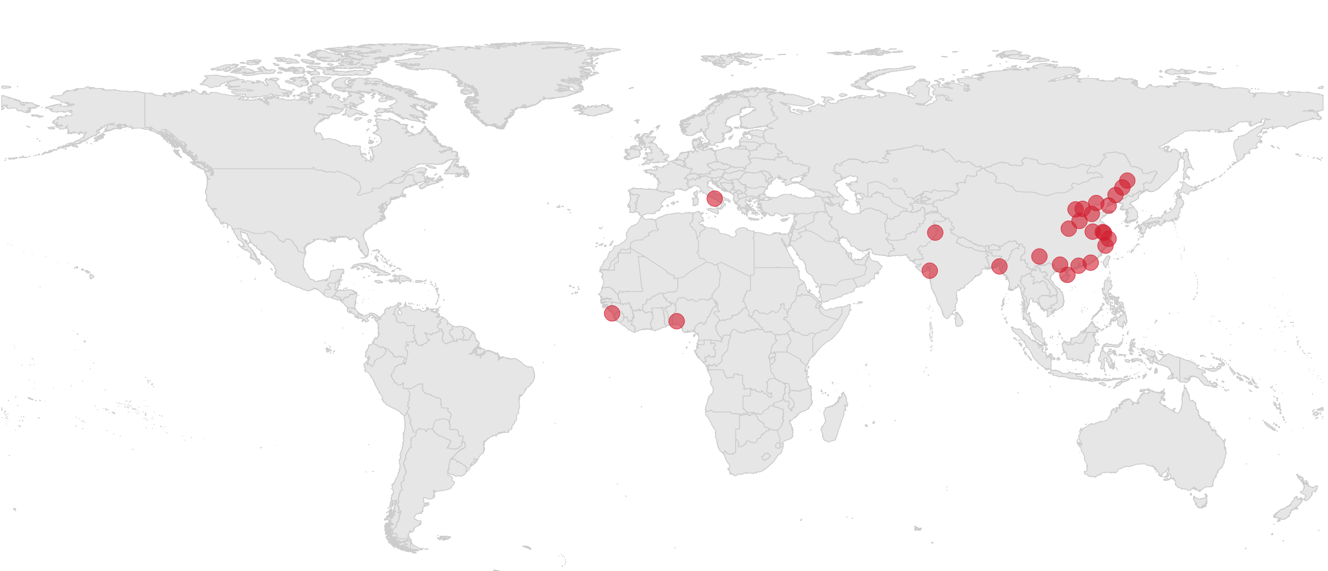
Underserved cities?
Top Cities with Highest Potential : Current Score Ratio
Notes:
Chinese cities are unreachable by most of the companies you represent.
But lots outside China – this is just the top 25
Why China? Huge population, large electricity generation base, lots of mobile subscribers, and really poor connectivity as measured by quantity of peers. Few cloud on-ramps and multi-tenant data centers here. Served by a much more top-down structure.
Naples Italy made the list! Probably served by Rome.
Africa: Conakry Guinea and Ibadan Nigeria (3rd largest city in Nigeria)

Slide 42
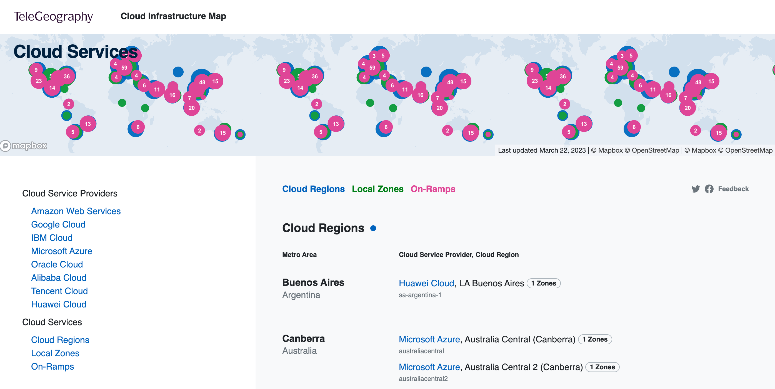
Have you seen the Cloud Infrastructure Map yet?
https://www.cloudinfrastructuremap.com
https://www.submarinecablemap.com
(yeah, you know this one)

Slide 43
Patrick Christian
pchristian@telegeography.com

