Slide 1
MAPS - and the Enterprises
(MAPS = Microsoft Azure Peering Service)
GPF 2024 – San Juan, Puerto Rico
Bernd Spiess

Slide 2
About myself: Bernd Spiess
in IT since 30+ Years
loves Peering
Favorite book: “The Internet Peering Playbook”
Works for DE-CIX (Presales & Consulting => Peering Team)
Please connect me at:
https://www.linkedin.com/in/bernd-spiess/

Slide 3
DE-CIX at a glance – the largest carrier & data center neutral interconnection ecosystem in the world
45
internet & cloud
exchanges
600+
cities
50+
cloud partners
1,000+
data centers
3,000+
connected networks
119+
Tbit capacity
North America (x5)
  Chicago, Dallas, New York,
  Phoenix, Richmond
Asia Pacific (x9)
  Brunei, Chennai, Delhi, Kuala Lumpur, Kolkata, Johor Bahru, Manila, Mumbai, Singapore
EMEA (x31)
  Aqaba, Athens, Baghdad, Barcelona, Berlin, Bucharest, Copenhagen, Dubai, Dusseldorf, Esbjerg, Frankfurt, Hamburg, Helsinki, Istanbul, Kinshasa, Kristiansand, Lagos, Leipzig, Lisbon, Madrid, Marseille, Munich, Oslo, Palermo, Prague, Ruhr region, Sofia, Tripoli, Warsaw

Slide 4
Part 2 - MAPS
MAPS means: Microsoft Azure Peering Service
Targeting: Enterprises
Hint: no, it is not about Azure
but first let´s go back 1 step…

Slide 5
Part 1 – the Enterprises
Theory:
“Todays Internet needs of an Enterprise are far more complex than a standard Business Internet Access is able to deliver.”
?

Slide 6
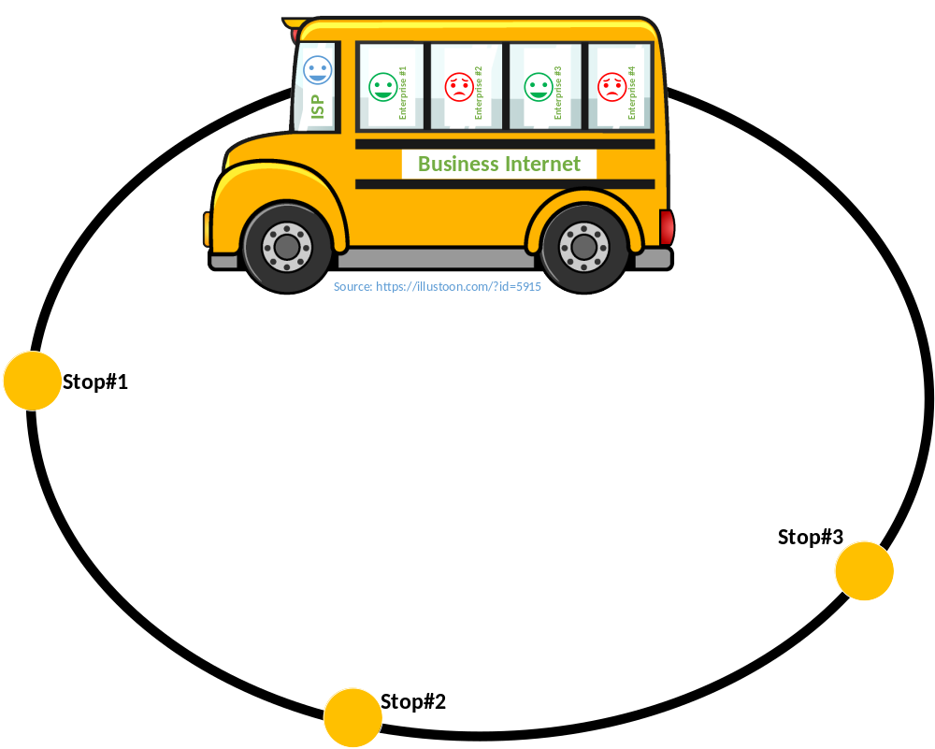
The Question:
75.000 Stops (ASN) = n
1 Driver (ISP)
m Passengers
(Enterprises)
How to manage n potential stops for m different passengers?

Slide 7
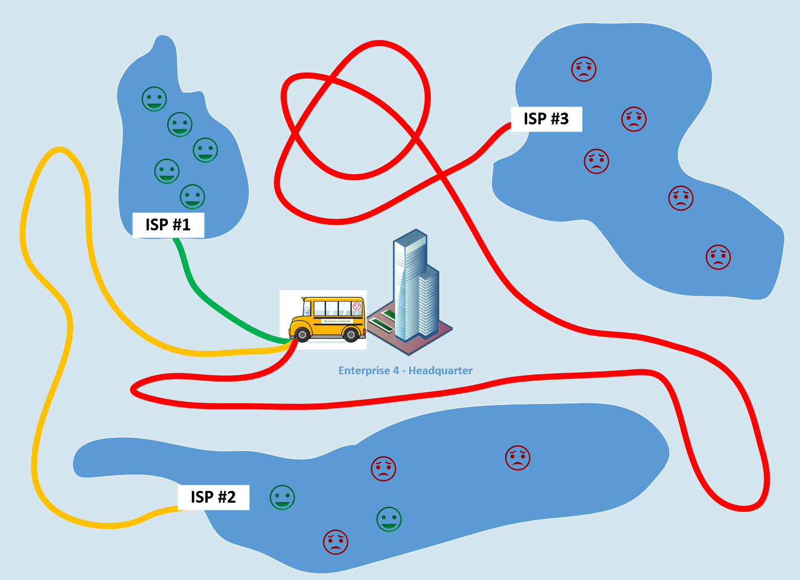
The “new”
Home Office
Challenge:
How does Enterprise #4 reach these 3 Eyeball ASN where their staff is sitting in the home office with VPN & Enterprise IT remote?

Slide 8
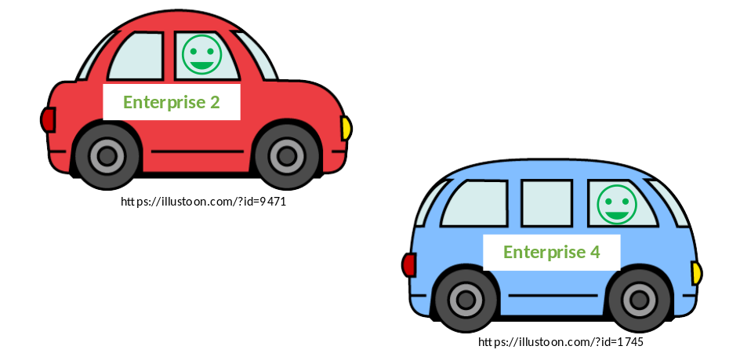
The new Reality:
Still driving public transport
But:
They bought a car (Router)
Got a driving license (ASN)
Drive some important destinations/shortcuts themselves
Solved their route problems = no waiting, no passenger drops
Enterprises are coming to the IXP

Slide 9
Putting the MAPS topic into the scene …

Slide 10
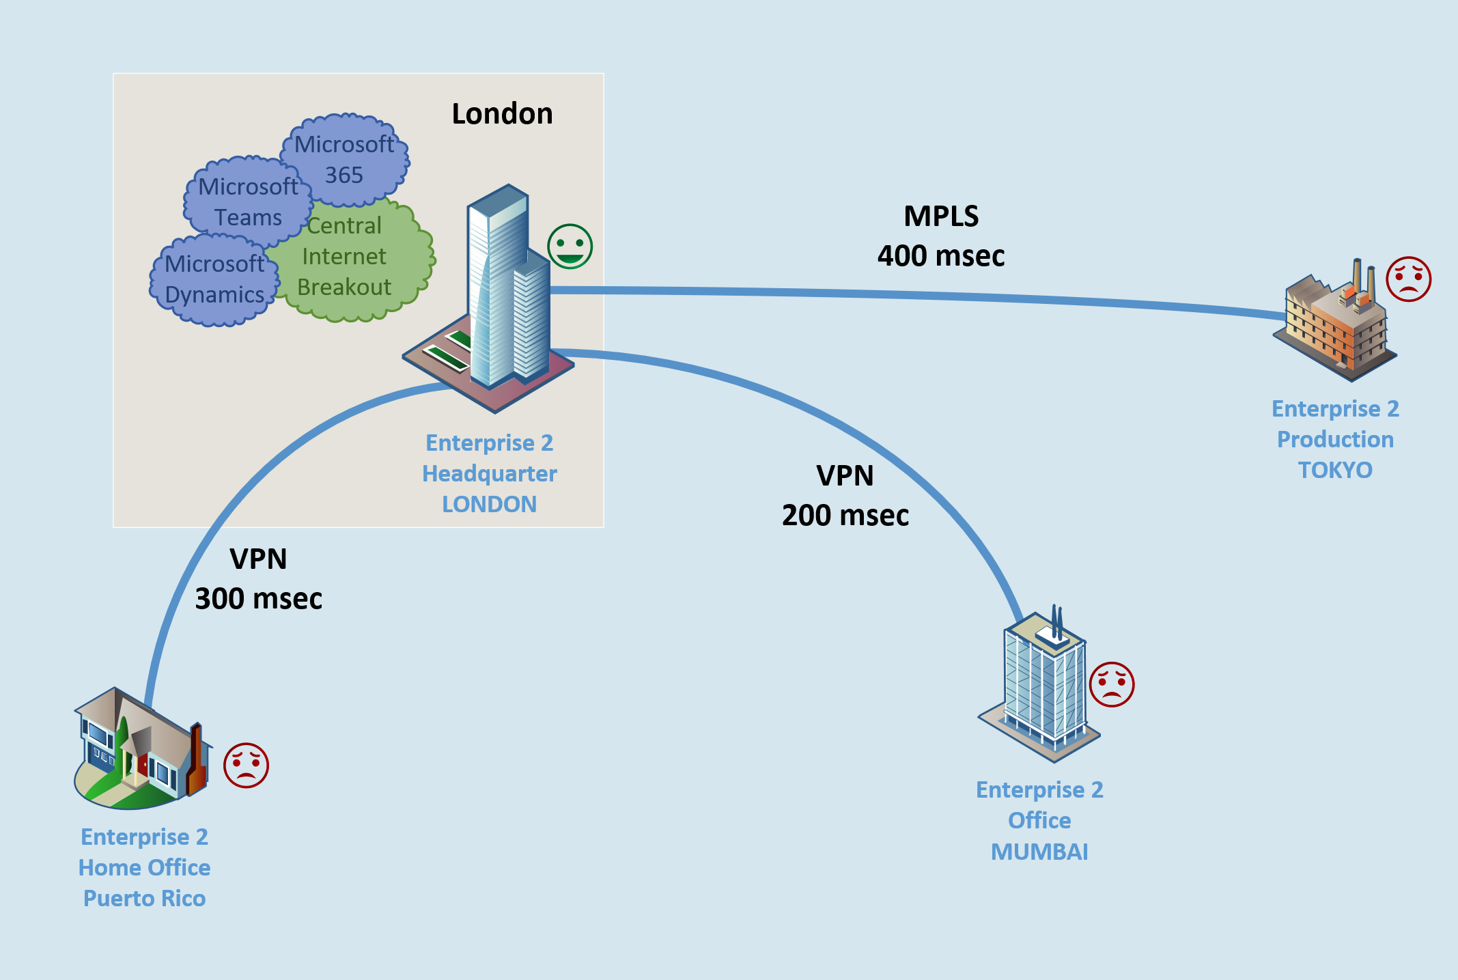
A historic
Enterprise
Challenge
HQ-Central Internet Breakout is a global latency troublemaker.

Slide 11
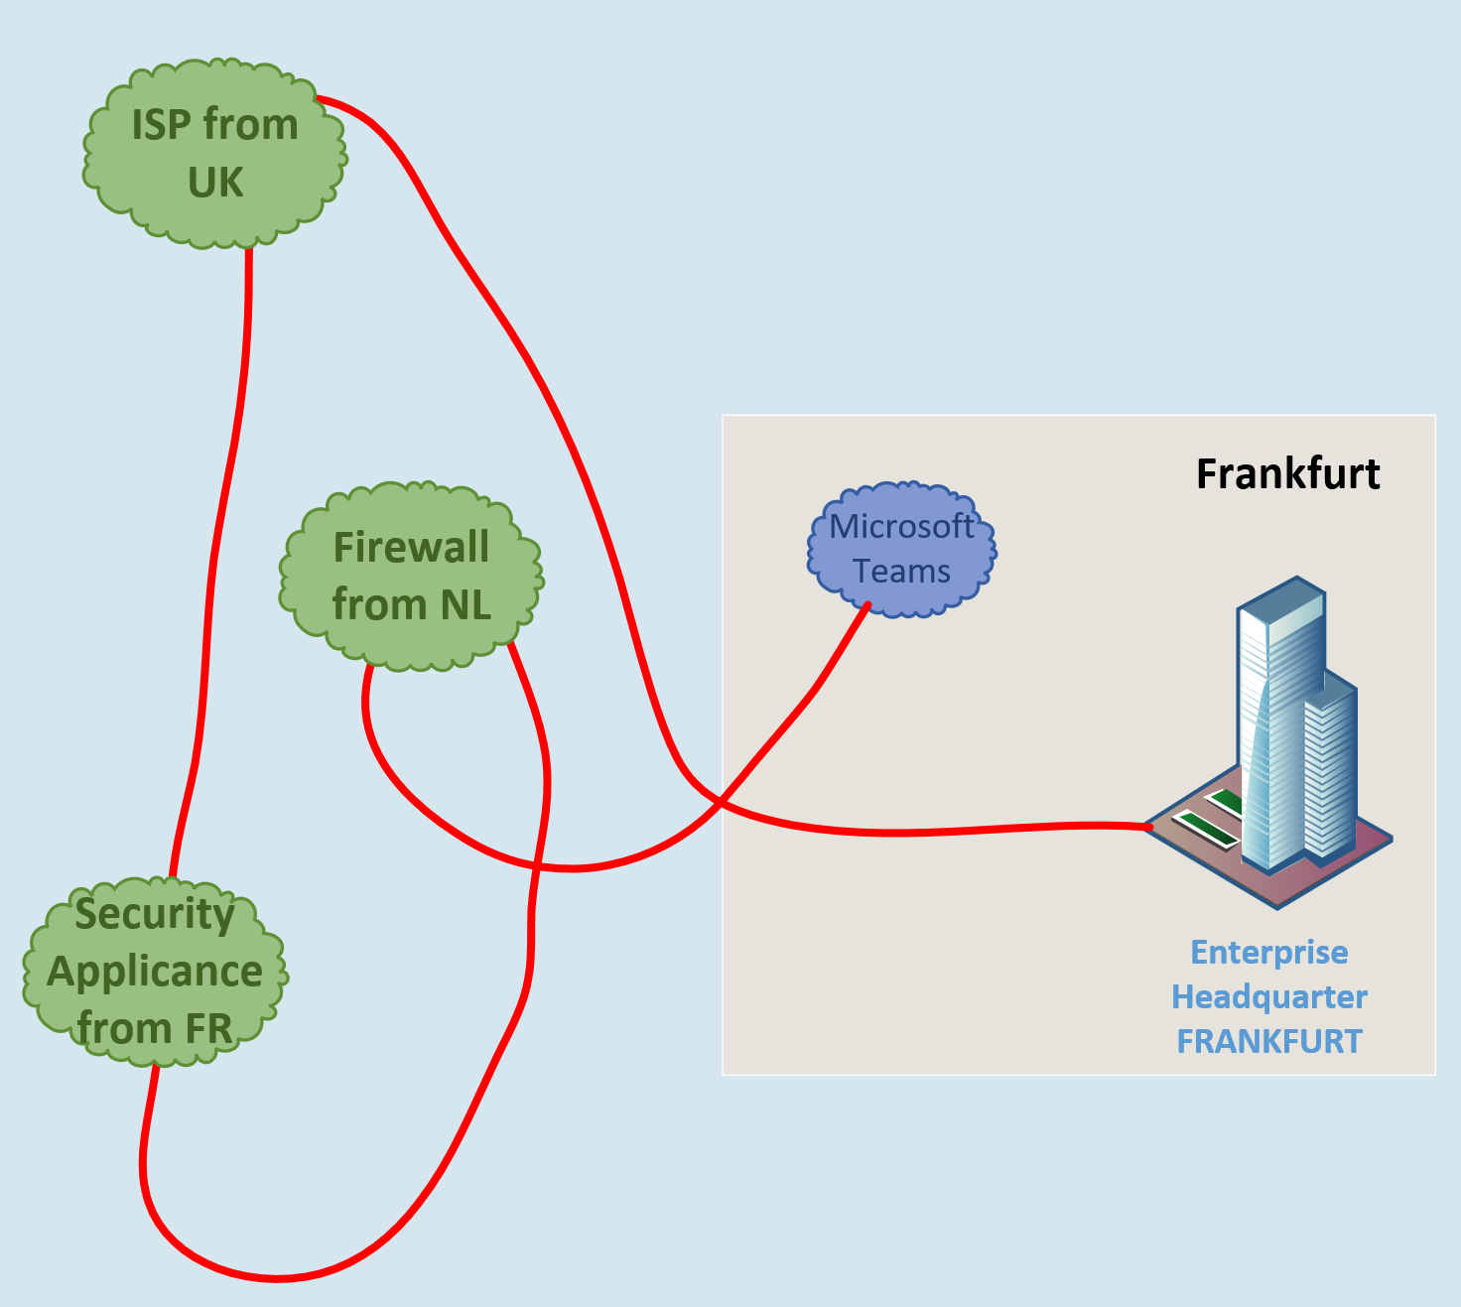
The “funny”
Delay Stacking
Game
Enterprise Internet Setup is a compromise of various things.

Slide 12
Summarizing Some Enterprise Challenges
Applications demanding (Ultra-) Low Latencies
Global Stretch of the Enterprise Network
Whatever Cloud to be used
Home Office Users in whatever ISP´s networks
Real Redundancies (Multihoming)

Slide 13
So, the enterprise now comes to the IXP … what now?

Slide 14
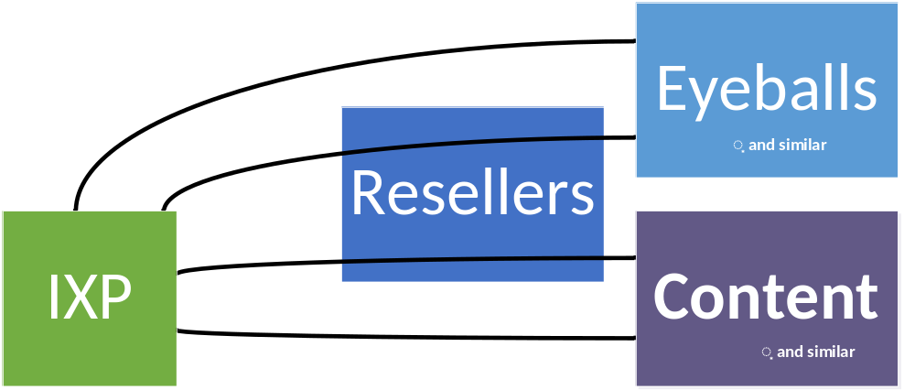
The simple old world of IXPs

Slide 15
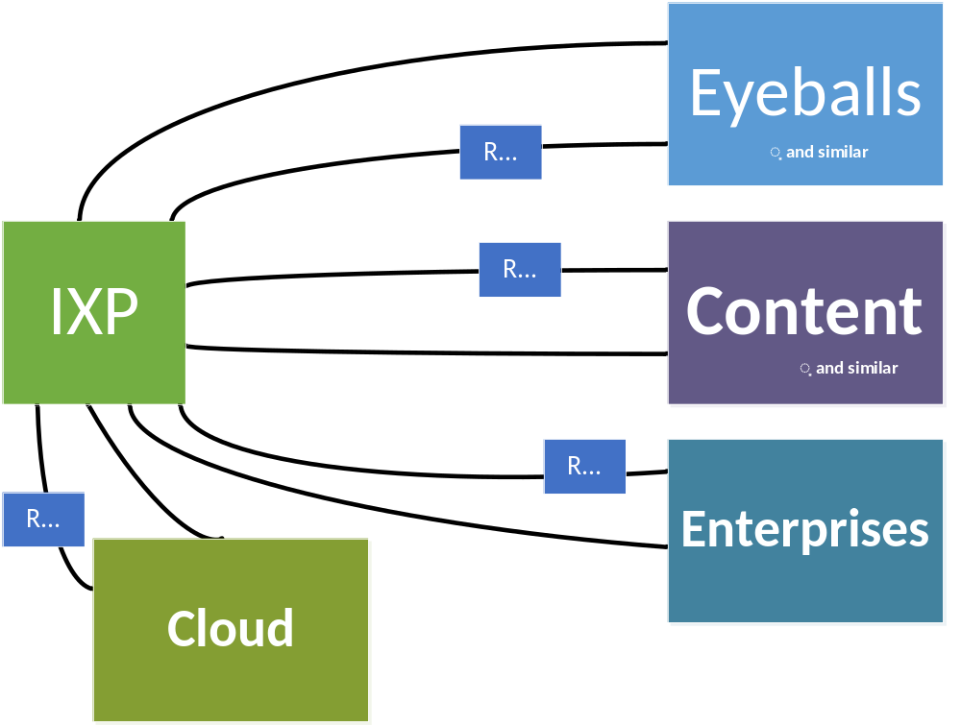
The new world at IXPs

Slide 16
Some Thinkable Challenges
Old World |  | Enterprise
all clear | Doing, Setup | nothing is clear
all given | IP, ASN | “can I work with IPv4 of my ISP?”
defined | Peering Manager | what is a peering manager?
standard | Big Router | “What do you mean with two full tables?”
simple | SLA | End to End SLA!
emails a noc team | Random Session down | Full Escalation
a person | Implementation | Many Many Many Teams

Slide 17
Part 2 - MAPS

Slide 18
Some initial Statements:
Microsoft
does not recommend
IXP peering
for
Enterprise customers

Slide 19
Some initial Statements:
Enterprises
seeking IXP Peering
with Microsoft
will require an
exception approval
Notes:
https://learn.microsoft.com/en-us/azure/internet-peering/policy
24 x 7 NOC
10 GBps at the IXP
Upgrade when reaching 50%
Minimum Traffic of 500 MBps

Slide 20
Some initial Statements:
The Enterprises
do have an issue
if a Microsoft Peering Session at an IXP goes down
and they cannot call anyone!
Notes:
Microsoft Support is not there to help on peering questions – peering is not covered by a Microsoft Support Contract – peering is not covered by any SLA

Slide 21
Some initial Statements:
The Enterprises
always needs
an End-to-End SLA backed connection!

Slide 22
Some initial Statements:
Microsoft cannot help
an Enterprise
if the connection to them
is coming via a
random unknown Internet bridge!

Slide 23
Some initial Statements:
There is no
Telemetry Option
for the Enterprise
when not using MAPS.

Slide 24
Some initial Statements:
Microsoft wants to see
the Enterprise Users
in a RTT of max. 10 msec
to their next network edge!
(500 miles, 800 km)

Slide 25
MAPS - simplified
MAPS means:
you peer with Microsoft AS8075 global Network – all Prefixes

Slide 26
The 10 msec Distance Question:
Microsoft wants to see
the Enterprise Users
in a RTT of max. 10 msec
to their next network edge!
(500 miles, 800 km)
Notes:
https://learn.microsoft.com/en-us/skypeforbusiness/optimizing-your-network/media-quality-and-network-connectivity-performance

Slide 27
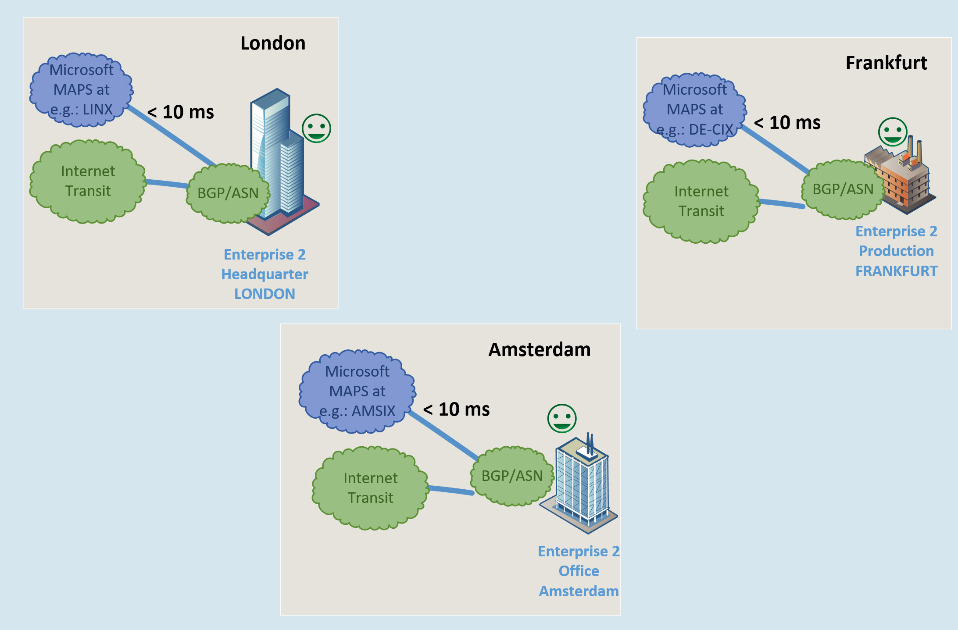
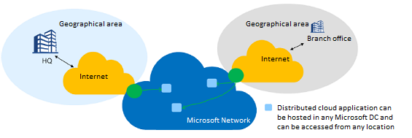
10ms – How?
Bring the different
geographical areas
of the enterprise
separately to the one
MAPS onramp which
is < 10 msec away!
https://learn.microsoft.com/en-us/azure/peering-service/about

Slide 28
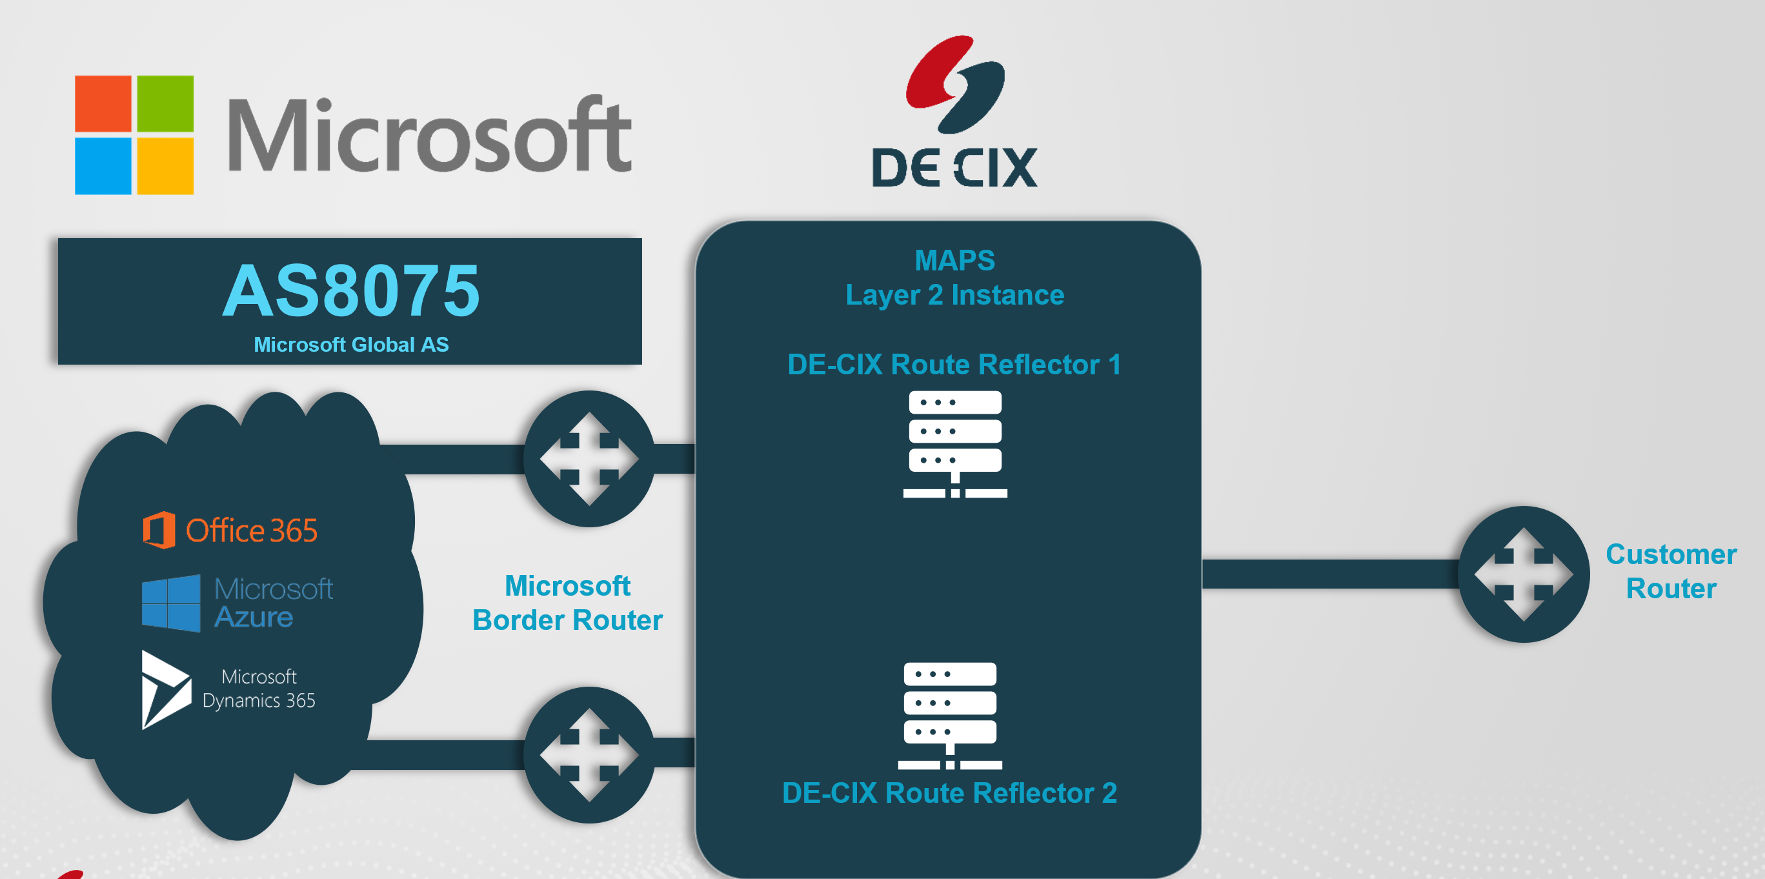
… an Important Setup Principle:
The IXP do have a capsulated peering fabric
There is a special routeserver setup
The routeserver pre-peers
already with Microsoft
The Enterprise peers with
the (transparent) routeserver.

Slide 29

… and the ISP Now Hates Us?
No …
This one delivers the Layer2
circuit from his customer to the
MAPS onramp – including SLA
… or: he is a MAPS partner himself

Slide 30
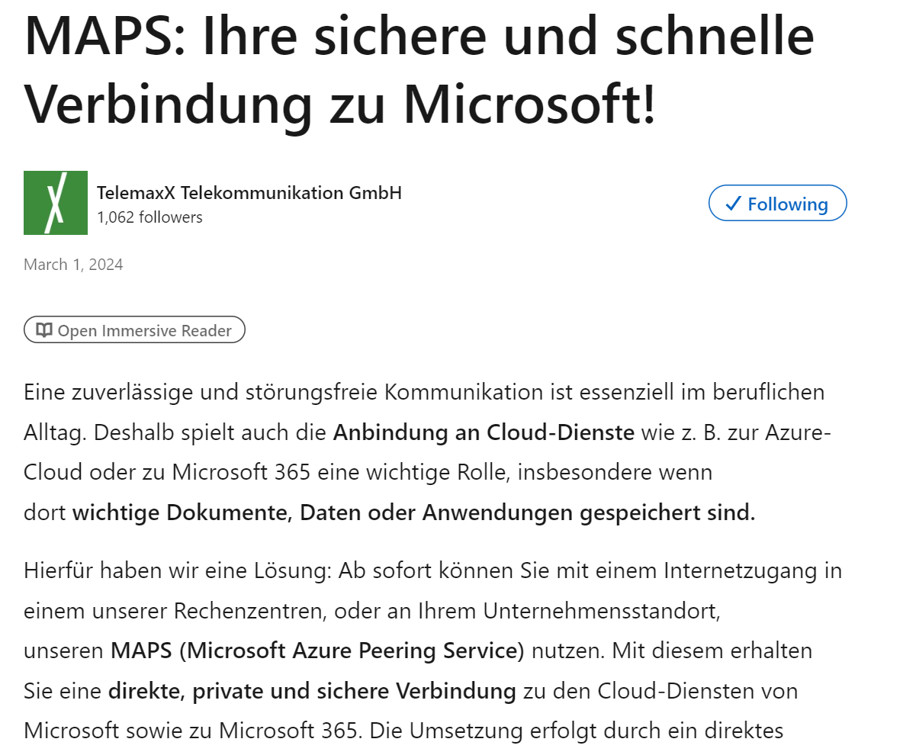
… and Where are the Resellers?
They have a ton of new options
for new services.
Not every Enterprise do have
BGP and ASN => Resellers world!

Slide 31
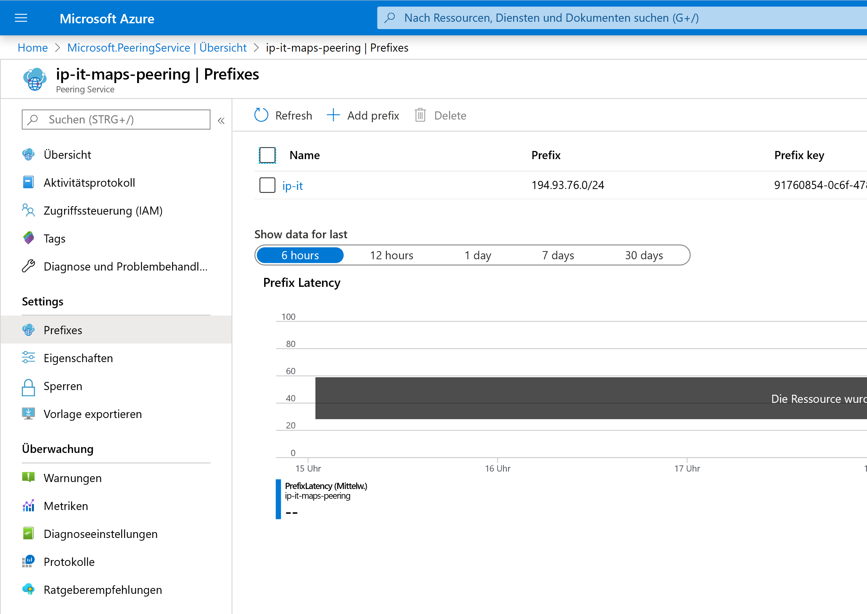
… the Telemetry Option?
Simply integrated in the
Azure Portal!
Reference RTT, Alerts etc…

Slide 32
How does it help the Enterprise?
The layer2 link will not change its latency!
The RTT/latency of the setup is predictable, contractable
All components do have End to End SLA
The Enterprise can call the IXP 24/7 about the peering from/to Microsoft; Microsoft tickets will find this setup!
Telemetry Dashboard in Azure Portal shows details.
DDOS safe (all separated)
No additional costs on Microsoft side for the Enterprise

Slide 33
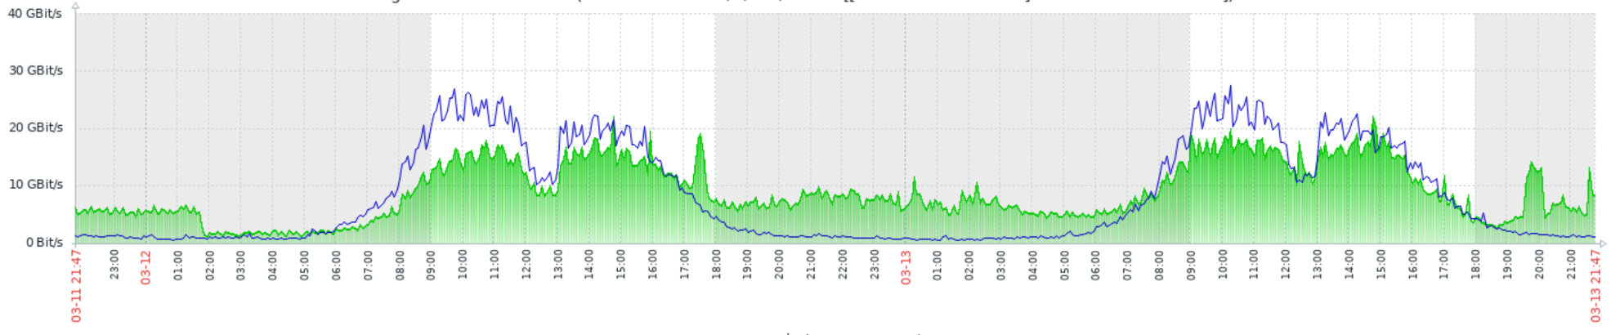
Example Graph
Lunch time
Event?
Event?
users start working
Night Jobs, Backup?, …

Slide 34
Redundancy?
In principle, all components are redundant (=SLA)
But: For the worst case:
As BGP is used, the fallback is the IP-BGP-Transit Setup
The Fallback Transit Provider should have a local IXP or PNI Peering with Microsoft too, this takes over meanwhile.
(no SLA, Telemetry will not see)

Slide 35
What Else? Beside MAPS for Enterprise:
Easy to combine with direct cloud options (via VLAN Trunk)
like AWS Cloud, Oracle Cloud, Google Cloud, MS-Expressroute, AliCloud, …

Slide 36
What Else? Beside MAPS for Enterprise:
Enterprise can peer with other typical important ASNs:
Finance ASN like Salesforce, SAP, Stock Exchange, Banks
Anti DDOS Specialists
Backup to the Cloud Networks
ISPs where their stuff do have the ISP-Access.

Slide 37
Some Customer Feedback:
5 msec instead of 50 msec (Hochtief)
Dramatic improvement of VPN stability
Stable reliable path
60% of traffic did go from transit to Peering/MAPS
Much cheaper than existing transit (non-EU)

Slide 38
Thank you for your attention!
Questions: bernd.spiess@de-cix.net
DE-CIX Management GmbH, Lindleystr. 12, 60314 Frankfurt, Germany
Phone + 49 69 1730 902 0, sales@de-cix.net, www.de-cix.net

