Slide 1
Global Peering Forum 2024
IXP Peering Personals
San Juan, Puerto Rico

Slide 2


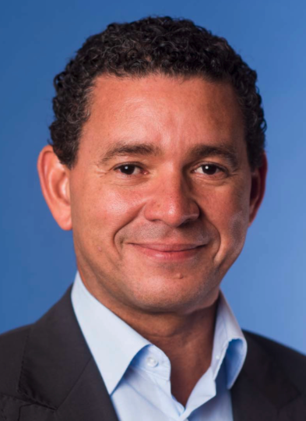
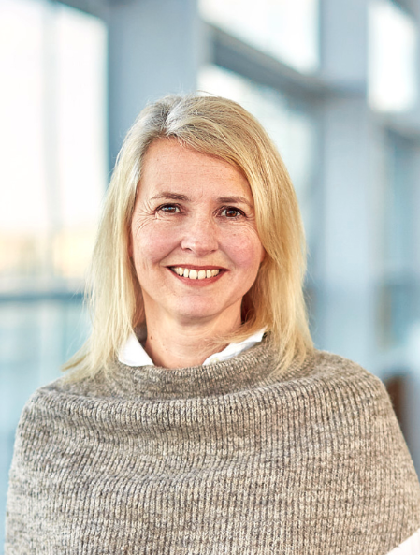
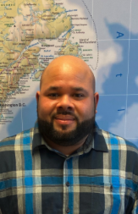
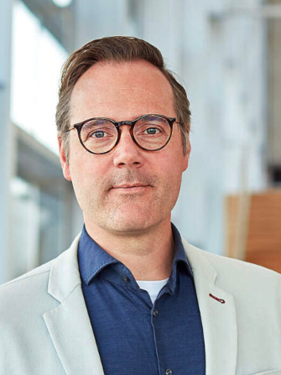
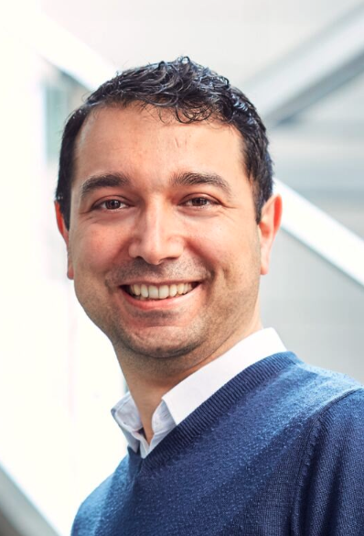
AMS-IX
IX Name | AMS-IX (AS1200)
City, Country | Amsterdam, Netherlands
Point of Presence | 16 PoPs in the Netherlands
# of connected ASN | +870
Peak traffic | +12 Tbps
Route Servers | Yes (BIRD)
RPKI | Yes
Contact | sales@ams-ix.net
Other independent international IXs around the world;
  North America: AMS-IX Chicago and AMS-IX Bay Area
  Latam: AMS-IX Caribbean (Curacao)
  Africa: EG-IX (Egypt), AMS-IX Lagos (Nigeria)
  Middle East: MN-IX (Bahrain)
  APAC: AMS-IX Hong Kong, AMS-IX Singapore, AMS-IX Bangkok, AMS-IX India (Mumbai, Hyderabad, Kolkata), irix (Malaysia)
Coming soon;
  Middle East: Oman-IX (Oman)
  Africa: AMS-IX Djibouti
  APAC: AMS-IX Manila (Philippines)
Wouter Ensing
Nico Scheper
Petra Wensing
Rony de Jesus
Ruben v.d. Brink
Emrah Yorulmaz

Slide 3


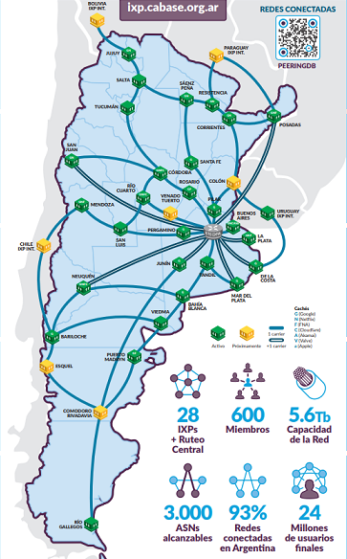

AR-IX CABASE
IX Name | AR-IX CABASE - ASN 52376 | Camara Argentina de Internet
City, Country | Buenos Aires + 28 IX locations | ARGENTINA
Point of Presence | Buenos Aires (Ciudad Autónoma) Buenos Aires Norte (Pilar) Rosario, Neuquén, Bahía Blanca, Mendoza, Santa Fe, Córdoba, Partido de La Costa, La Plata, Mar del Plata, Posadas, Bariloche, Puerto Madryn, | Junín, San Luis, Tucumán, Pergamino, Sáenz Peña (Chaco), Jujuy, Salta, Tandil, Resistencia, San Juan, Viedma, Río Gallegos, Río Cuarto y Corrientes SyT datacenter (PAT) Linkear datacenter (PAT)
# of connected ASN | 3.000 reachable ASNs | 600 members
Peak traffic | 3.500 Gbps | www.peeringdb.com/ix/3788
Route Servers | Yes (FRR)
RPKI | Yes
Contact | HERNAN SEOANE www.cabase.org.ar hernan.seoane@cabase.org.ar
24 MM reachable End Users
One big LAN – All IXs interconnected
Non profit Organization

Slide 4

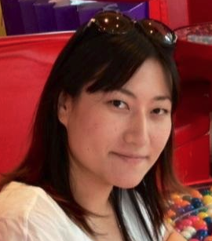


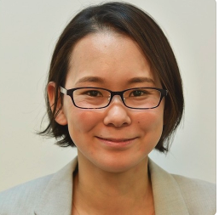

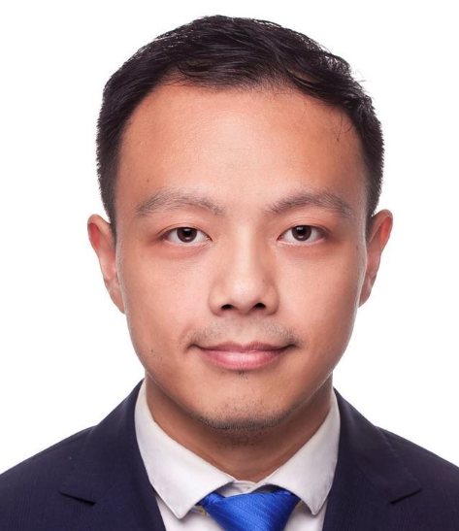
BBIX
AS23640
IXP Name/s | BBIX Tokyo | BBIX Osaka | BBIX Fukuoka | BBIX Singapore | BBIX Hong Kong | BBIX Thailand | BBIX USA | BBIX Europe | BBIX Philippines
Location | Tokyo Sendai Okinawa | Osaka | Fukuoka | Singapore | Hong Kong | Bangkok | LA, Chicago Dallas, Miami San Jose | Amsterdam London Marseille | Malina
POP | ・NTT Data Otemachi ・Digital Edge TYO2 (ComSpace 1) ・Equinix TY2/TY4 ・AT TOKYO CC1 ・Softbank Maruyama CLS ・NTT Communications Nexcenter ・Colt DCS Tokyo Shiohama DC/ Inzai 1 DC ・SCSK nexTDC Chiba Center ・Softbank Tokyo No.4 Data Center ・TOHKnet Sendai Central Data Center ・FRT Data Center (iDC) | ・NTT Data Dojima ・Equinix OS1 ・Equinix OS3 ・NTT SmartConect Dojima ・AT TOKYO DC12 ・Sonezaki Data Center ・ Digital Edge OSA1 | ・QTnet Fukuoka No.3 Data Center ・AT TOKYO QC1 | ・Equinix SG1 ・Equinix SG5 ・Global Switch ・STT Singapore 5 | ・Mega-i ・Equinix HK1 | ・True IDC North Muang Thong ・NT Bangrak Tower ・NTT Bangko 1 Data Center ・Telehouse Bangkok (New) | ・Coresite LA1 ・Equinix SV5 ・Equinix CH1 ・Equinix DA6 ・Equinix MI1 | ・Digital Realty AMS9 ・Telehouse Dockland North2 ・Digital Realty MRS2 ・Smartdc Rotterdam （New） | ・ePLDT VITRO Makati 2 ・ePLDT VITRO Makati 1 ・ePLDT VITRO Pasig ・Globe Data Center (MK2) ・Total Information Management Corp. Carmona ・Digital Edge MNL1 (NARRA1) ・Globe Data Center （QC2) （New）
# of ASNs | Total 400+
Peak Traffic | Total 7.83T+
Route Servers | YES (BIRD) |  |  |  |  |  |  |  | YES(Cisco)
RPKI | NO (Will deploy soon)
Contact | bbix-sales@bbix.net
Iku Lisa Araki Hama Kikuchi Liyu

Slide 5

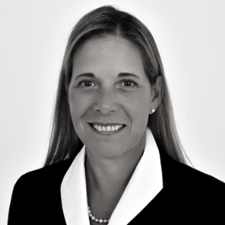



DE-CIX North America
IX Name | DE-CIX New York | DE-CIX Dallas | DE-CIX Chicago | DE-CIX Phoenix | DE-CIX Richmond
Point of Presence | 165 Halsey MMR DataBank LGA1/2 CoreSite NY1/NY2 DRT 60 Hudson, 111 8th, 32 AoA Equinix Secaucus NYI 60 Hudson H5 325 Hudson QTS Piscataway Iron Mountain NJ Telehouse Chelsea, Teleport Sabey 375 Pearl 1025Connect | Cologix DAL1 Cologix DAL2 DataBank DFW1 DataBank DFW5 DRT 2323 Bryan Equinix DA1,3,6,11 Evocative DA4 Flexential DAL01 Aligned DFW-01 CyrusOne Carrolton QTS Fort Worth QTS Irving | CoreSite CH1 CoreSite CH2 DRT CH1 Equinix CH1,2,4 DRT CH2 NYI 800 Jorie QTS CH1 365 CH6 CyrusOne Aurora Cyxtera ORD1 ServerCentral CH1 Equinix CH3 | PhoenixNAP EdgeConneX DRT 120 E Van Buren Iron Mountain AZP-1 Aligned PHX1 Flexential PHX01 | Pixel Factory EdgeConneX QTS RIC1
# of ASN | 255 (+4 connecting) | 135 (+14 connecting) | 43 (+9 connecting) | 24 (+6 connecting) | 21
Peak traffic | 1.66 Tbit/s | 1.01 Tbit/s | 83.4 Gbit/s | 43.8 Gbit/s | 15.6 Gbit/s
Route Servers | Yes, DE-CIX operates two redundant v4 and two redundant v6 route servers at each of its Internet Exchanges. The detailed route server guides for our locations are linked on our website and PeeringDB. | Yes
RPKI | Yes, DE-CIX deployed RPKI in 2019 - https://www.de-cix.net/en/resources/service-information/route-server-guides/rpki
Contact | Ed d’Agostino - VP North America – Market Lead Central ed.dagostino@de-cix.net Kendra Pignotti - Regional Director Strategic Partners, kendra.pignotti@de-cix.net Zach Jones – Market Lead, East, zach.jones@de-cix.net Hector Calderon – Market Lead, West, hector.calderon@de-cix.net
Recent updates
  DE-CIX Chicago secures commitments from Google Fiber, Starlink, US Internet, and NineStar.
  DE-CIX Phoenix secures Google Fiber, Gila River, Starlink & Sun Corridor Network, comprised of: ASU, U of A, NAU.
Kendra
Zach
Hector
Ed

Slide 6

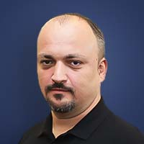
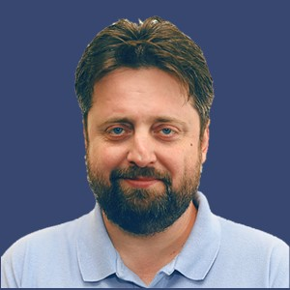
InterLAN-IX
IX Name | InterLAN-IX
City, Country | Bucharest, Romania
Points of Presence | NXDATA-1 Bucharest NXDATA-2 Bucharest iNES Datacenter Bucharest Voxility IRD Bucharest M247 Europe Bucharest Teletrans HB Bucharest Radiocom Bucharest Massive Telecom Bucharest | CobraNET Arad CIA Cluj-Napoca Top Telecom Iasi Universitatea Politehnica Timisoara Teletrans Craiova Teletrans Constanta Teletrans Suceava Equinix FR5 Frankfurt
# of connected ASN | 135
Peak traffic | 600 Gbps
Route Servers | Yes (BIRD v2)
RPKI | Yes (MANRS)
Contact | Eric Andrei Băleanu eric.baleanu@interlan.ro Adrian Călineață adrian.calineata@interlan.ro
Recent updates
  Upgrading main POPs in Bucharest and Frankfurt to Nokia routers
  New POP project in Sofia, Bulgaria to be opened in 2024
Peering Persons
Eric
Adrian

Slide 7

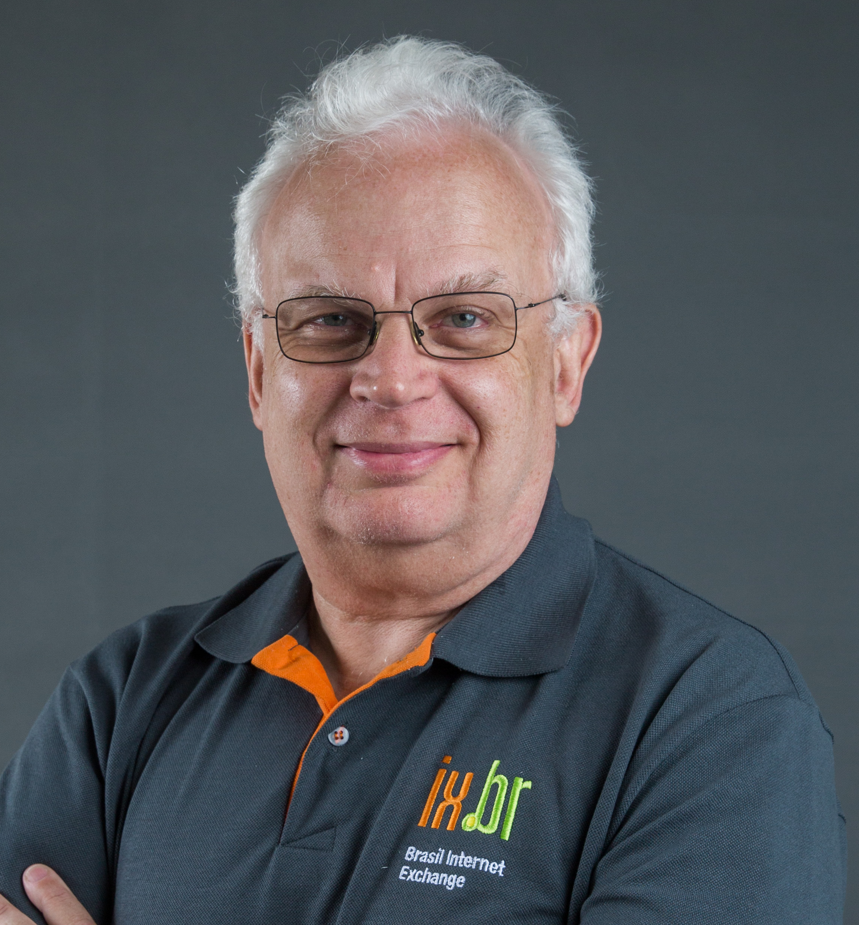
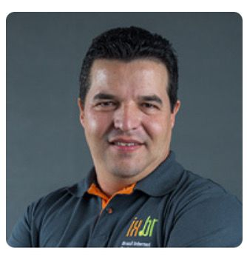


IX.br
IX Name | IX.br São Paulo | 35 IX.br IXP in other Brazilian cities
City, Country | São Paulo | Fortaleza, Rio de Janeiro, etc
Point of Presence | 30 datacenters in São Paulo metropolitan area https://www.ix.br/adesao/sp | https://www.ix.br/localidades/atuais
# of connected ASN | 2,747 | 4,075
Peak traffic | 23,5 Tbps | 12 Tbps
Route Servers | Yes (BIRD) | Yes (BIRD)
RPKI | Yes | Yes
Contact | info@ix.br
Peering Persons
Recent updates
  6 x 400G ports in use by 4 participants
  Start of offering 100G-LR1 in many IXPs
  Fortaleza is now the 2nd largest IXP in Brazil (5 Tbps / 779 ASN)
Julio
Antonio

Slide 8
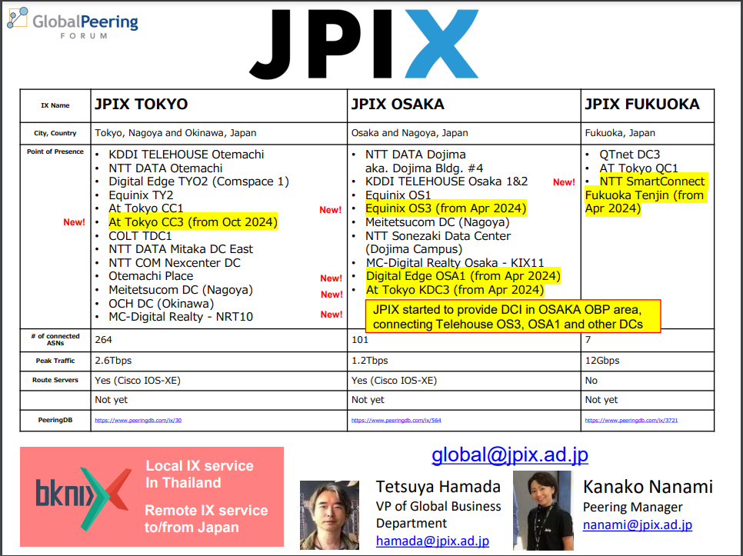

Slide 9

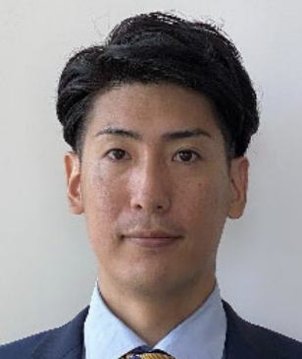

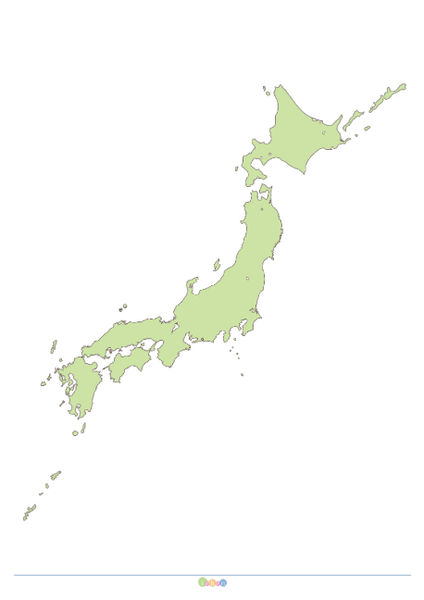
JPNAP
IX Name | JPNAP Tokyo | JPNAP Osaka | JPNAP Fukuoka | JPNAP Sapporo/Sendai
City, Country | Tokyo, Japan | Osaka, Japan | Fukuoka, Japan | Sapporo, Japan Sendai, Japan
Point of Presence | NTTCom TK1/TK7 IIJ Ikebukuro AT Tokyo CC1/CC3 BBT New Otemachi Colt DCS Shiohama Digital Edge CS1 Equinix TY2/TY4 --------------------- IIJ Shiroi DC SCSK netXDC Inzai MC Digital Realty NRT campus | NTT Dojima (#4, #3, #1) NTT Sonezaki Equinix OS1/OS3 Digital Edge OSA1 --------------------- NTTCom OS7 MC Digital Realty KIX campus | QTnet DC#3 AT Tokyo QC1 | (Sapporo area) NTT EAST Hokkaido DC (Sendai area) NTT EAST Miyagi DC
AS | 212 | 91 | 12 | Coming soon
Peak traffic | 4.66T | 2.26T | 108G | Coming soon
Route Servers | Yes (BIRD2.0)
RPKI | Yes (ROV at route servers)
Contact info | info@mfeed.ad.jp / toyama@mfeed.ad.jp
Sapporo
The total peak traffic is 6.96Tbps
New JPNAP has been launched in Sapporo (Oct. 2023)
Remote peering to JPNAP Tokyo is available by several resellers:
IPTP, PCCW, Epsilon, Megaport, and NTT group companies.
Location: Singapore, Hong Kong, Jakarta, Bangkok, and so on
Sendai
Rei
toyama
Tokyo
Osaka
Fukuoka

Slide 10

London Internet Exchange (LINX)
IX Name | LINX | LINX NoVA | LINX Nairobi (New)
ASN | 5459 | 21919 | 37732
City, Country | UK | USA | Kenya
Points of Presence | London – LON1 & LON2 Manchester Scotland Wales | Reston Ashburn Manassas | Nairobi
Traffic profile | Access/ CDNs / Gaming/ Media/ Finance/ Cloud/ Enterprise/ Telco | Access/ CDNs/ Telco/ Enterprise/ Gaming | ISPs CDNs coming soon!
Traffic Volume All time max | LON1 - 7.646 Tbps LON2 – 985.719 Gbps | 95.102 Gbps | -
Peering Policy | Open/ Closed/ Selective
PeeringDB entry | https://www.peeringdb.com/net/578 | https://www.peeringdb.com/ix/777 | https://www.peeringdb.com/ix/4231
Contact information | Inga Turner Senior Peering Advisor at LINX Inga@linx.net

Slide 11


City, Country | London, UK
Point of Presence | Telehouse Equinix DRT
# of connected ASN | > 270
Peak traffic | 1.5 Tbps
Route Servers | Yes (BIRD x 2)
RPKI | Yes
Contact | sales@lonap.net

Slide 12

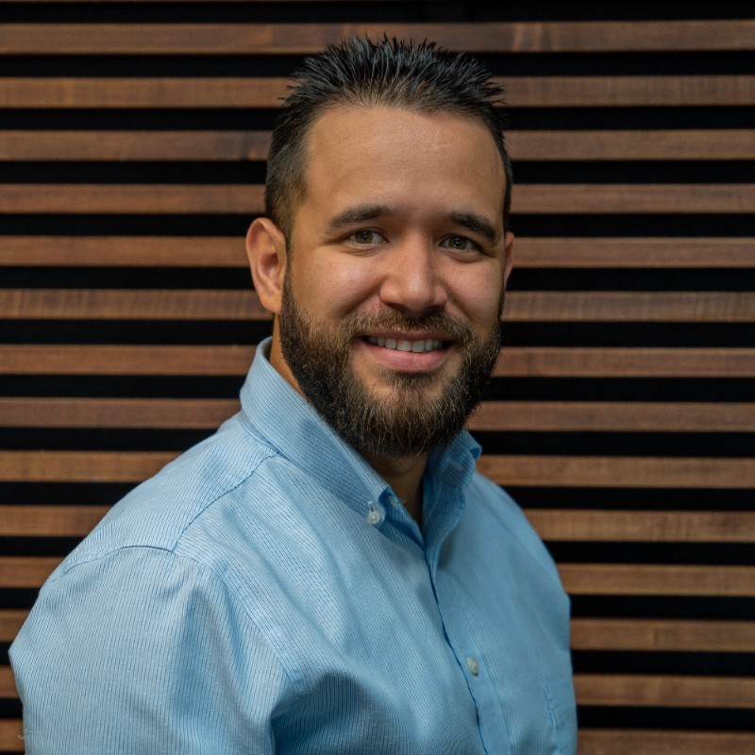
MEX-IX
IX Name | MEX-IX McAllen | MEX-IX El Paso
City, Country | McAllen, Texas, US | El Paso, Texas, US
Point of Presence | MDC McAllen | MDC El Paso
# of connected ASN | 15 | 4
Peak traffic | 296 Gbps | 1 Gbps
Route Servers | Yes | Yes
RPKI | Yes | Yes
Contact | peering@mdcdatacenters.com jap@mdcdatacenters.com
Peering Persons
Recent updates
  Reached first gig in new MEX-IX in El Paso
  Upcoming location in San Diego, CA
Joel

Slide 13


MorePeering
IX Name | Los Angeles
City, Country | Los Angeles, US
Points of Presence | 600 W 7th (Equinix LA1) 818 W 7th (Equinix LA2) 530 W 6th (Morlin & Quadranet) More PoPs coming this summer!
# of connected ASNs | 0 (We’re brand new!)
Peak traffic | ∞
Route Servers | Yes (BIRD)
RPKI | Yes
Contact | peering@morepeering.net Chris Rogers <chris@morepeering.net>
Updates:
We’re going live in 2 weeks!
Peering People:
Chris

Slide 14

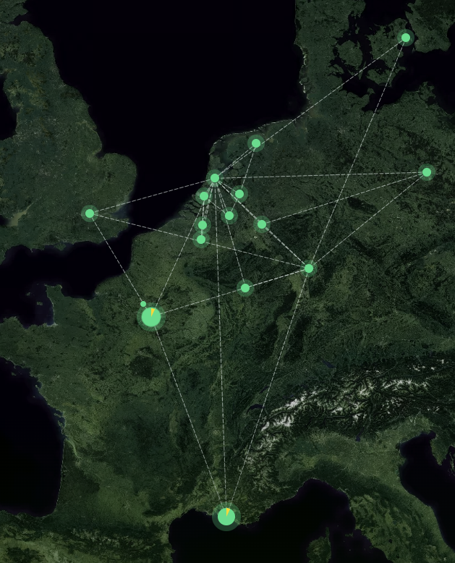

NL-ix
IX Name | NL-ix
City, Country | Major cities western Europe NL, DE, UK, FR, DK, BE, LU, IR
Point of Presence | 100 Pop’s inEurope, 1 peering vlan Marseille to Copenhagen London to Berlin core pops Amsterdam and Frankfurt; Equinix & Digital Realty, Nikhef
# of connected ASN | 660 networks
Peak traffic | 8 Tbps
Route Servers | Yes (BIRD )
RPKI | Yes
Contact | vinnie@nl-ix.net kevin@nl-ix.net
Peering Persons
Recent updates
  Dublin connected
  Launching City IX Frankfurt
Vinnie
Kevin

Slide 15


NYIIX
IX Name | NYIIX-NY | NYIIX-LA
City, Country | New York, NY | Los Angeles, CA
Point of Presence | 32 Ave of the Americas, NYC 60 Hudson st, NYC 7 Teleport drive, NYC 85 10th ave, NYC 111 8th ave, NYC 165 Halsey st, NJ 275 Hartz Way, NJ 401 N. Broad st, PA | 626 Wilshire Los Angeles, CA 624 S. Grand ave Los Angeles, CA
# of connected ASN | 214 | 38
Peak traffic | 1.72T | 15G
Route Servers | Yes (BIRD 2.0) | Yes (BIRD 2.0)
RPKI | Yes | Yes
Contact | iixeng@telehouse.com iixsales@telehouse.com
Recent updates
    NYIIX is live at Equinix 275 Hartz Way in Secaucus, New Jersey
Akio Sugeno

Slide 16



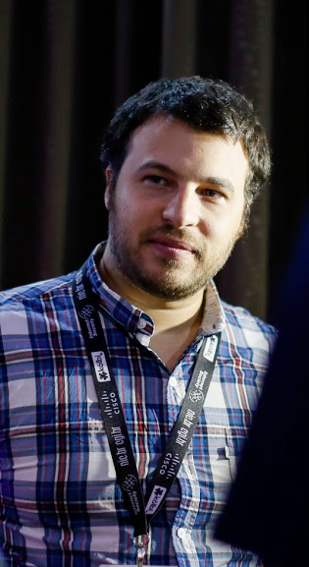
PIT
IX Name | PIT Chile AS61522 | PIT Mexico AS61525
City, Country | Santiago, Chile | Queretaro, Mexico
Point of Presence | 13 POPs over Metropolitan region | KIO Queretaro (QRO1) Equinix (MX1) Coming up!
# of connected ASN | 149 | 20
Peak traffic | 16 Tbps | 600 Gbps
Route Servers | Yes (BIRD) | Yes (BIRD)
RPKI | Yes | Yes
Contact | info@p-i-t.net
Peering Persons

Slide 17
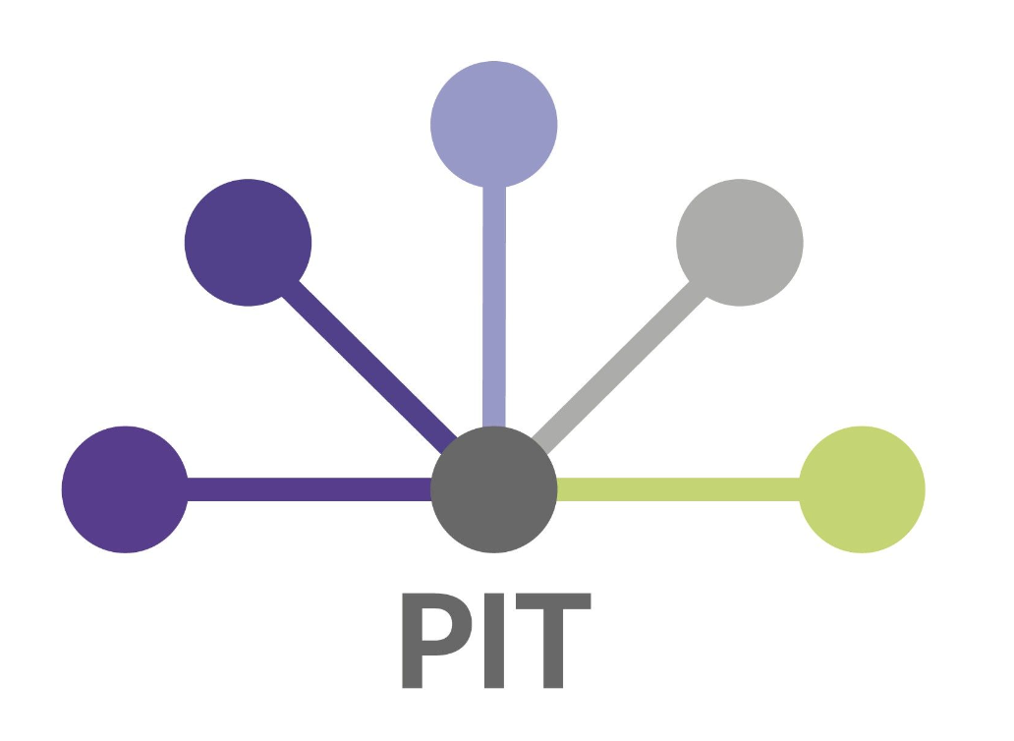

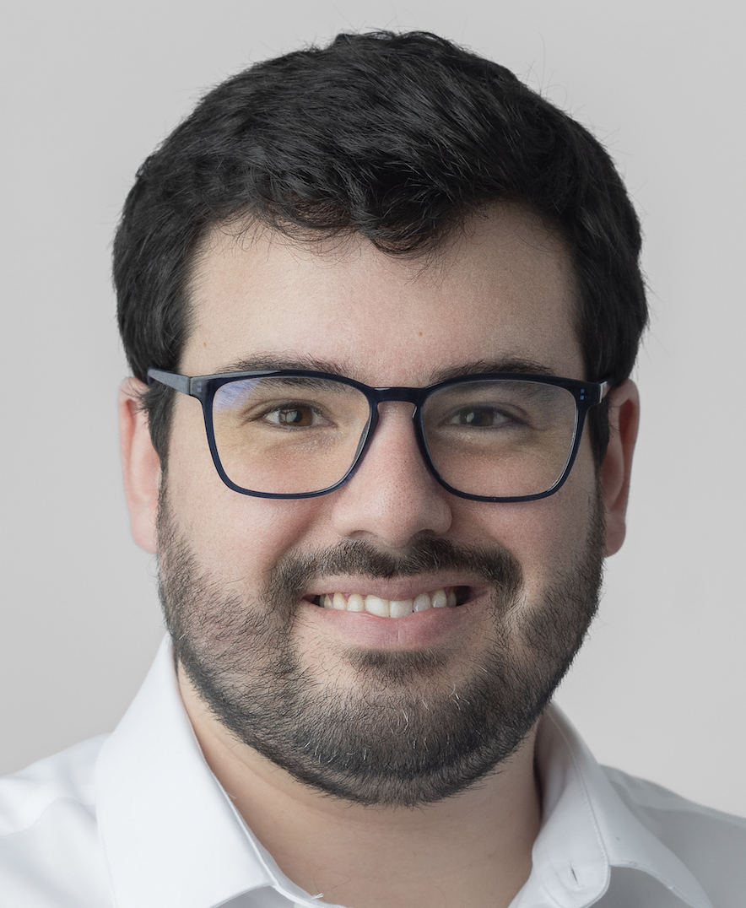
PIT
IX Name | PIT – Peru (aka Perú IX) | PIT - Colombia | PIT - Guatemala | PIT - Ecuador | PIT - Panama
City, Country | Lima, Arequipa, Trujillo, Chiclayo, Piura, Cuzco, | Bogota, Medellin, Barranquilla, Cali, Bucaramanga, Cucuta | Guatemala City | Quito, Guayaquil | Panama City
Point of Presence | Equinix, GTD, Cirion, Telxius, Optical and 20 + PoPs | Bogota: Equinix BG1, BG2, ODATA, Liberty, EdgeUno and 10 + PoPs | KIO and 5 others PoPs in the city | EdgeUno, Cirion, UFINET | PDG, KIO
# of ASNs connected | 90+ | 35+ | 28 | 5 | Just started
Peak traffic | 3 Tbps | 650 Gbps | 280 Gbps | < 100 Gbps
Route Servers | Yes (BIRD)
RPKI | Yes
Contact | salvador@pit.net, +51 947 145 352
Recent updates
  400GbE ports now available in some locations ☺
  Launching PIT Panama
Peering Persons
Salvador

Slide 18



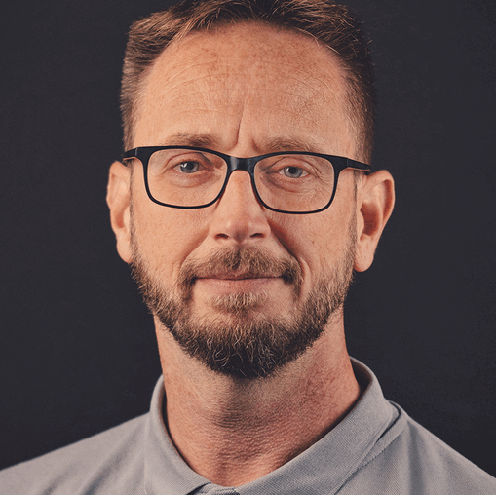
IX Name | SwissIX | Peering Persons
City, Country | Zurich, Switzerland
Point of Presence | colobern.ch, Bern colozueri.ch, Zurich Digital Realty ZUR1, Zurich Equinix ZH4, Zurich greenDatacenter, Lupfig IWB, Basel NTT ZRH1, Zurich
# of connected ASN | ~230
Peak traffic | >650 Gbps
Route Servers | Yes
RPKI | Yes
Contact | info@swissix.ch Arist Volger, arist.volger@swissix.ch
Arnold
Arist
Recent updates
  Running on new Nokia 7750 SR Platform since 2023
  SwissIXs Platform run by DE-CIX since 2023
  SCION Ports available

Slide 19
Global Peering Forum 2024
Network Peering Personals
San Juan, Puerto Rico

Slide 20
Apple Inc.
ASNs | 714, 6185, 31128
Traffic Profile | Inbound & Outbound
Traffic Volume | Significant
Peering Policy | Generally open. Must have a NOC & Peeringdb.com entry.
Peering Locations (IX or POP) | ~75 IX options (2x100G per location minimum), similar for PNI options.
PeeringDB Entry | https://as714.peeringdb.com
Contact Information | peering@group.apple.com
Updates:
Bookmark – https://www.apple.com/support/systemstatus/
10G PNI being phased out – AMR & Europe first
100G & 400G for PNIs – available now in Reston, Miami. Tokyo, Stockholm soon.
Apple caches available for deployment with qualifying ISP and IXPs. More information: cache.edge.apple.com
Notes:
Many thanks to our hosts!

Slide 21

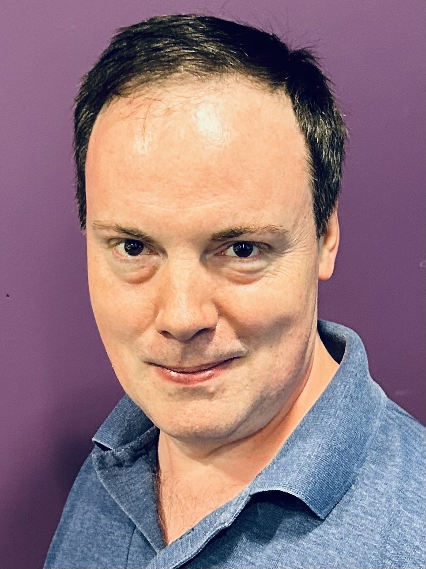
ASK4
ASN | 41230
Traffic profile | Primarily eyeball
Traffic Volume | Not disclosed
Peering Policy | Generally open – ask4.com/peering
Peering Locations (IX or POP) | LONAP, IXLeeds, E-CIX, LINX LON1, NL-ix, IX Manchester
PeeringDB entry | as41230.peeringdb.com
Contact information | peering@ask4.com
Specialists in MDU accommodation (student, BTR, later living) and
business connectivity
Servicing >300,000 beds in 12 countries and growing
(envisioning 1,000,000 by end of decade)
Network in 4 countries and expanding rapidly
Multitenant owned data centre in Sheffield
Talk to me about peering, colocation, deep caching, or if you
provide last-mile access in any country!
David Croft

Slide 22

Amazon Web Services
ASN | 16509
Traffic profile | IRR as-set/route-set
IRR as-set/route-set | AS16509:AS-AMAZON
Peering Policy | https://aws.amazon.com/peering/policy
Peering Locations | https://aws.amazon.com/peering/locations/
PeeringDB entry | https://www.peeringdb.com/net/1418
AWS Peering | https://peering.aws/
Peering requests
IX: https://interconnect.amazon/
Established Peers - please request IX peering sessions via this peering portal. First time Peer requests for IX peering sessions MUST email the appropriate regional contacts below.
PNI: PNI peering request MUST be via email to your established AWS contact. First time PNI peering request MUST only be emailed to the specific regional contact listed below, for the geographical region in which you wish to request PNI peering.
              Example: PNI peering requests for London should use peering-emea@amazon.com while PNI peering requests for Singapore should use peering-apac@amazon.com.
This will ensure your request is processed and addressed in a timely fashion. Please do not copy contacts not meant for peering policy in the location of your request
Role | Name | Email
Maintenance | Maintenance | peering-maintenance@amazon.com
NOC | Technical Operations/Infra Comms | peering-to@amazon.com
Policy | Frank Blackman | blankman@amazon.com
Policy | PNI Peering EMEA | peering-emea@amazon.com
Policy | PNI Peering APAC | peering-apac@amazon.com
Policy | PNI Peering Americas | peering-amer@amazon.com
Policy | PNI Peering India | peering-india@amazon.com

Slide 23
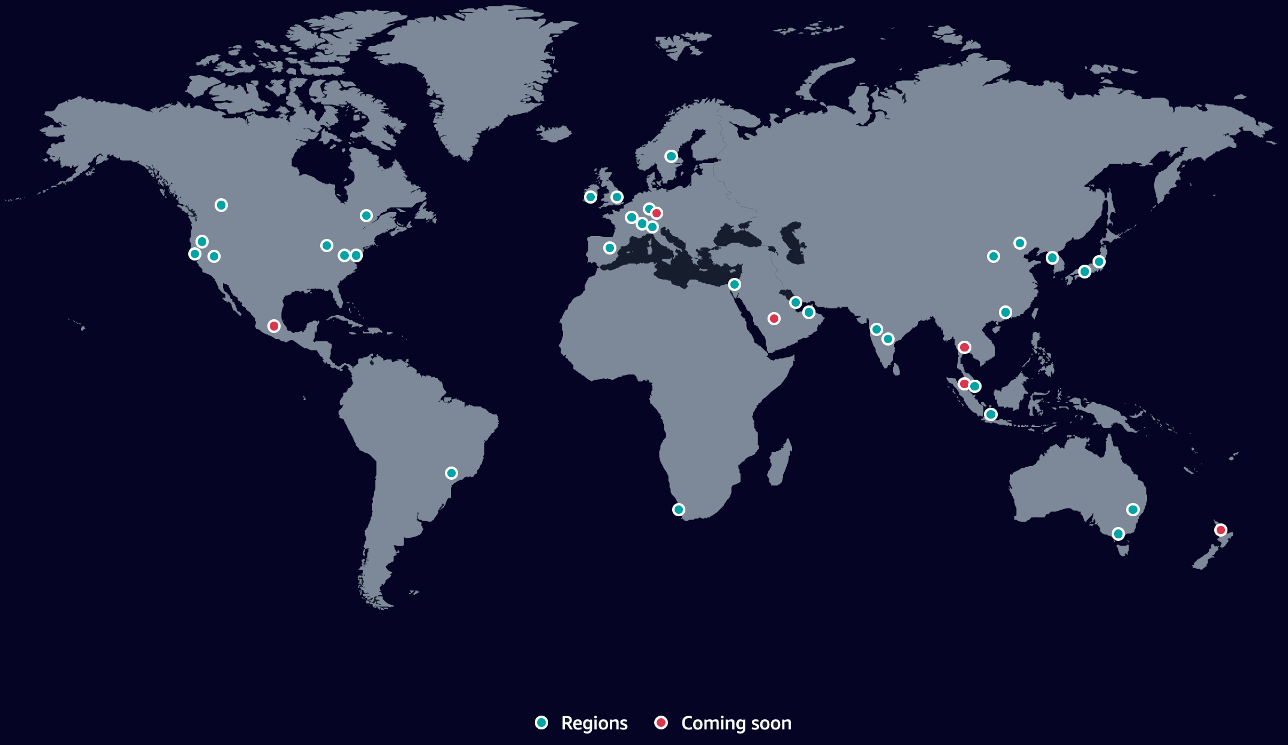
AWS - AS16509
Secure, extensive, and reliable Global Cloud Infrastructure, for all your applications
33 Launched Regions
Each with multiple Availability Zones
39 Local Zones
29 Wavelength Zones
for ultralow latency applications
105 Availability Zones
within 33 geographic regions around the world
245 Countries and Territories Served
600+ CloudFront POPs
& 13 Regional Edge Caches
135 Direct Connect Locations
400G Network Innovation at Scale: Core & Edge Peering
Clos Fabric
Innovative Network Design
Automated Core Network and Network Operation Processes
Automated Peering, Interconnect & Embeds
RPKI & Encryption Routing Security
World Class Streaming Service (Live & VoD)

Slide 24
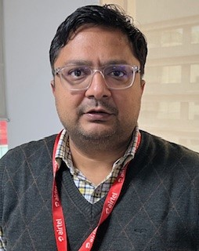
Bharti Airtel Limited
ASN | 9498
Traffic profile | Mostly Inbound
Traffic Volume | 55+ Tbps
Peering Policy | Open in USA, Europe
Peering Locations (IX or POP) | CoreSite - Los Angeles (LA1) One Wilshire Digital Realty London LHR20 London Digital Realty Marseille MRS2-3 NYIIX-USA NewYork Equinix Singapore
PeeringDB entry | https://www.peeringdb.com/net/1903
Contact information | kshitiz.singhal@airtel.com
Insert Lead Contact photo if desired – not mandatory
Kshitiz Singhal

Slide 25
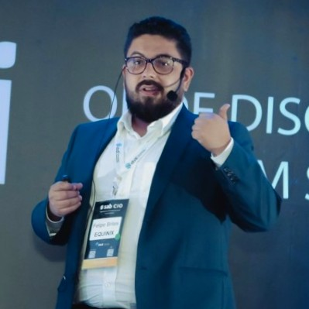
CDN STAR
ASN | 272713
Traffic profile | Heavy Outbound
Traffic Volume | +1 Tbps
Peering Policy | Selective
Peering Locations (IX or POP) | Brazil - 2 POPs in Sao Paulo, 1 POP in Rio de Janeiro, 1 POP in Belo Horizonte, 1 POP in Vitória, connectivity with IX.BR SP and RJ
PeeringDB entry | https://www.peeringdb.com/net/30113
Contact information | noc@cdnstar.com.br | brites@cdnstar.com.br
Updates:
New POP in US soon
New POP in Porto Alegre soon
Connectivity with major Telcos in Brazil
Felipe Brites

Slide 26
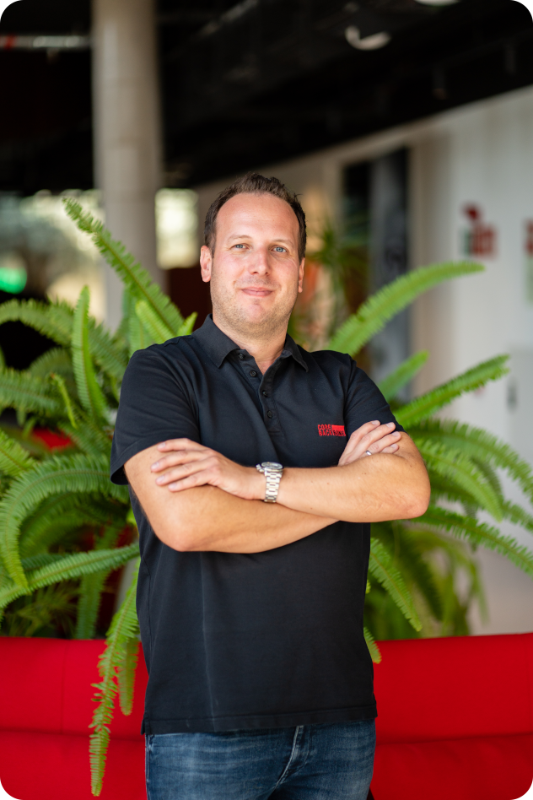
Core-Backbone GmbH
ASN | 33891
Traffic profile | Balanced
Traffic Volume | 10 – 20 Tbps
Peering Policy | Selective
Peering Locations (IX or POP) | More than 20 IXs and 60 DCs worldwide please check PeeringDB
PeeringDB entry | https://www.peeringdb.com/net/1599
Contact information | peering@core-backbone.com
Insert Lead Contact photo if desired – not mandatory
Andreas Götz
Peering Manager

Slide 27
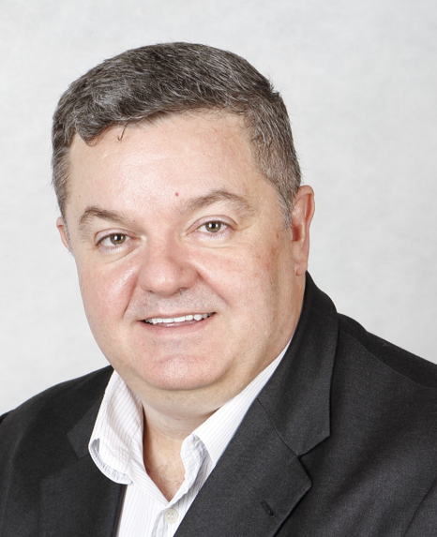

Durand do Brazil
ASN | 22356
Traffic profile | Mostly outbound
Traffic Volume | ~1TB
Peering Policy | open
Peering Locations (IX or POP) | IX.BR – Sao Paulo, Rio de Janeiro, Belo Horizonte, Fortaleza, Brasilia, Curitiba, Londrina e Brasilia. Pops in all major datacenters in Brazil (SP,RJ,PR, BSA and FLA. US Equinix MI1, MI6 and DRT NYC2
PeeringDB entry | as22356.peeringdb.com
Contact information | Eduardo Parajo – eduardo@durand.com.br
Updates:
Increase underground fiber capillarity in Sao Paulo area
Increase connectivity with Brazilian eyeballs
Complete fiber ring connectivity between Fortaleza Datacenters
Complete diverse capacity in different sea cables between
Brazil and US
Eduardo Parajo

Slide 28



Epsilon Telecommunications
ASN | 44356 (also known as 23936, 55199)
Traffic profile | Mostly inbound
Traffic Volume | 20 Gbps
Peering Policy | Selective
Peering Locations (IX or POP) | LINX, AMS-IX HK NYIIX, DE-CIX & MASS-IX (New York for AS55199) SG-IX (Singapore for AS23936) NAPAfrica and JPNAP
PeeringDB entry | as44356.peeringdb.com
Contact information | peering@epsilontel.com Albert Yu, a.yu@epsilontel.com Mark Daley, m.daley@epsilontel.com
Updates
  We are part of the KT family
  We have added JPNAP as a Peering Location
Albert Yu
Mark Daley

Slide 29

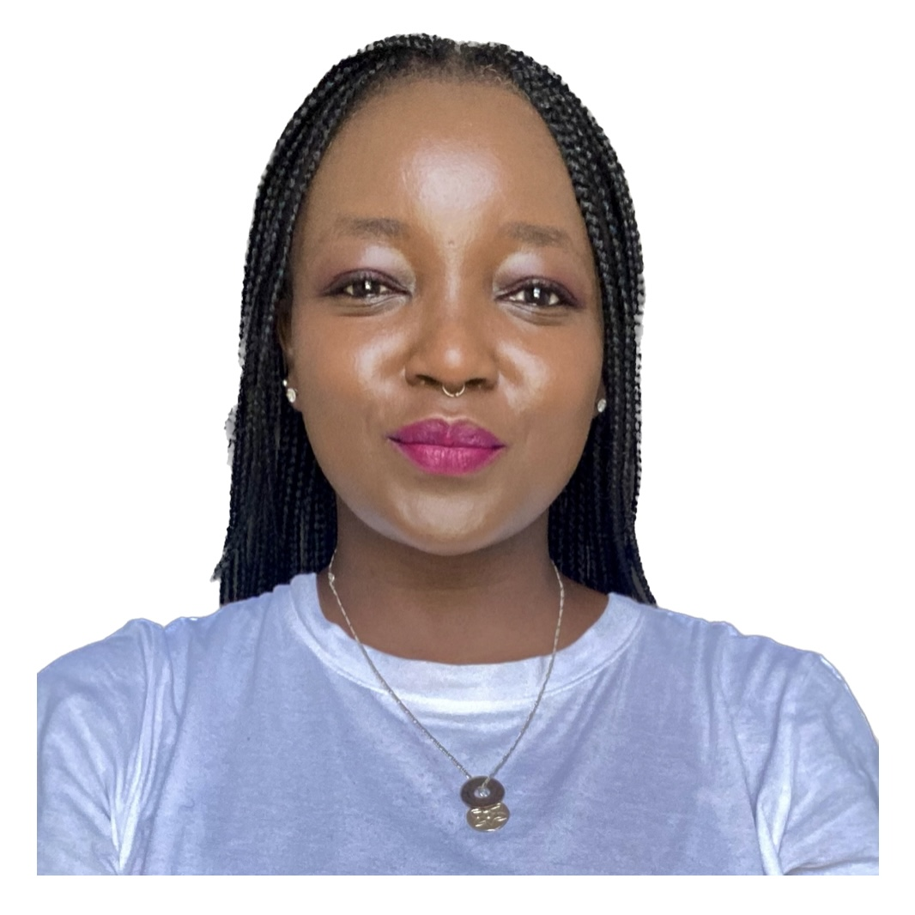

Gcore
ASN | AS199524
Traffic profile | Outbound Heavy
Traffic Volume | 25+Tbps
Peering Policy | Selective
Peering Locations (IX or POP) | Global
PeeringDB entry | as199524.peeringdb.com
Contact information | peering@gcore.com
Izzy
Tucker

Slide 30





Internet Initiative Japan Inc. - IIJ
ASN | 2497
Traffic profile | Balanced
Traffic Volume | Not Disclosed
Peering Policy | Restrictive(Japan), Selective(Outside Japan)
Peering Locations (IX or POP) | PNI: Equinix TY2/SG1/SE2/SV1/LA1/NY9/DC1, Telehouse TOKYO Otemachi/London(Docklands West), MEGA-i, AT TOKYO(CC1), Otemachi Place West Tower IXPs: APAC: JPNAP Tokyo/Osaka, Equinix Hong Kong/Singapore, HKIX, SGIX NA: Equinix San Jose/Los Angeles/New York/Ashburn, SIX Seattle, NYIIX New York EMEA: LINX LON1, DE-CIX Frankfurt
PeeringDB entry | https://as2497.peeringdb.com/
Contact information | Peering team: peering@iij.ad.jp
Updates:
Upgraded Los Angeles routers to MX304.
Planning to upgrade Hong Kong routers.
Keigo
Tomoya

Slide 31
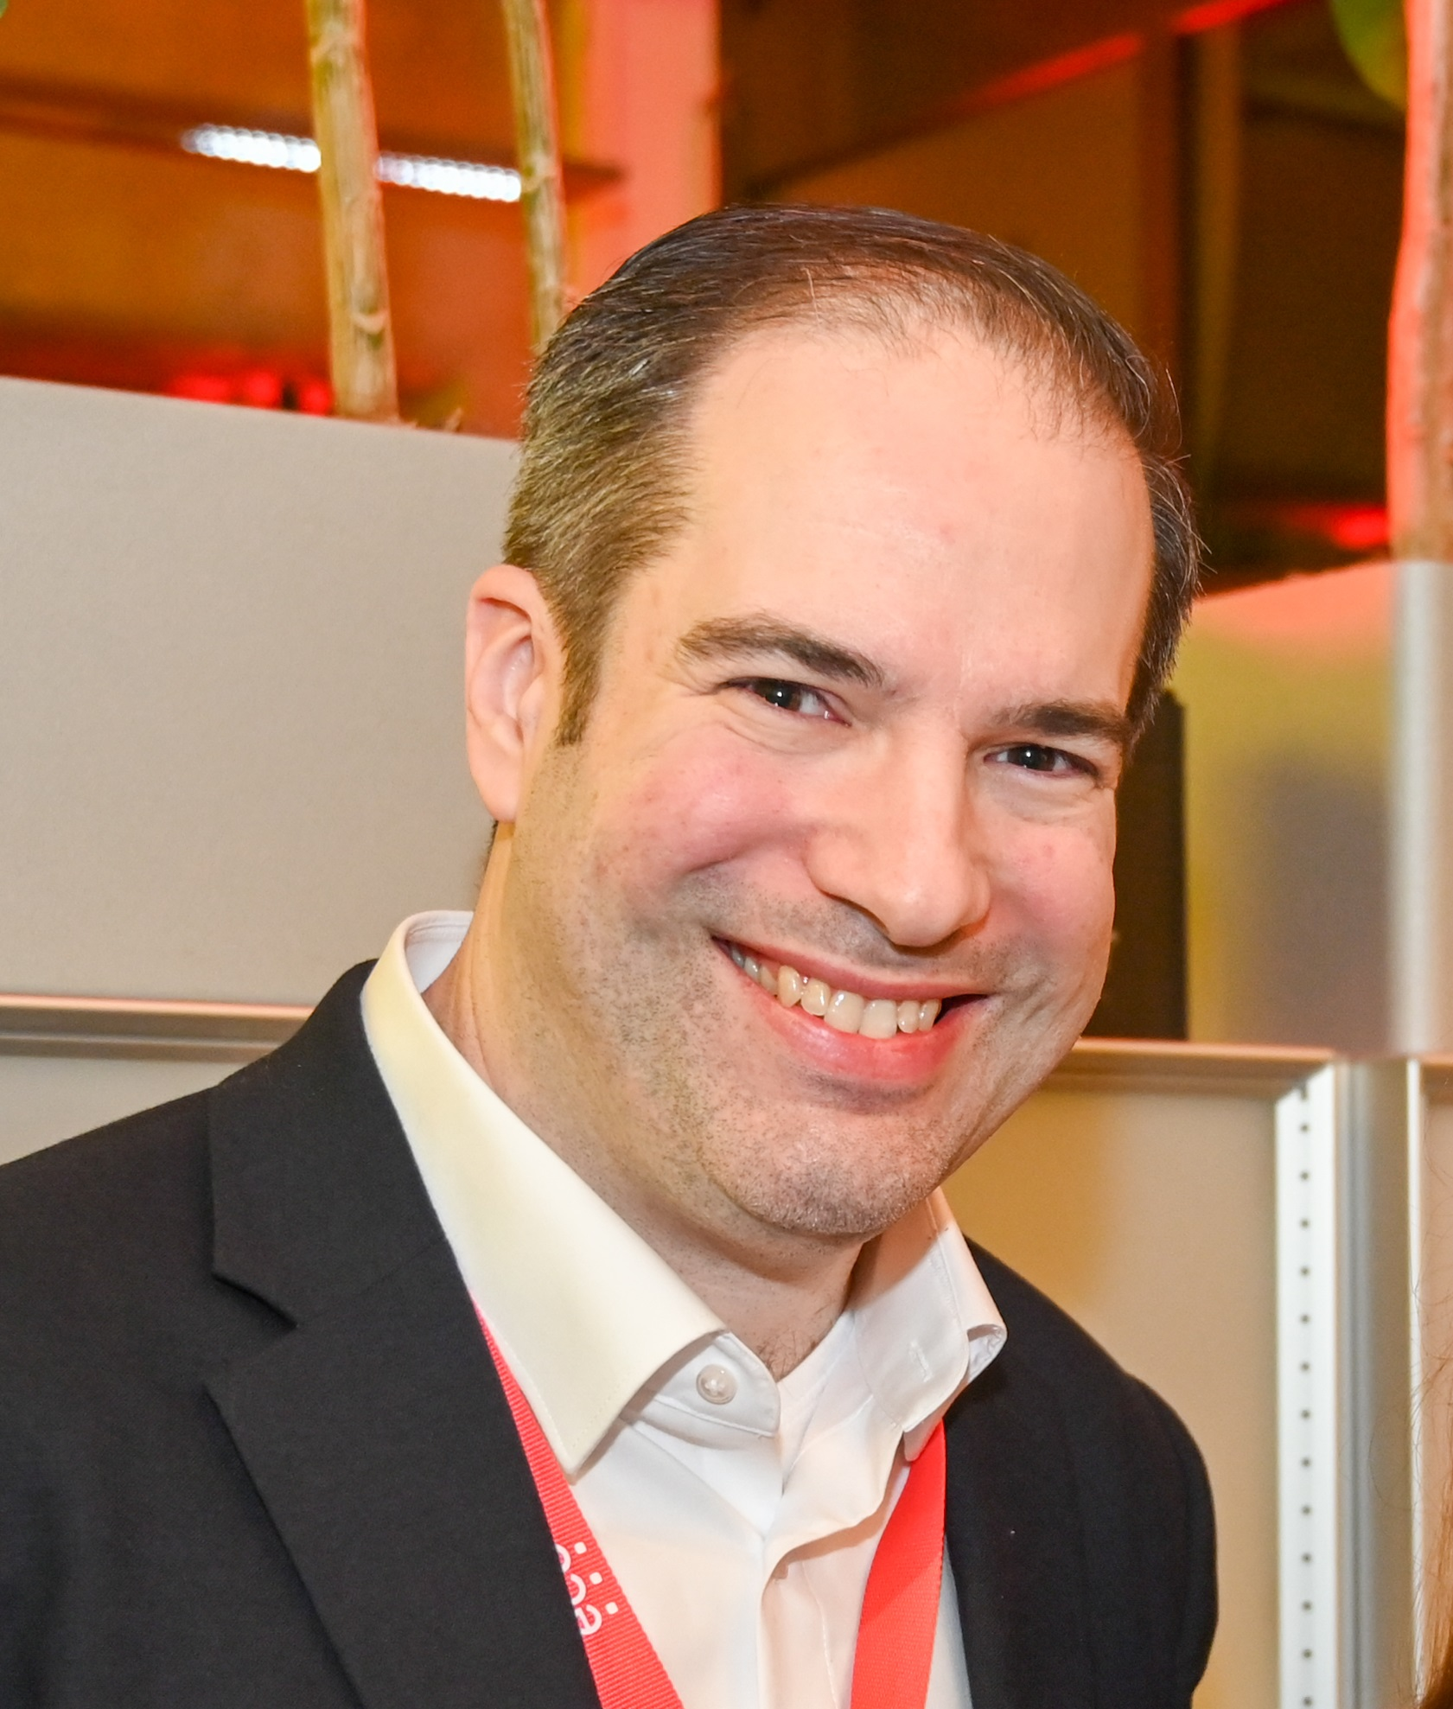
IPHH
ASN | 12731
Traffic profile | Balanced
Traffic Volume | 100 Gbit/s
Peering Policy | Open
Peering Locations (IX or POP) | DE-CIX FRA, AMS-IX, MegaIX BER,DUS,FRA,HAM,MUC
PeeringDB entry | https://www.peeringdb.com/net/1625
Contact information | peering@iphh.net
Insert Lead Contact photo if desired – not mandatory
Sascha Pollok

Slide 32
Lancom Greece – Balkan Gate
ASN | 199081
Traffic profile | Balanced
Traffic Volume | 30-40G
Peering Policy | Open
Peering Locations (IX or POP) | Active PoPs: Balkan Gate - Thessaloniki, Greece TI Sparkle – Athens, Greece Digital Realty – Athens, Greece Telepoint City Center – Sofia, Bulgaria Equinix FR5 – Frankfurt, Germany NIKHEF – Amsterdam, Netherlands MIX DC – Milan, Italy Cineca DC NaMeX – Rome, Italy
PeeringDB entry | https://www.peeringdb.com/net/18167
Contact information | George Nolis - CEO

Slide 33
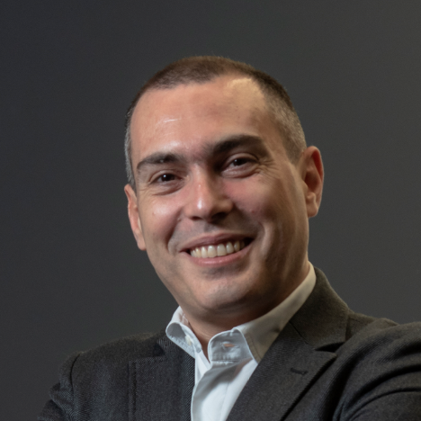
Updates:
100G protected Links from Balkan Gate Greece to Sofia, Frankfurt, Amsterdam, Milan and Rome have been just delivered by EXA Infrastructure.
Upcoming connections to AMS-IX and MIX are in progress
Lead Contact George Nolis - CEO

Slide 34
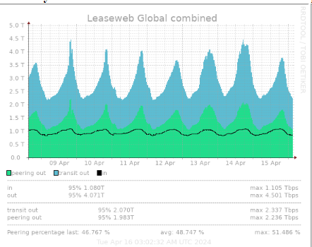

Leaseweb Network B.V
ASN | 16265
Traffic profile | 4.5Tbps out 1.1Tbps in
Peering Policy | Open
Peering Locations (IX or POP) | EUROPE AMS-IX, DE-CIX, LINX, NLIX, SPEED-IX US & CA EQUINIX ASHBURN EQUINIX SAN JOSE LINX NOVA QIX APAC SGIX HKIX Equinix SIN
PeeringDB entry | https://www.peeringdb.com/net/678
Contact information | peering@network.leaseweb.com
Insert Lead Contact photo if desired – not mandatory
Bart van der Sloot

Slide 35

Pixel Factory Data Center, Inc
ASN | 32425
Traffic profile | Inbound Eyeball
Traffic Volume | 250-300G
Peering Policy | Open
Peering Locations (IX or POP) | POP---CoreSite - Atlanta (AT1) 55 Marietta , Digital Realty ATL 56 Marietta , Equinix DC1-DC15, DC21 – Ashburn, Iron Mountain Data Center - Manassas (VA-1), QTS Richmond (RIC1), Pixel Factory Data Center Richmond IX---MegaIX Ashburn, MASS-IX,Equinix Ashburn, DE-CIX Richmond, DE-CIX New York, DE-CIX Frankfurt, CIX-ATL, ChIX, Any2East
PeeringDB entry | 8243
Contact information | scott@pixelfactorydc.com, peering@pixelfactorydc.com

Slide 36

Sangoma
ASN | 32035 (and underneath 15092, 26967)
Traffic profile | Fairly balanced
Traffic Volume | Undisclosed
Peering Policy | Open
Peering Locations (IX or POP) | Any2Denver, Any2East, Any2West, ChIX, CIX-ATL, DE-CIX Chicago, DE-CIX Dallas, DE-CIX Marseille, DE-CIX New York, Digital Realty Atlanta, Equinix Chicago, Equinix Sydney, Equinix Toronto, NAPAfrica IX Johannesburg, NL-ix, SFMIX, SIX Seattle, TorIX
PeeringDB entry | https://www.peeringdb.com/net/13084
Contact information | peering@sangoma.com
Eric Krichbaum

Slide 37


Softbank
ASN | 17676
Traffic profile | Eyeballs
Traffic Volume | Non-disclosure
Peering Policy | Selective
Peering Locations (IX or POP) | Tokyo: AT Tokyo, BBTower, NW1 Osaka: Equinix OS1, NTT DATA Dojima, NTT Sonezaki US: Equinix SV5, CoreSite LA OWB, Seattle WBX EU: AMS9 ASIA: SG Equinix SG1 / HK MEGA-I BBIX (Tokyo/Osaka/HK/SG/LA/SJ/AMS) JPNAP (Tokyo/Osaka), EIESG, SIX Seattle, ANY2
PeeringDB entry | as17676.peeringdb.com
Contact information | Takuma Sato, Makoto Kawano- sbbgrp-peering@g.softbank.co.jp
Takuma Sato
Makoto Kawano

Slide 38
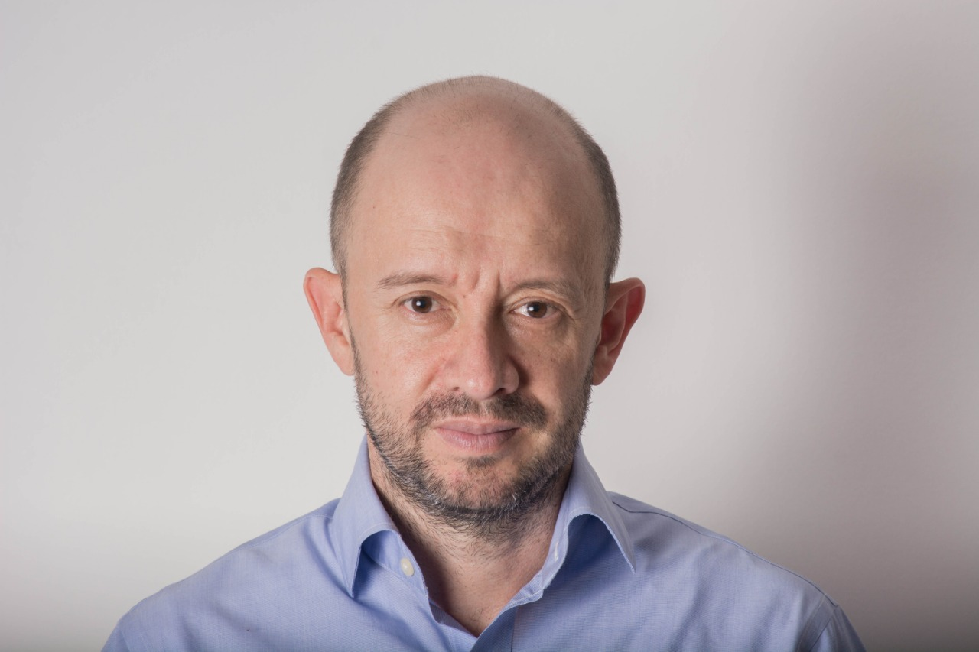
SOMOS Networks
ASN | 271957
Traffic profile | ISP
Traffic Volume | 80 GBPS
Peering Policy | Open
Peering Locations (IX or POP) | Equinix BG1, Edgeuno BG4 GTD Medellin , PIT Colombia
PeeringDB entry | https://www.peeringdb.com/net/31632
Contact information | carlos.florez@somosinternet.co, forrest@somosinternet.co
Updates:
Deploying Colombia Backhaul
New presence in Edgeuno BG4
Equinix BG1 third quarter 2024
Insert Lead Contact photo if desired – not mandatory
Head Of Interconnection
Carlos Florez

Slide 39


SPARK NZ 4648
IX Name | Spark NZ
City, Country | Alpha, XX
Point of Presence | Equinix Palo Alto SV8 Equinix LA1 Equinix Sydney Equinix Singapore NSW-IX Sydney MegaIX Sydney
# of connected ASN | 4648
Peak traffic | 500 Gbps
Route Servers | No
RPKI | Not Yet
Contact | Limor.jones@spark.co.nz or peering @spark.co.nz Limor Jones
Limor Jones
Recent updates:
Exit EQ HK and Coresite San Jose

Slide 40

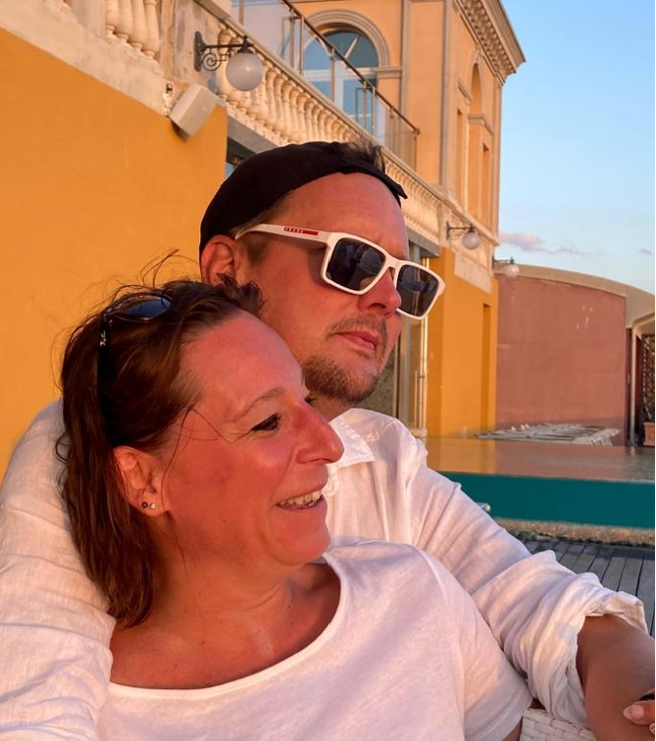
ASN | AS1273 and many more...
Traffic profile | Balanced / Global
Traffic Volume | 100Tbps
Peering Policy | Selective / Closed
Peering Locations (IX or POP) | 100+ POPs / All major metros EU, US and Asia
PeeringDB entry | 1273 - PeeringDB search
Contact information | peeringrequest@vodafone.com
Updates:
Vodafone will start charging for peering (pricing strategy: cheaper than transit)
We want to work with a small number of channel partners
like Qwilt other scale CDNs and IXPs (pro-choice – edge scaled @ N xTbps)
We will decommission 10GE technology in 2024
Enterprise focus: We want to work with scale cloud providers as
‘’cloud broker’’ creating bilateral value (more than 30% of our revenue
today Is B2B and we plan to invest in B2B). Focused on MNC, Public sector and
SME verticals
Insert Lead Contact photo if desired – not mandatory
Lead Contact name (if desired – not mandatory)

Slide 41

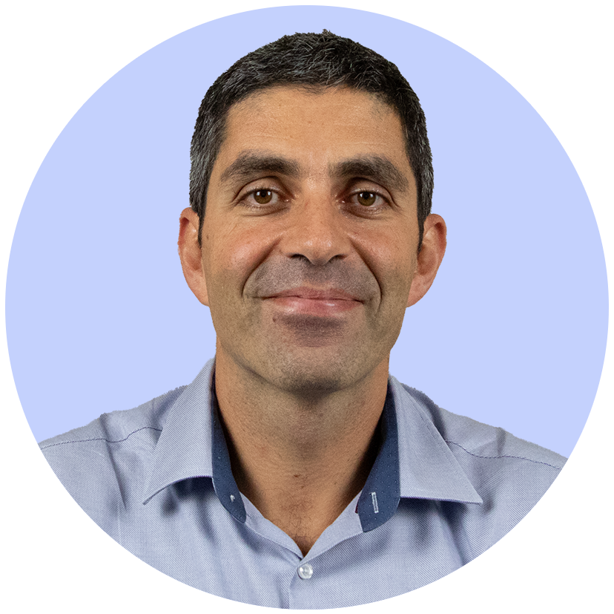
France-IX
IX Name | France-IX Paris | France-IX Marseille | France-IX AURA | France-IX Toulouse | France-IX Lille
City, Country | Paris, FR | Marseille, FR | Lyon + Grenoble, FR | Toulouse | Lille
Point of Presence | 10 PoPs, main DC locations in Paris | 3 PoPs : DRT MRS1 and MRS2 Freepro MRS1 | 7 PoPs | 1 single PoP to start | 1 single PoP to start
# of connected ASN | 450 | 120 | 92 | 13 | 8
Peak traffic | 2.7 Tbps | 500 Gbps | 100Gbps | 12 Gbps | 1Gbps
Route Servers | Yes (BIRD) | Yes (BIRD) | Yes (BIRD) | Yes (BIRD) | Yes (BIRD)
RPKI | Yes | Yes | Yes | Yes | Yes
Contact | info@franceix.net
Peering Persons
Recent updates
  MAPS (Microsoft Azure Peering Service) available
  Installing caches in small regions (Lyon/AURA, Toulouse and Lille)
Simon

